Slide 1
Model Portfolio Rosa Bakker
Sizes
Height: 175cm / 5’9 Weight: 47kg / 104lbs Bust: 79cm / 31in Waist: 57cm / 22in Hip: 87cm / 34in
Shoes: EU39, UK6, US8, KOR250 Dress: EU32/34, US0, UK4, KOR44, XS

Slide 2
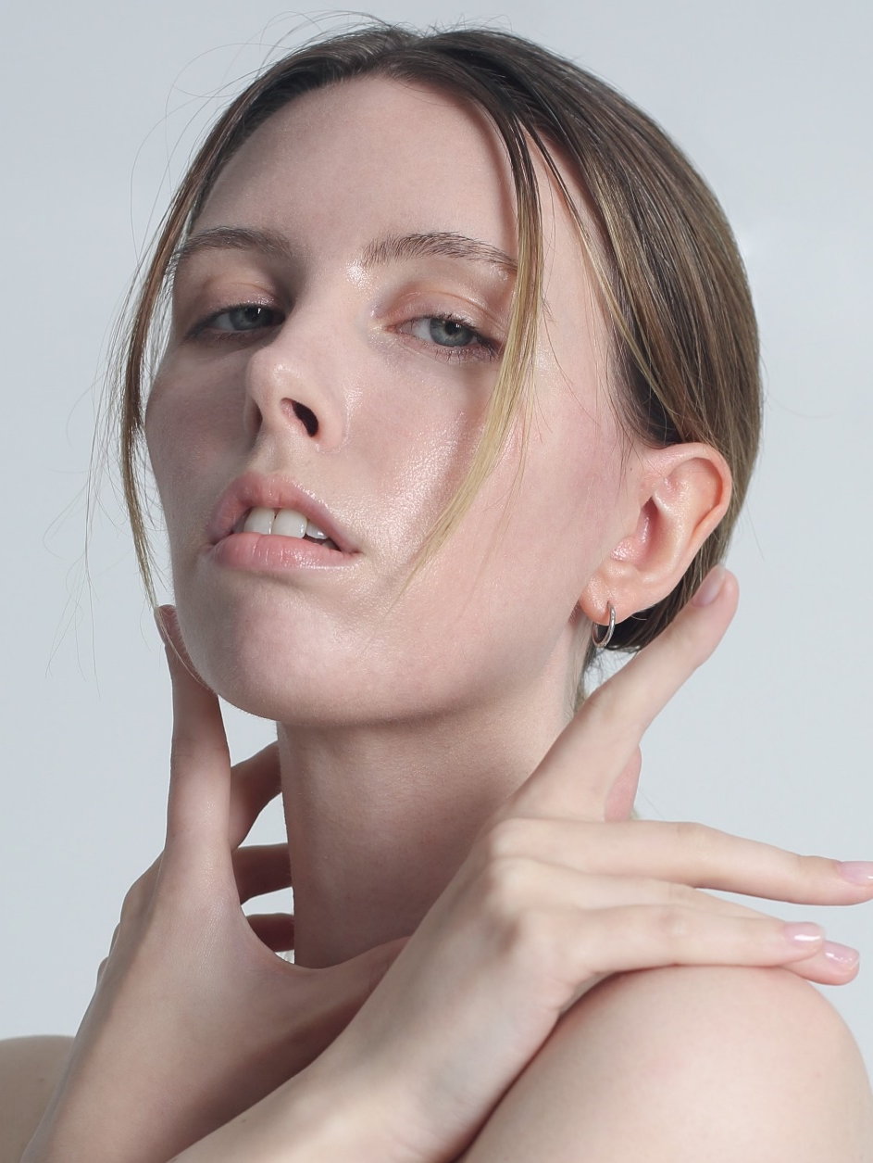
Sections
Haute Couture & Editorial Commercial
Hand
Runway Publications
………………… p. 4
………………… p. 14
………………… p. 21
………………… p. 24
………………… p. 31

Slide 3
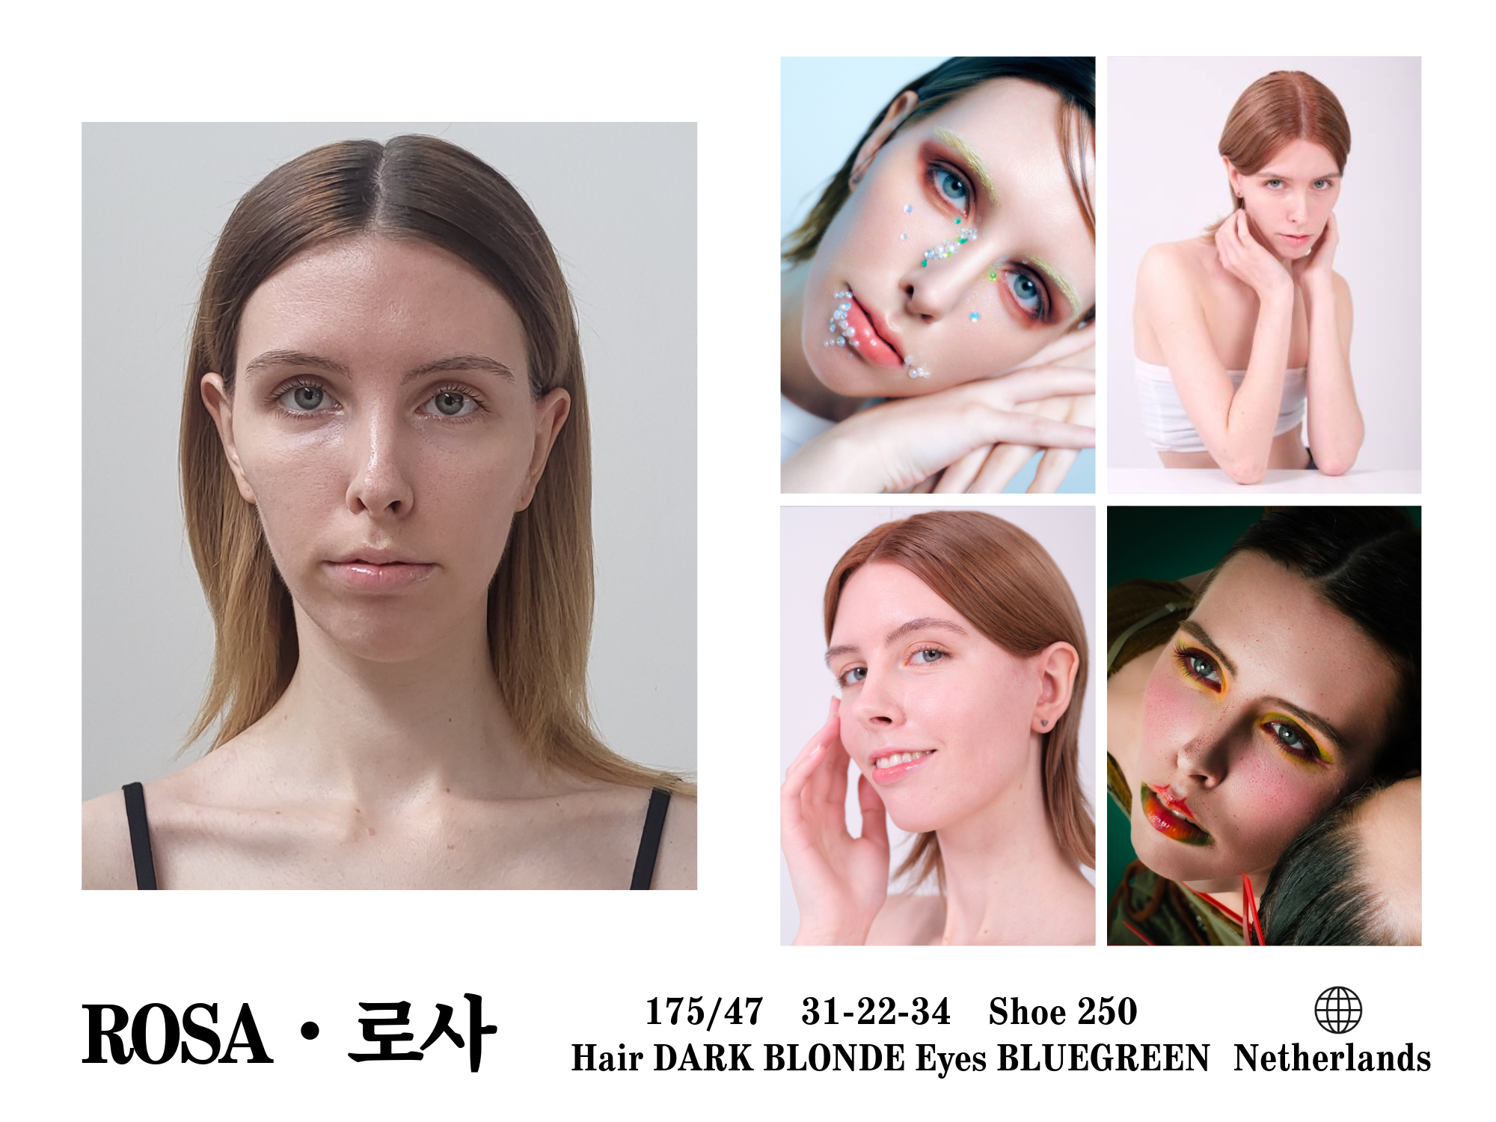
English introduction: video, Korean introduction: video

Slide 4
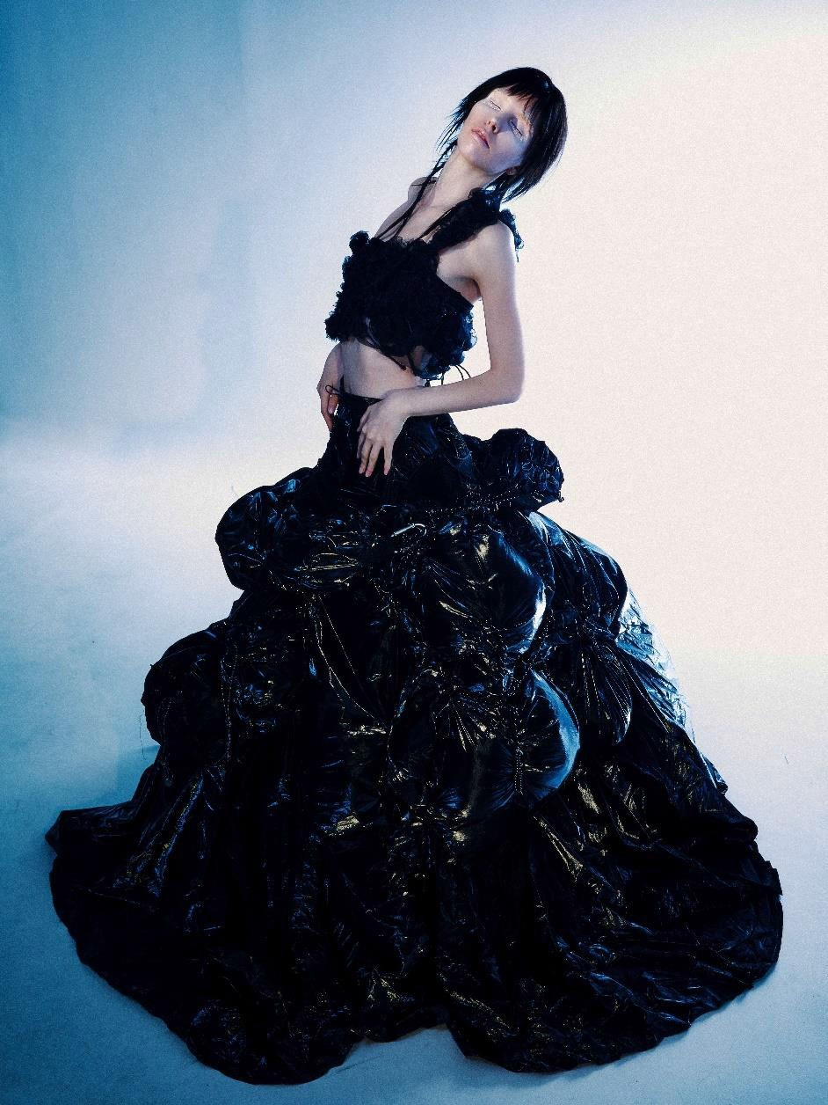
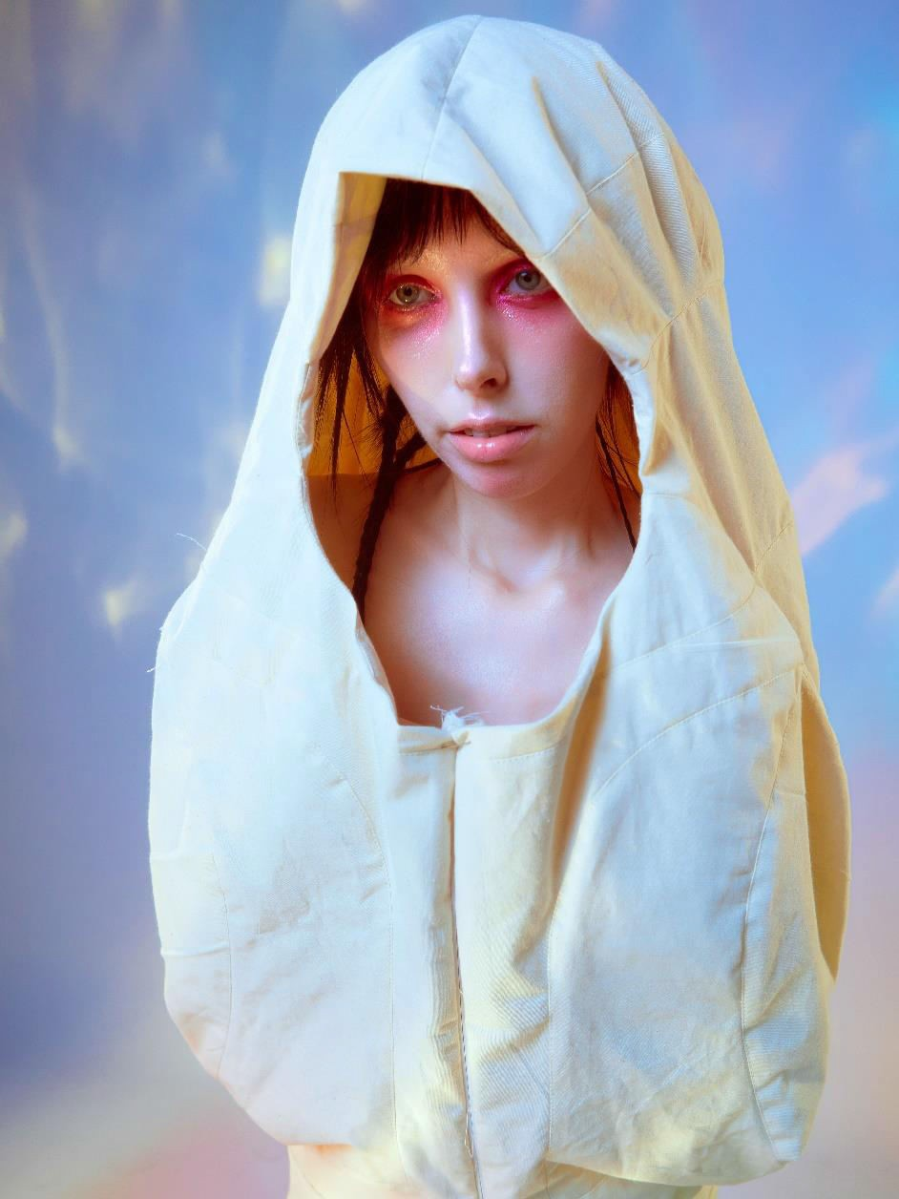
Haute Couture & Editorial

Slide 5
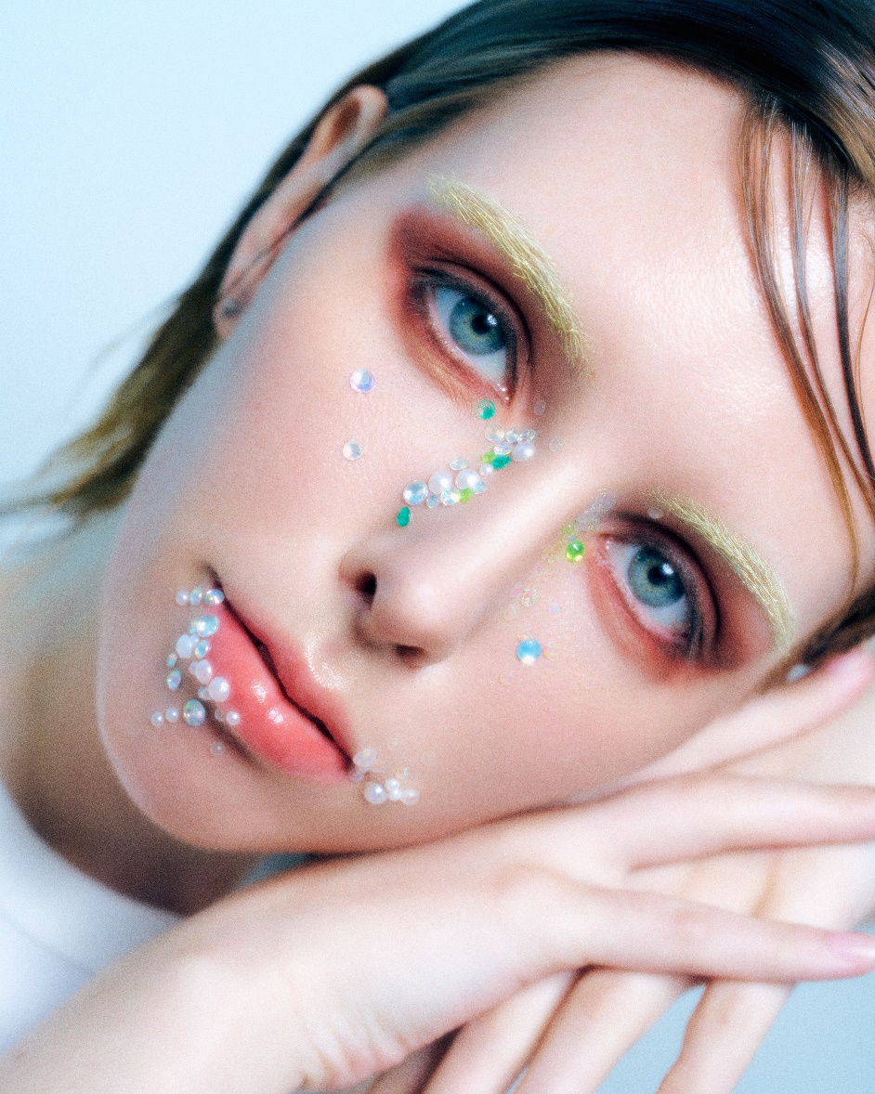
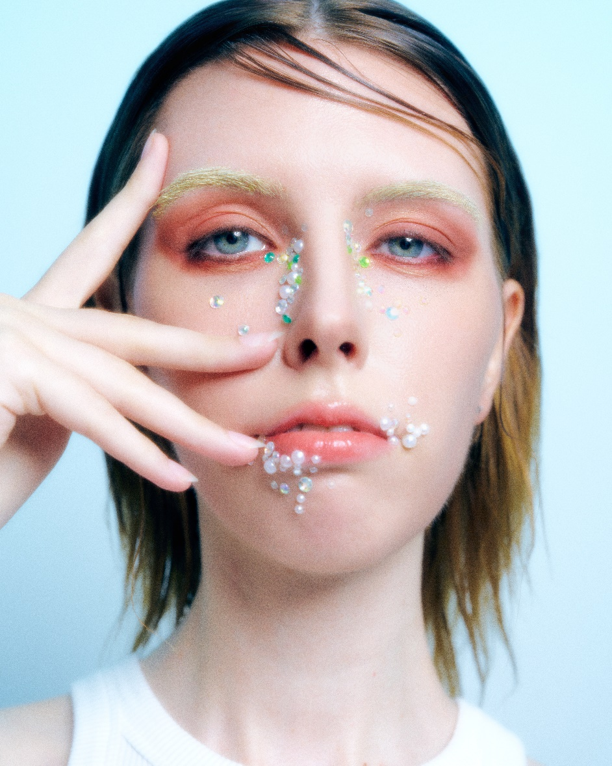

Slide 6
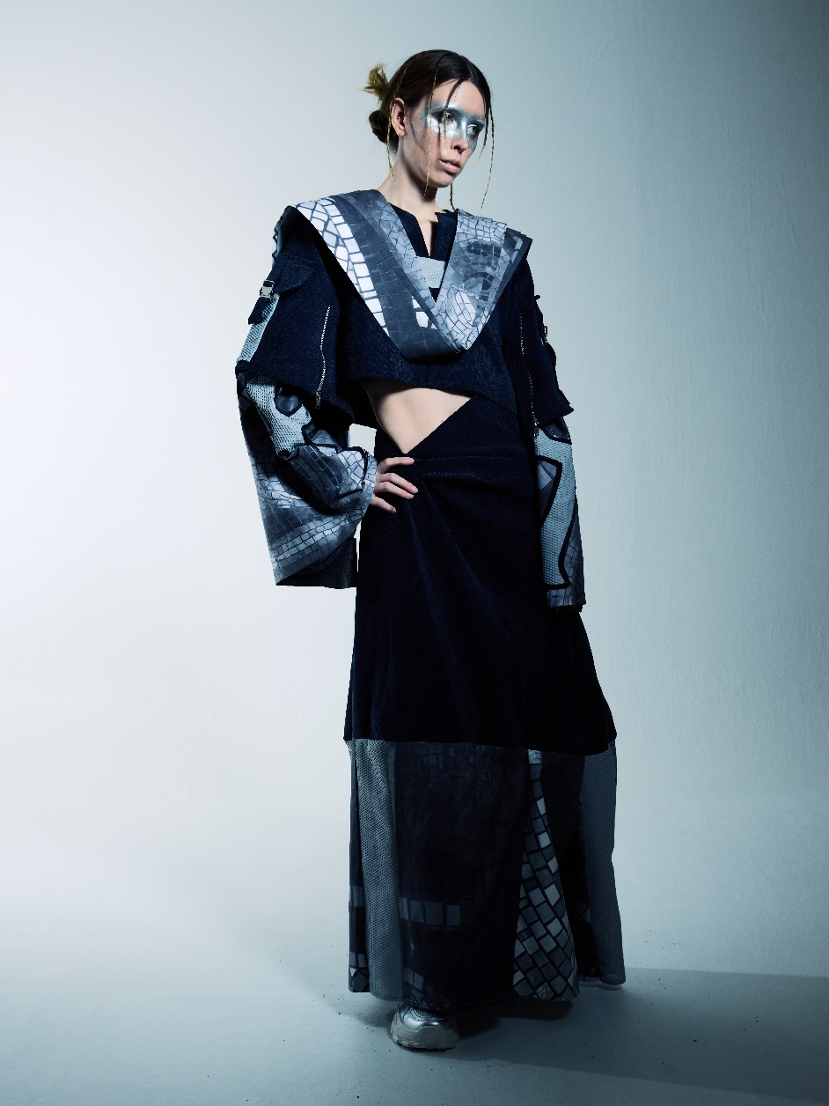
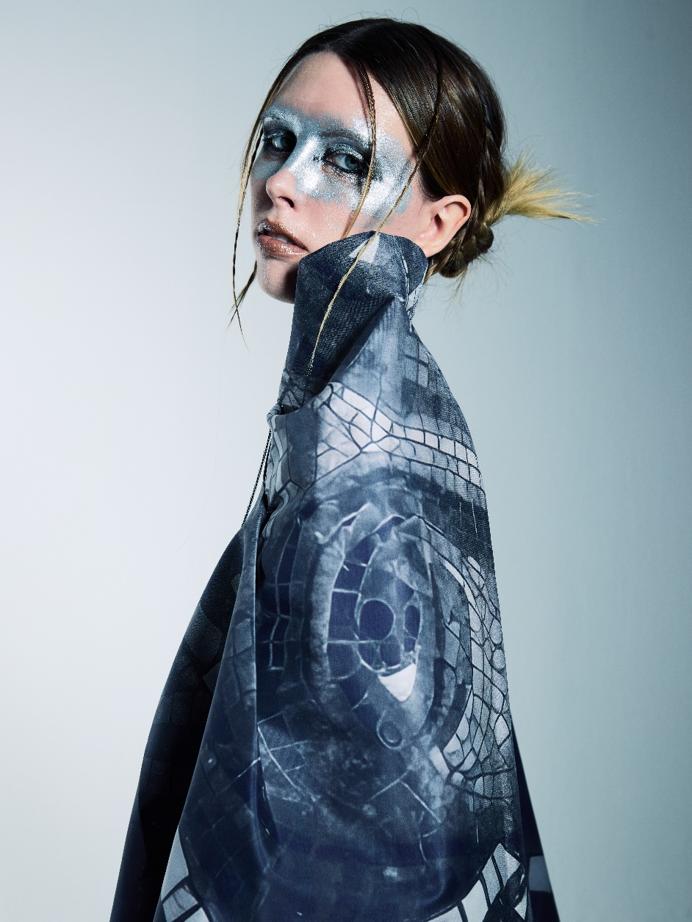

Slide 7
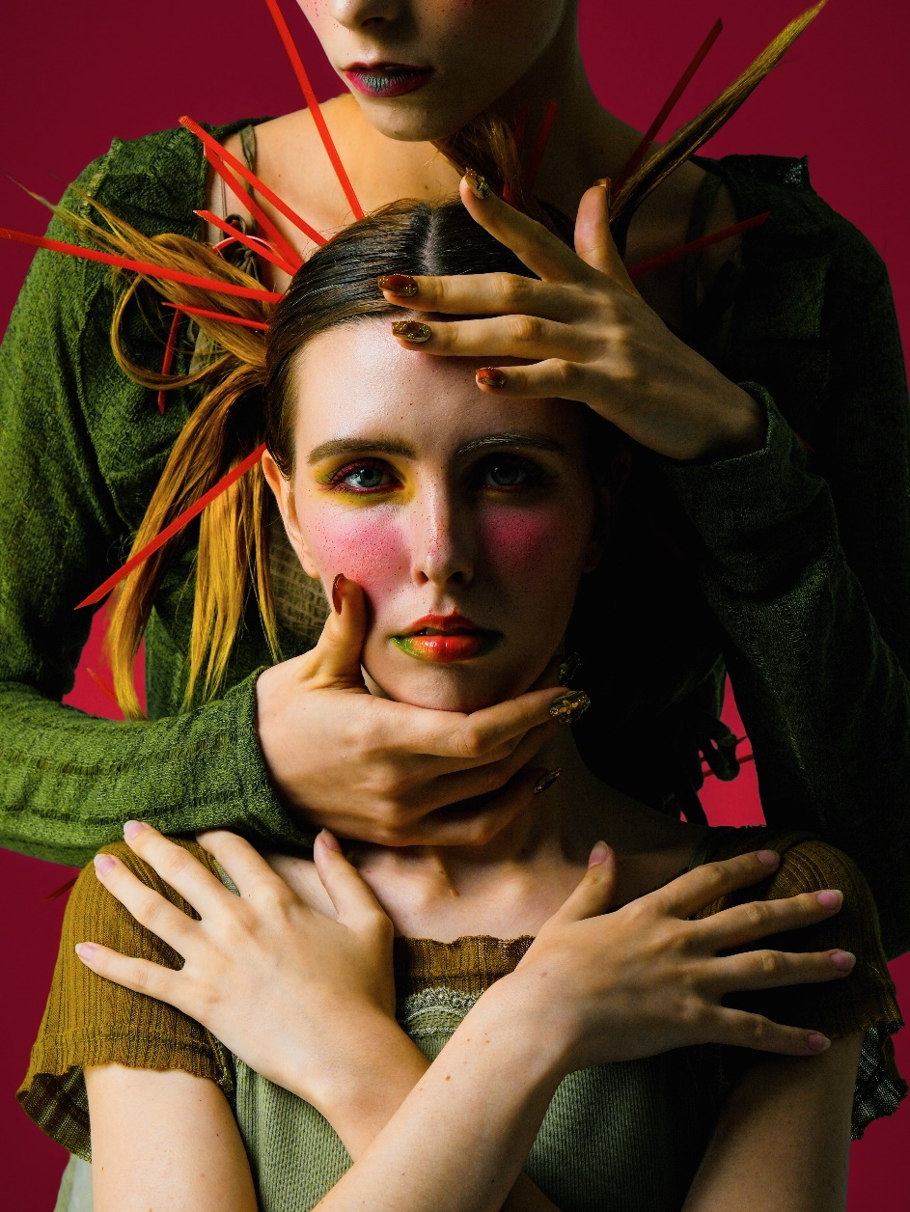
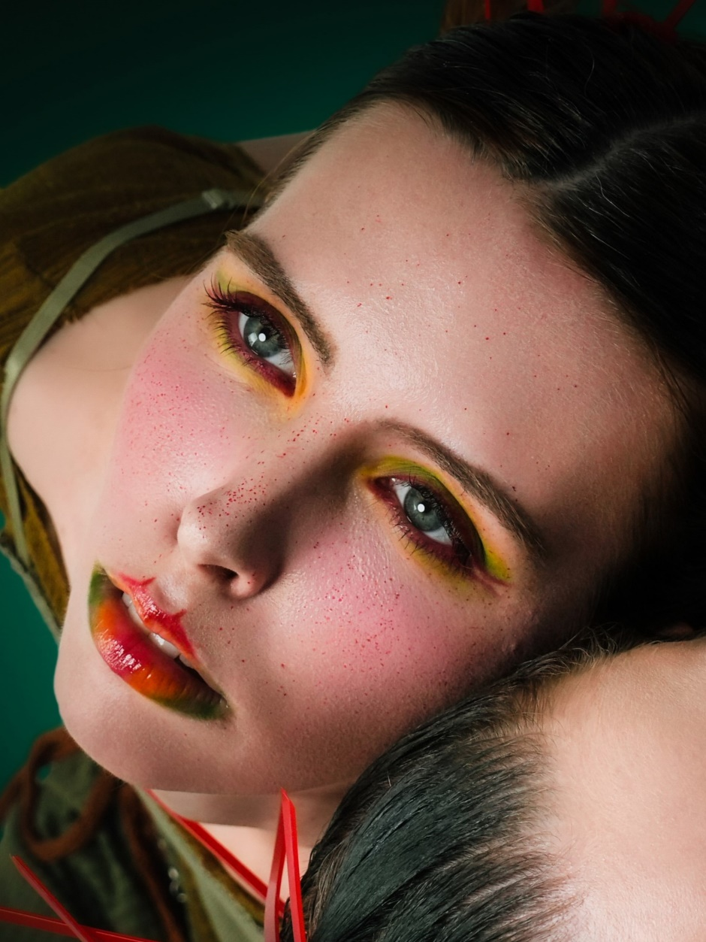

Slide 8
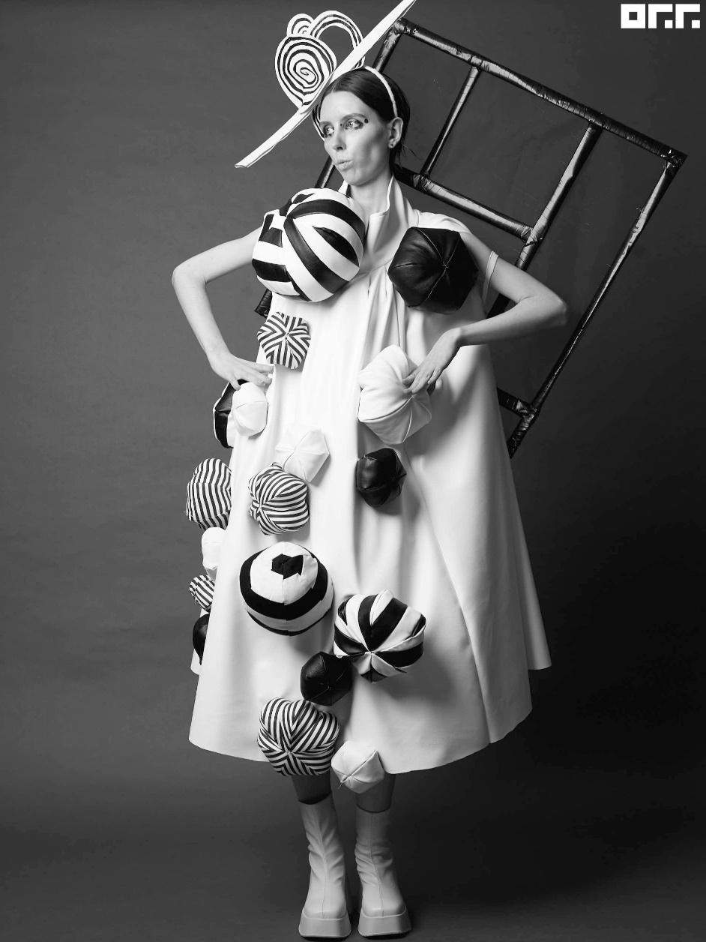
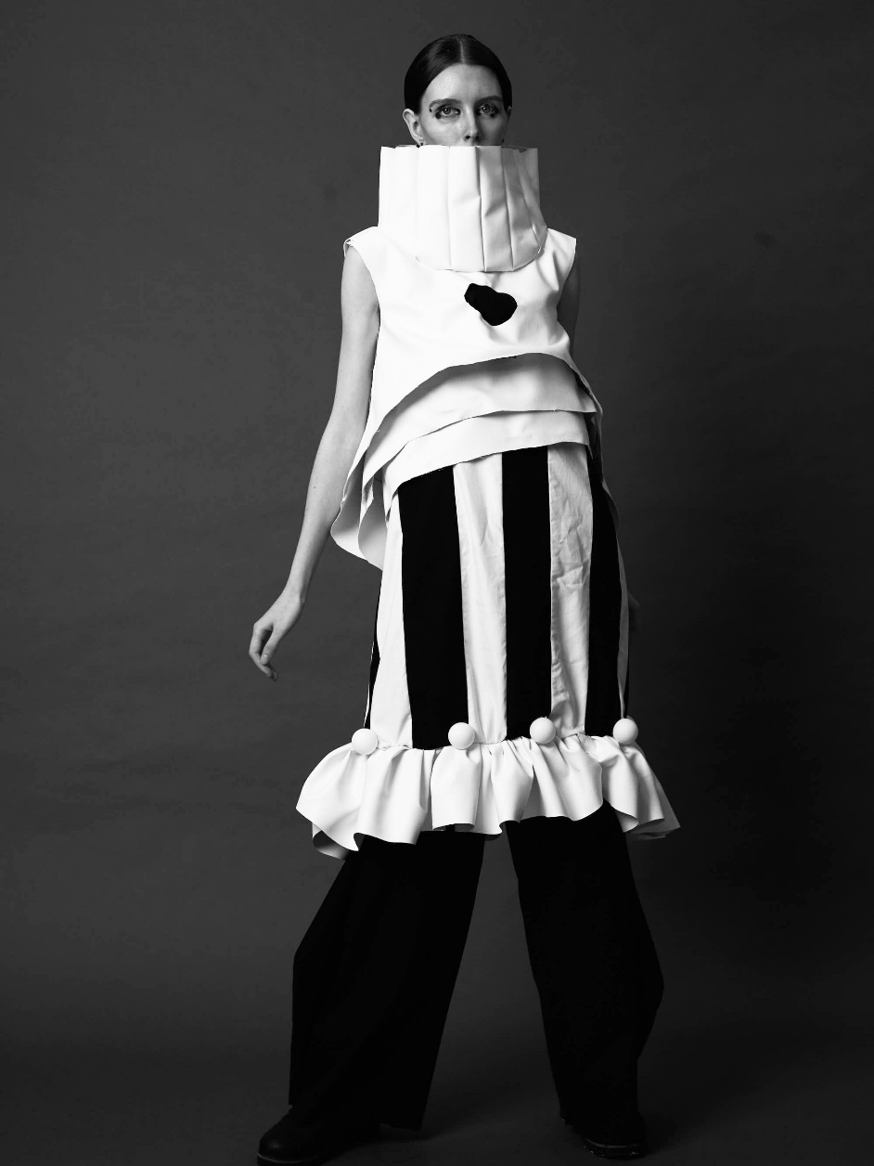

Slide 9
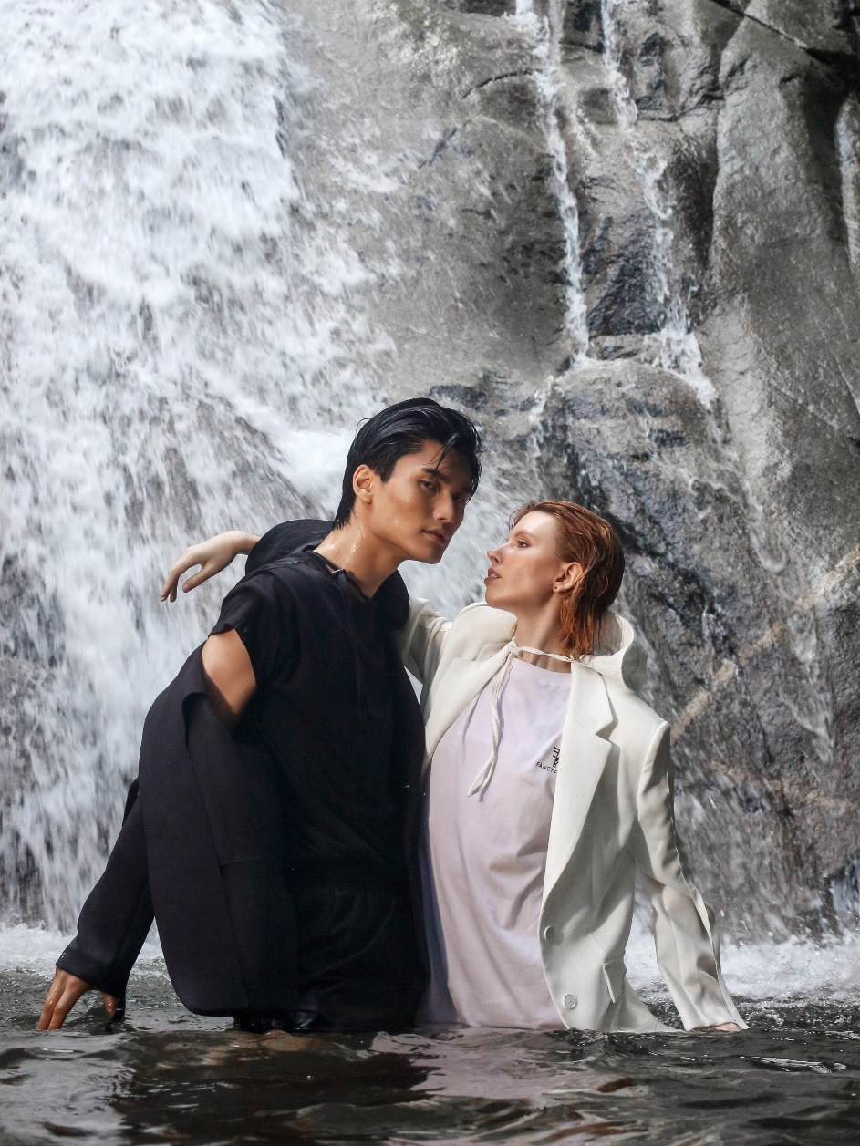
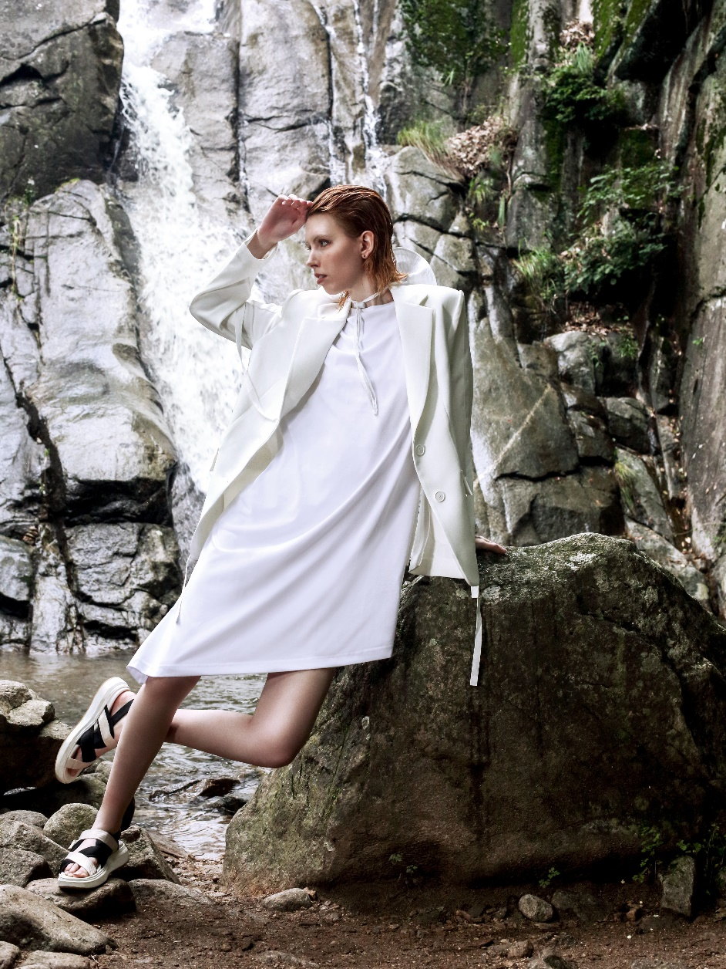

Slide 10
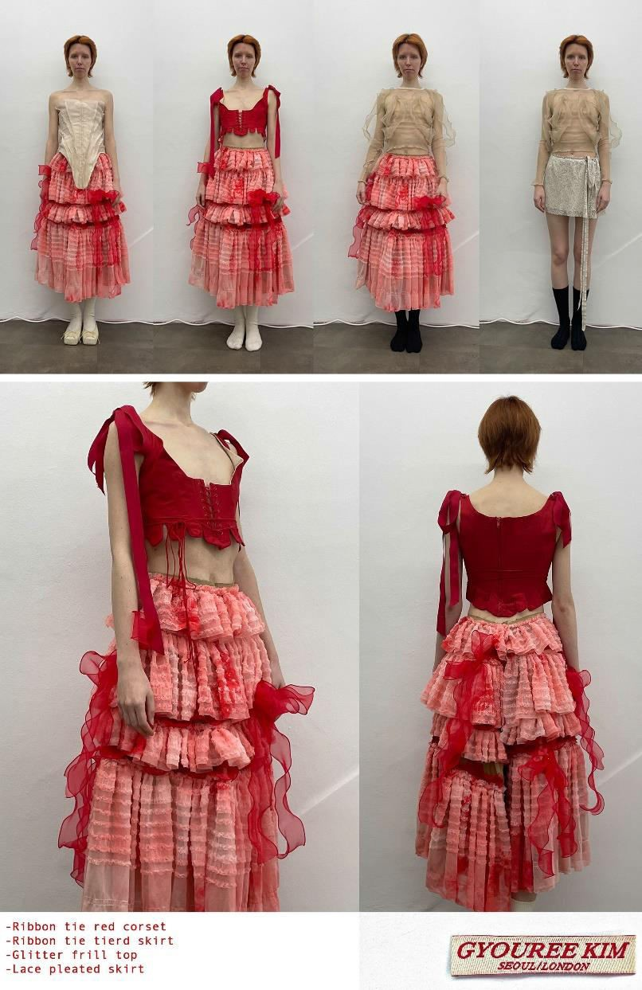
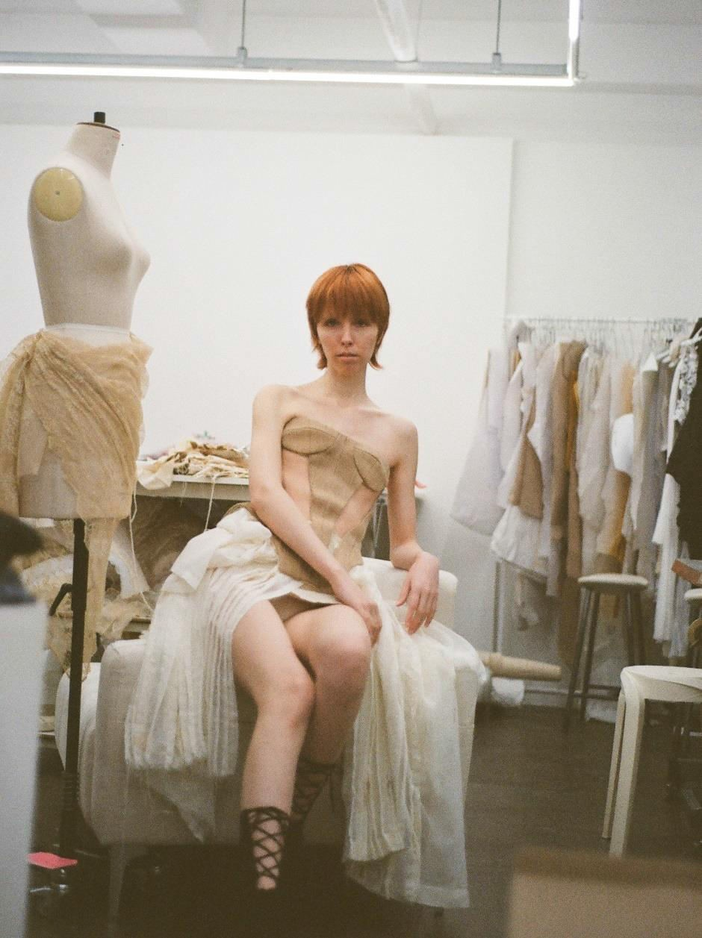

Slide 11
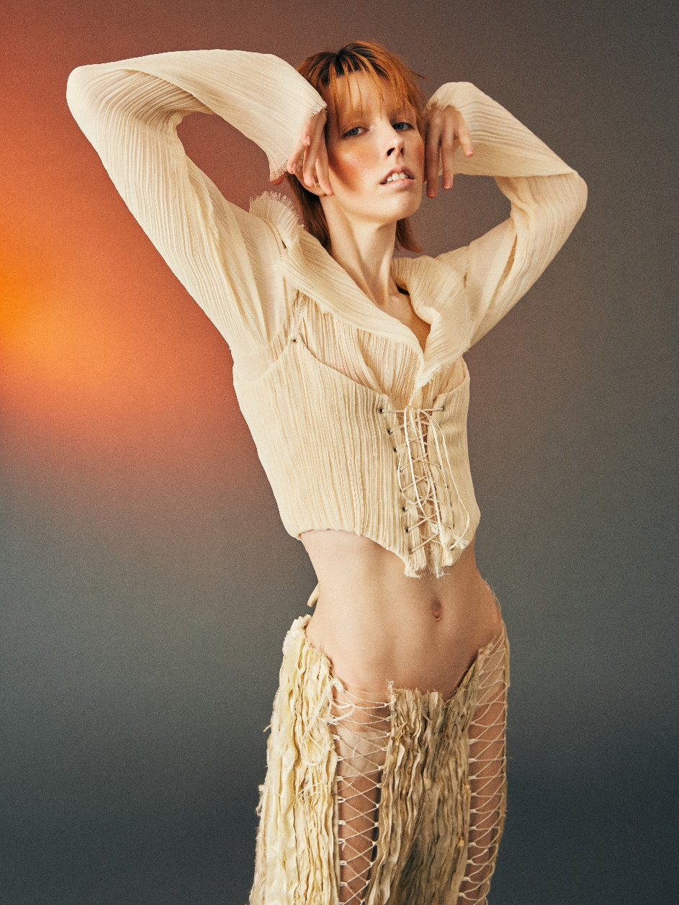
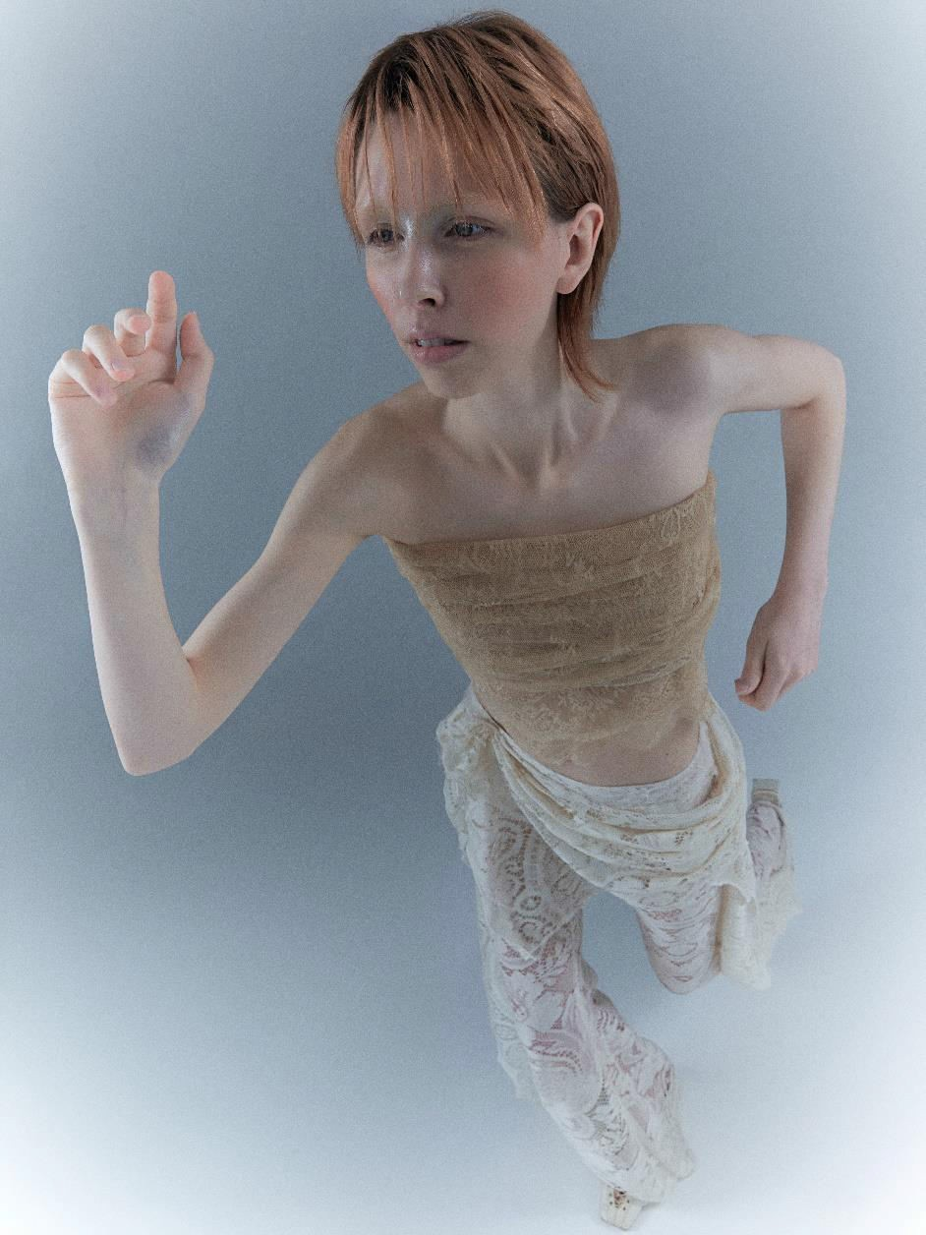

Slide 12

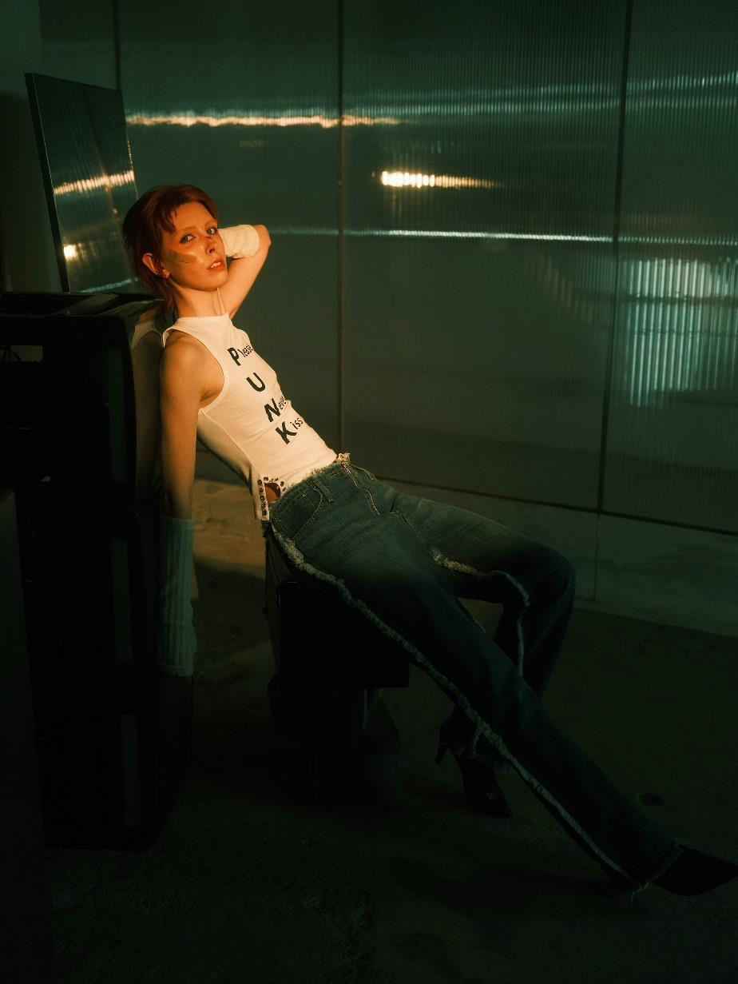

Slide 13
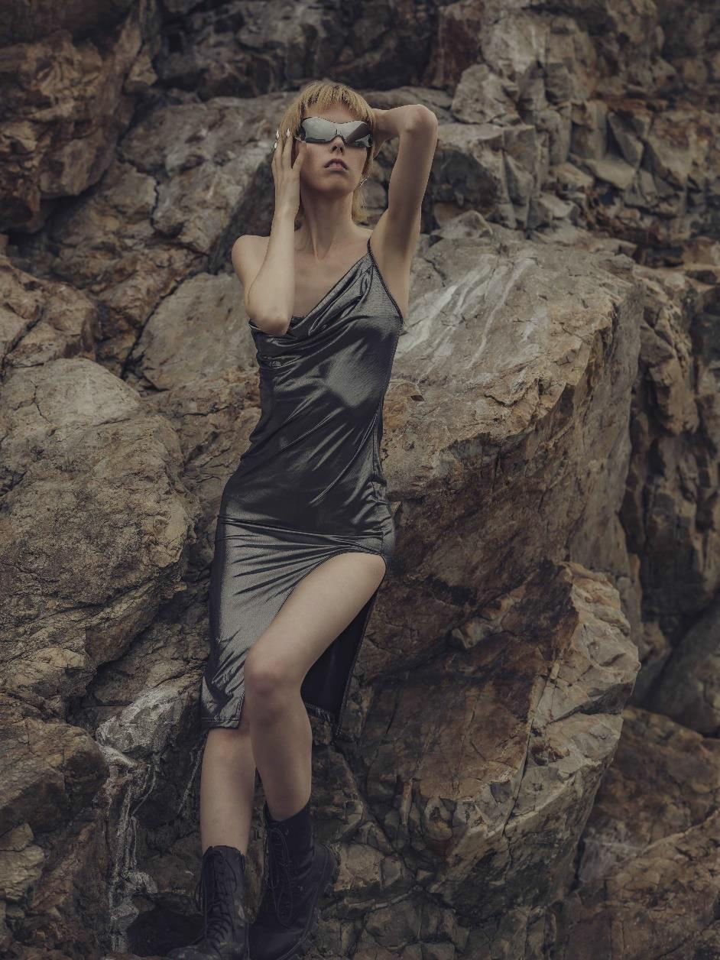
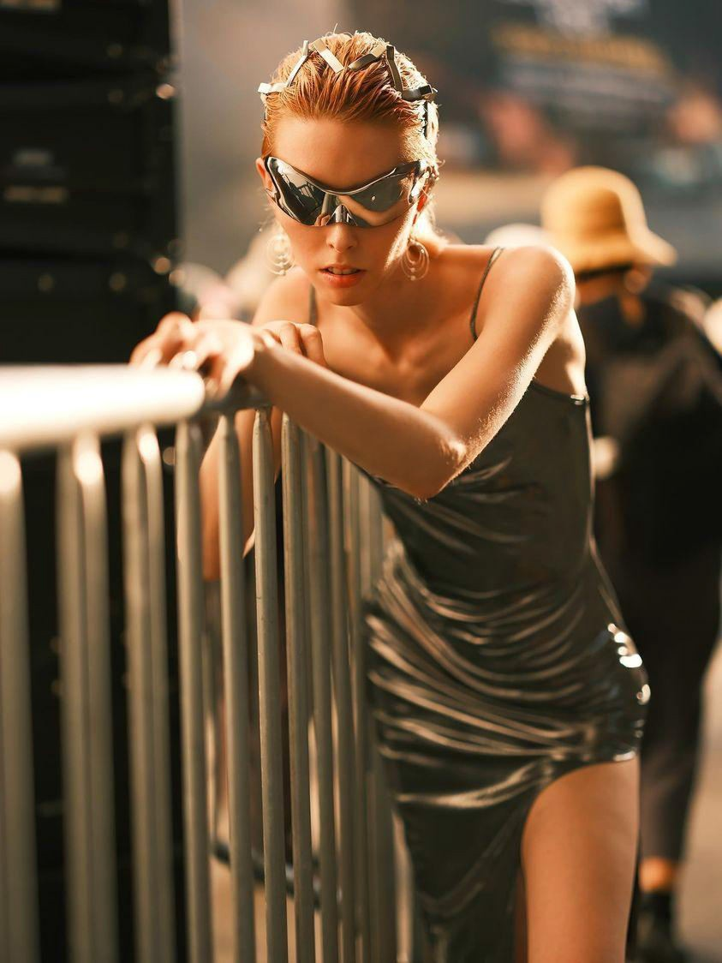
10

Slide 14
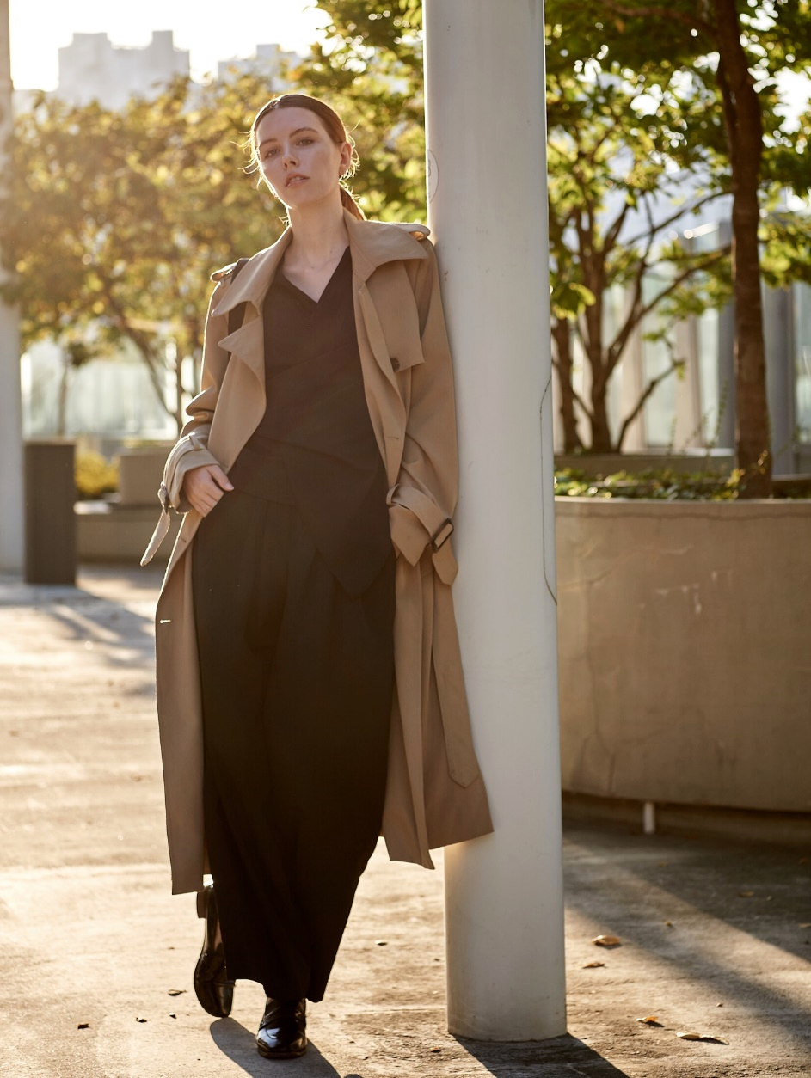
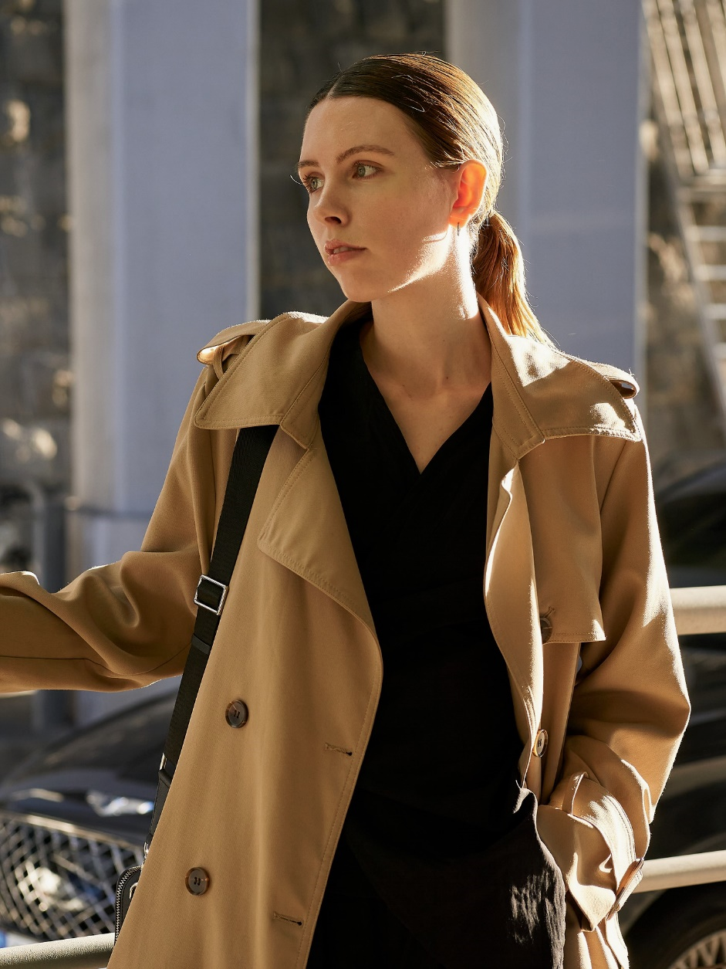
Commercial

Slide 15
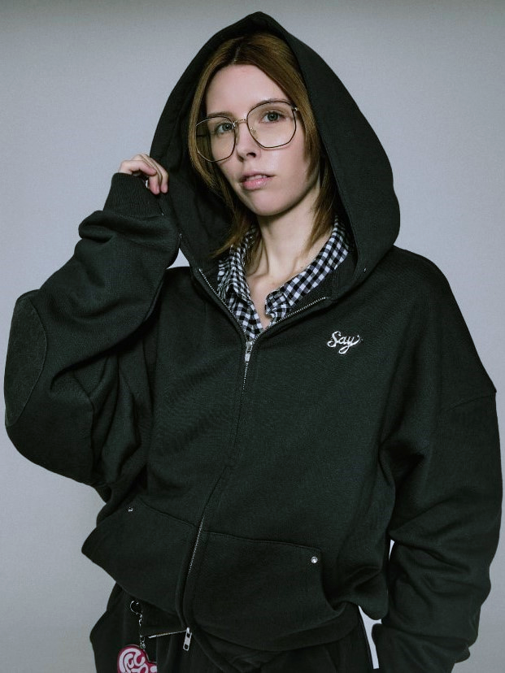
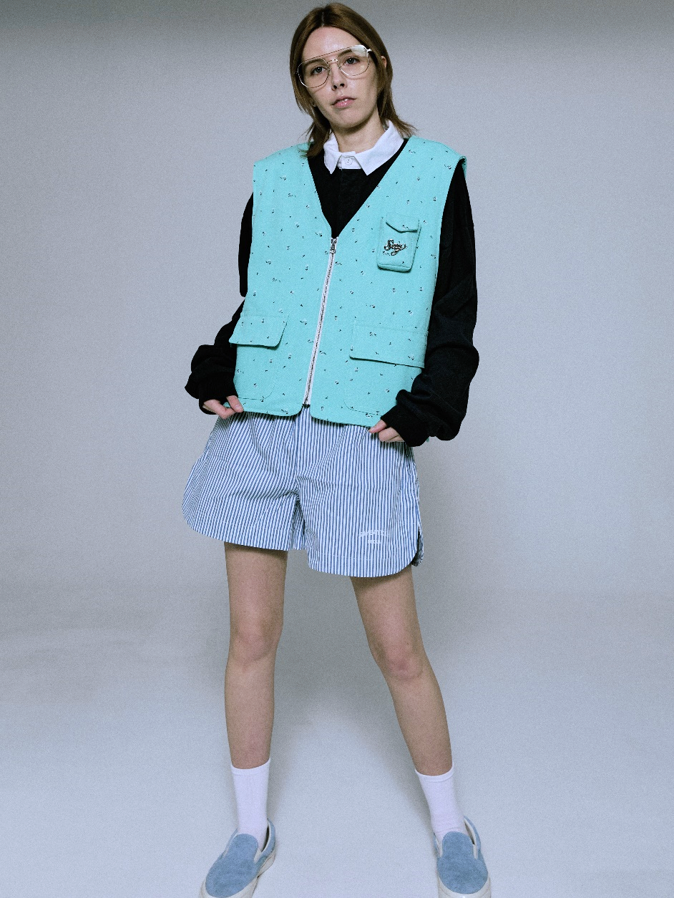

Slide 16
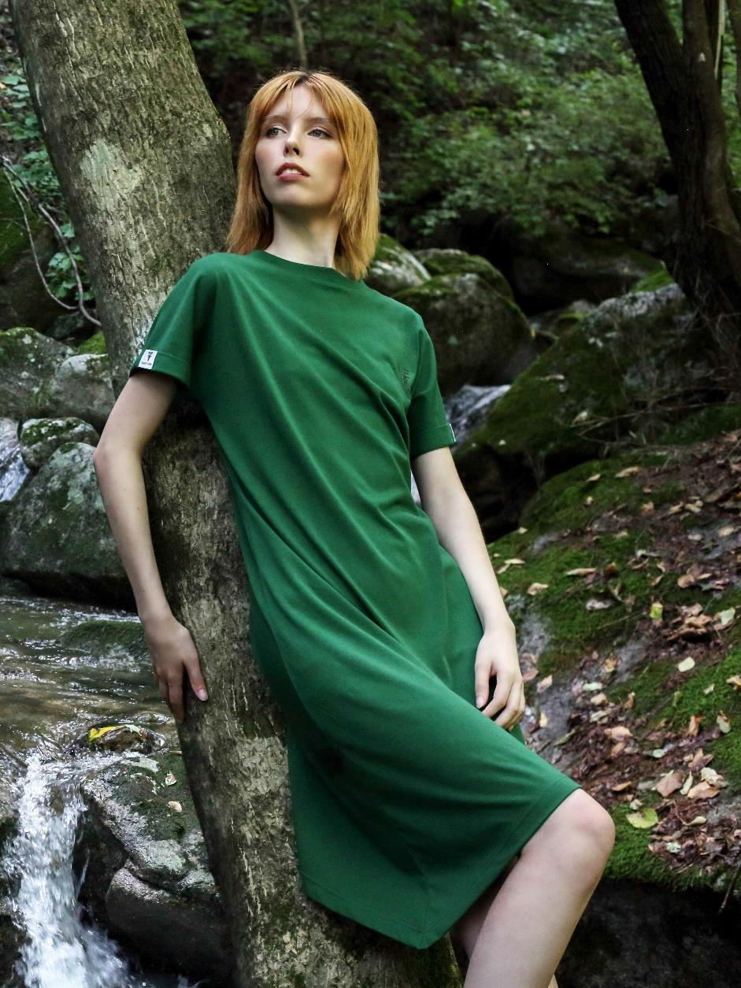
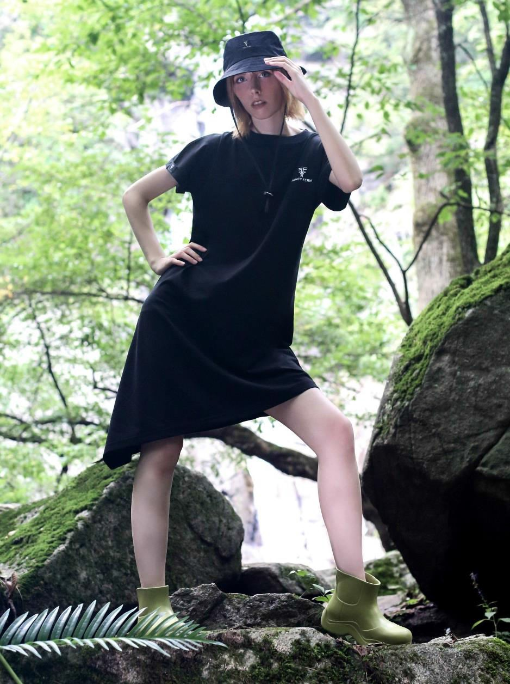

Slide 17
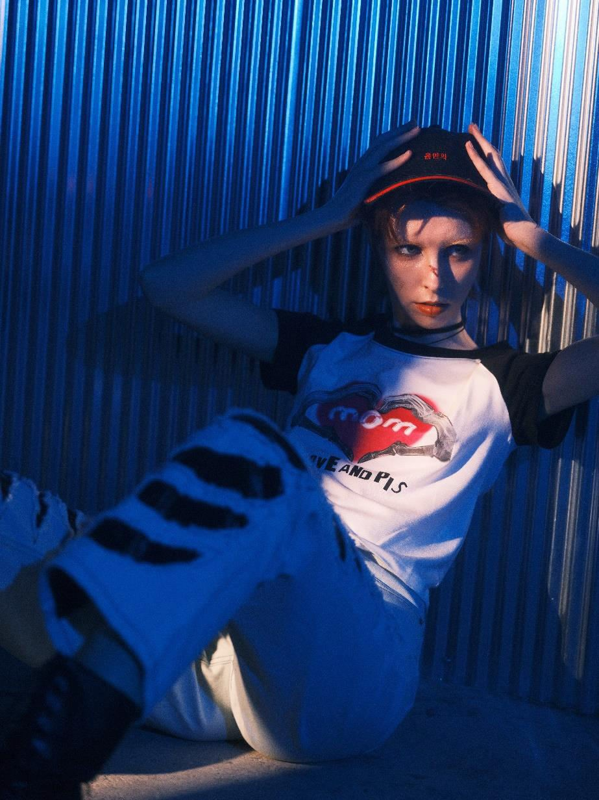
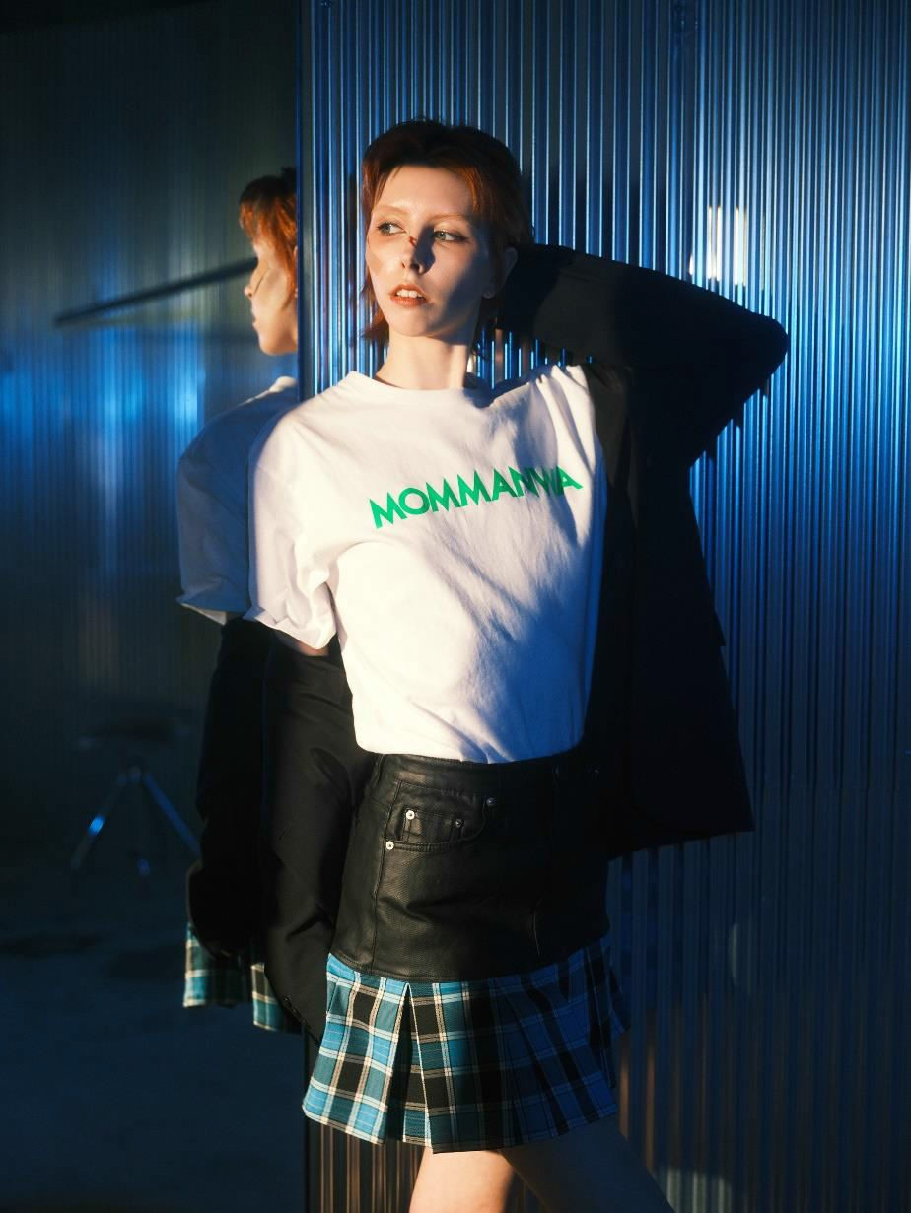

Slide 18
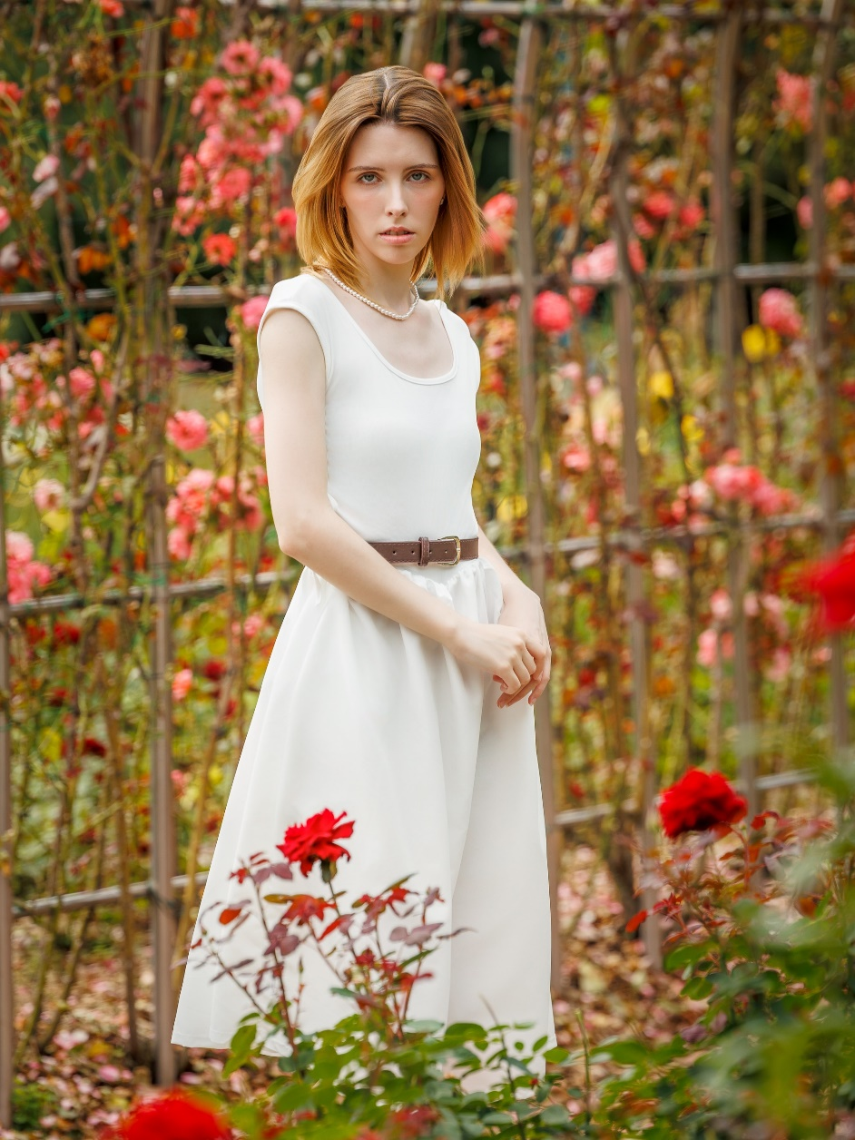


Slide 19
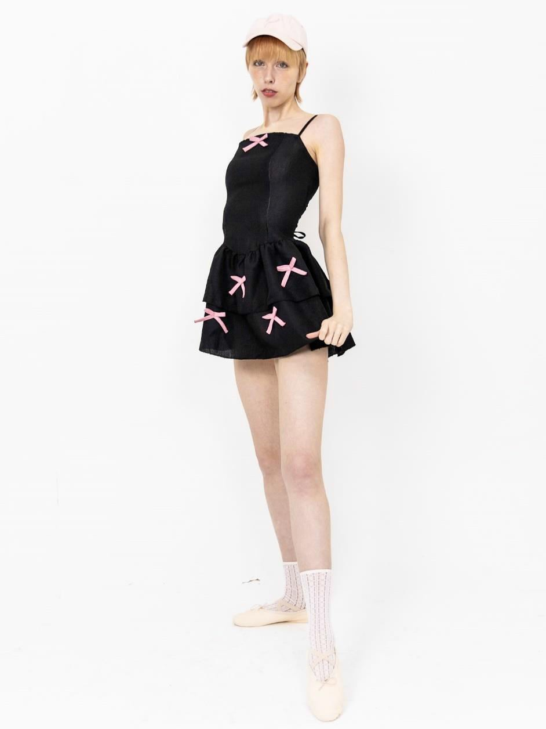
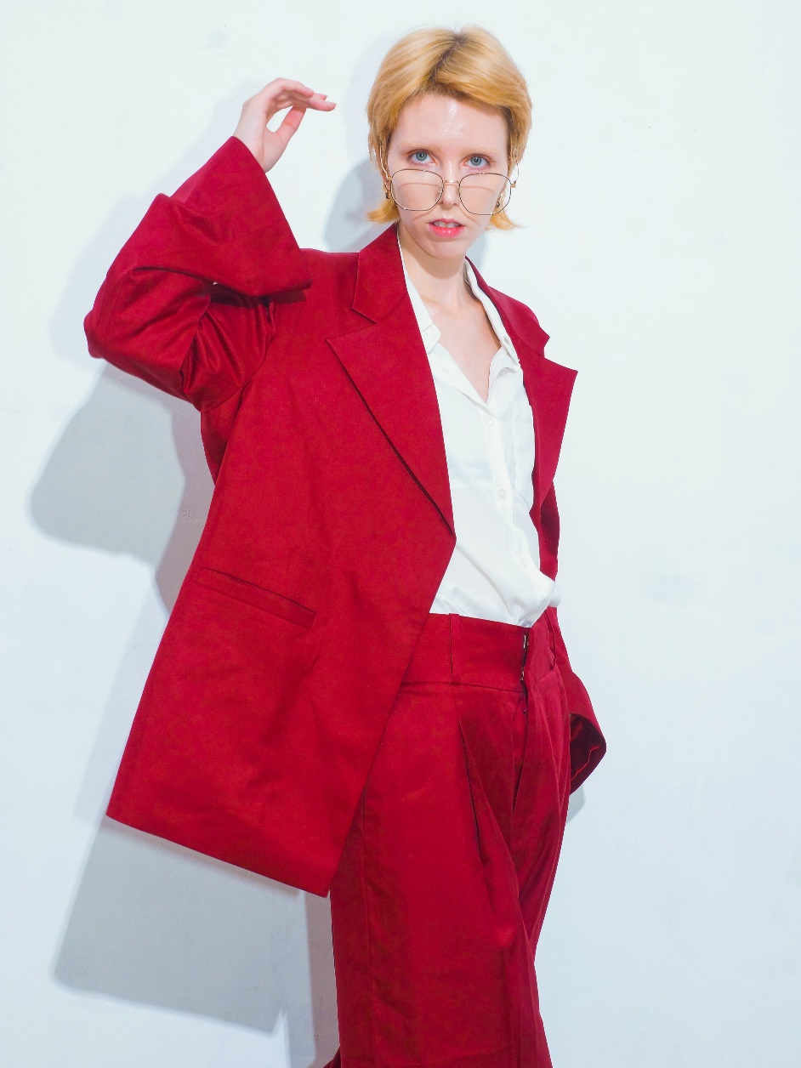

Slide 20
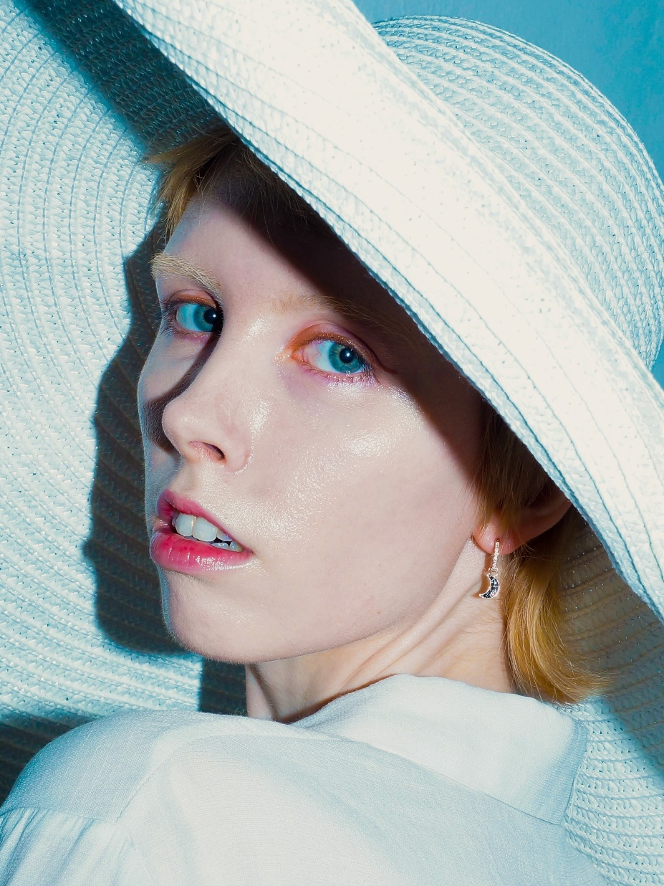
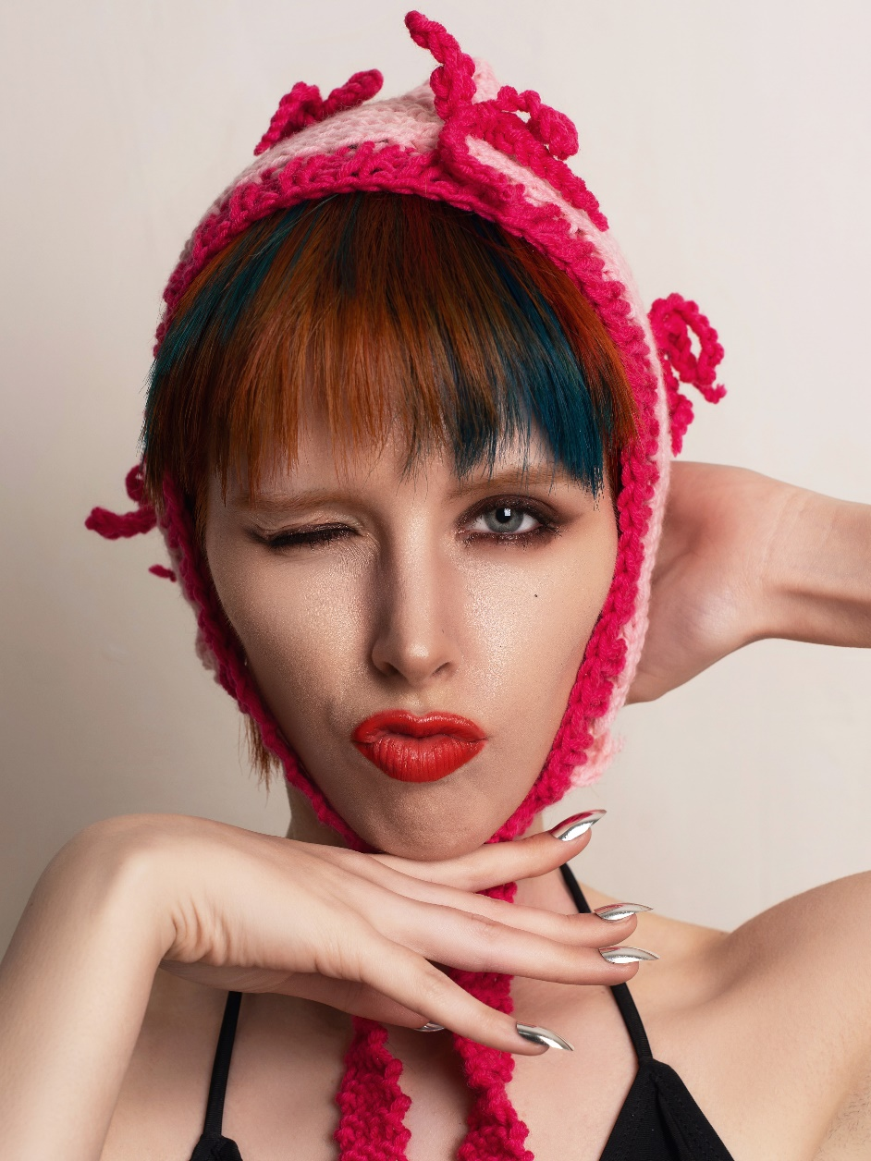

Slide 21

Hand

Slide 22

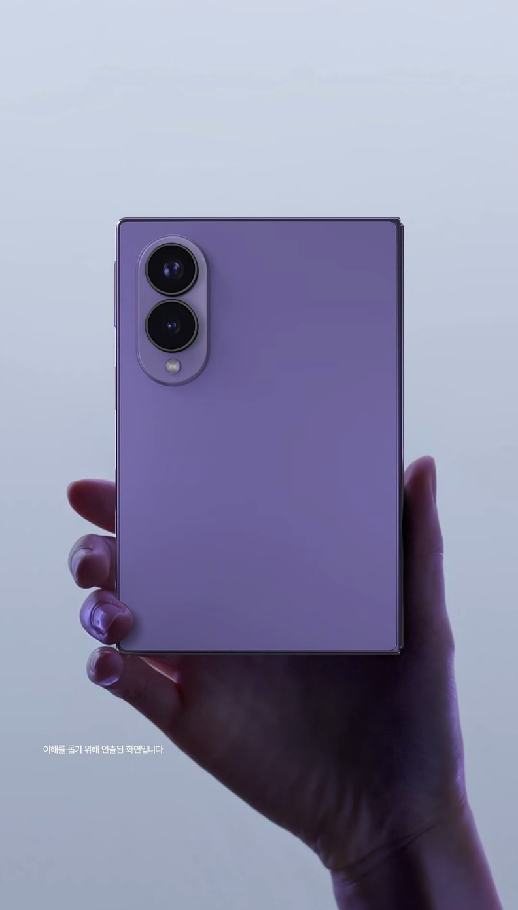

Slide 23
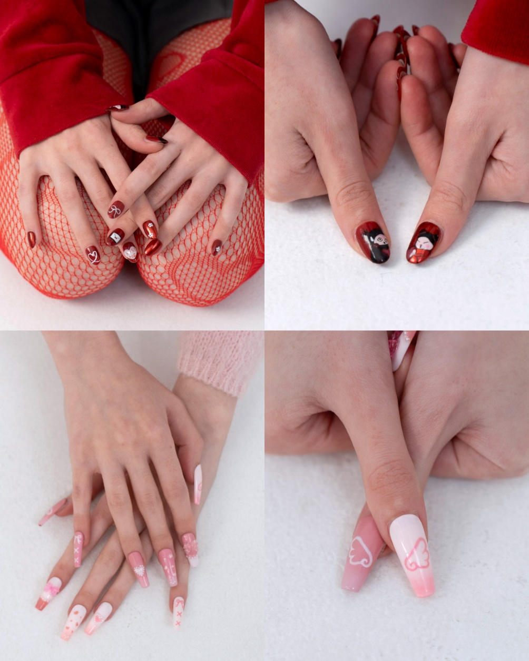
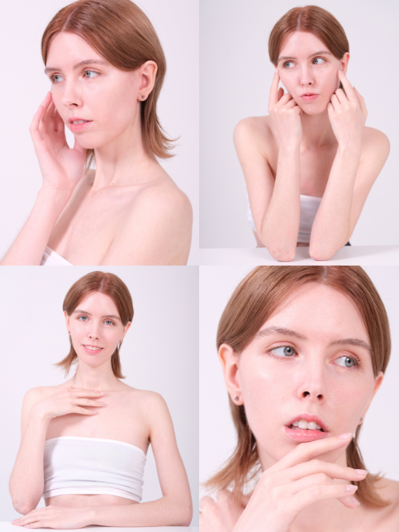

Slide 24
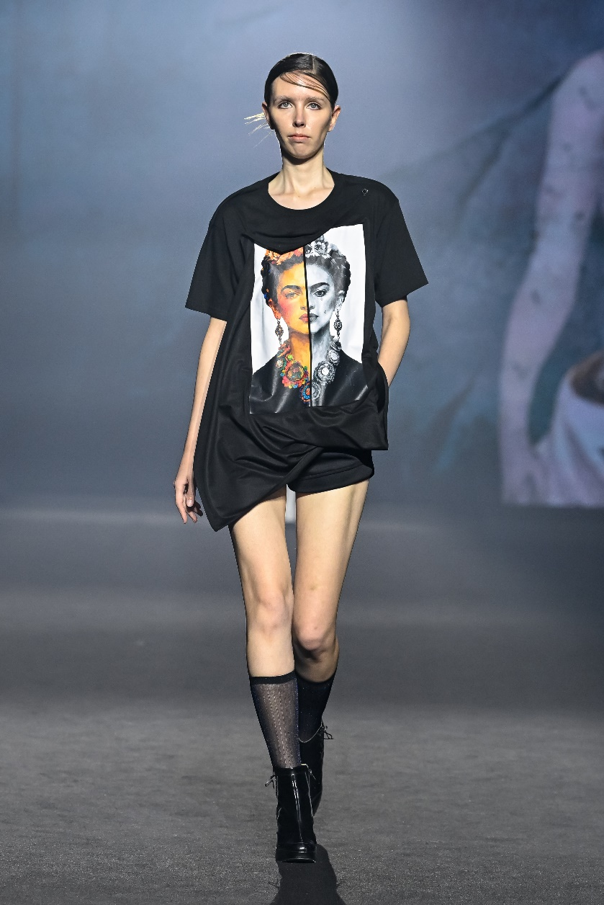
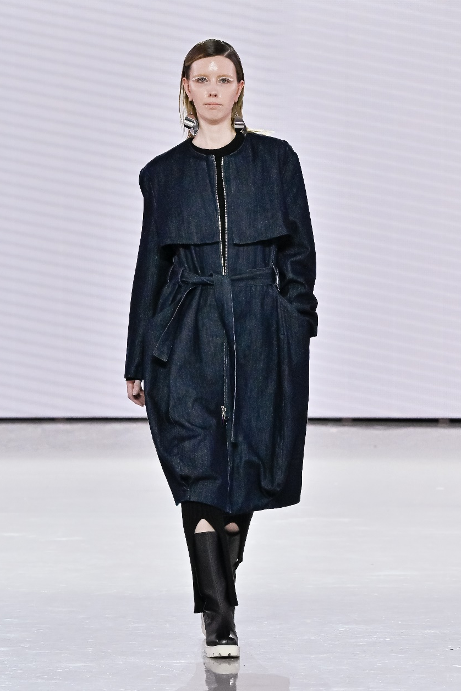
Runway
LIE SANGBONG, 2026
Seoul Fashion Week 27SS, video
KIMOUI, 2026
Seoul Fashion Week 26FW, video
20

Slide 25
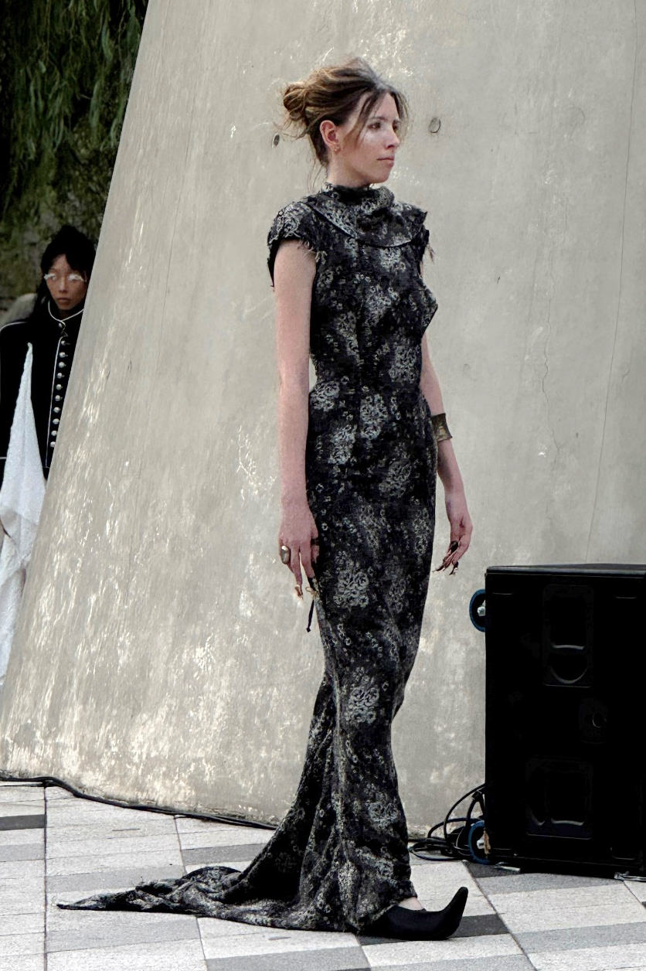
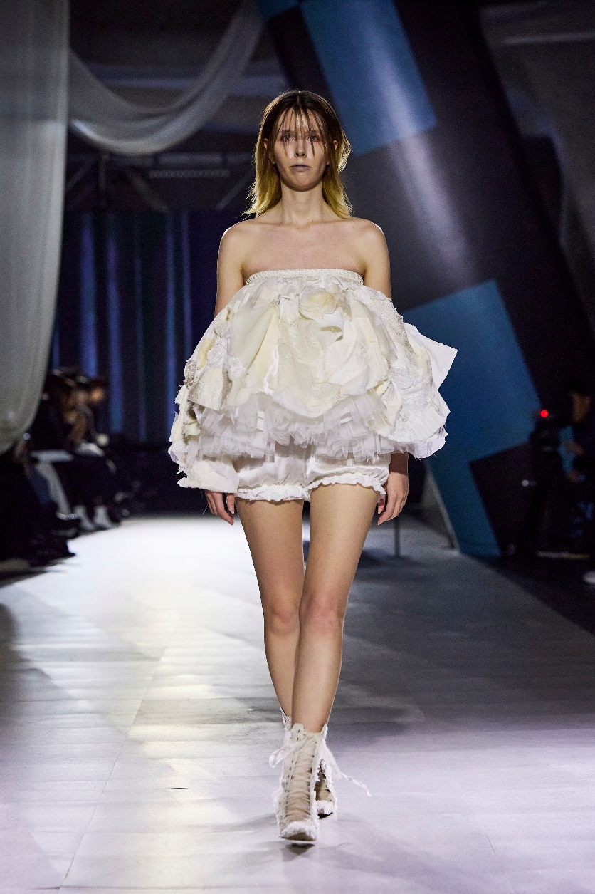
Gyouree Kim, 2026
UK-Korea Fashion Futures, British Embassy and British Council Korea
Gyouree Kim, 2025
Runway to Seoul, video
21

Slide 26
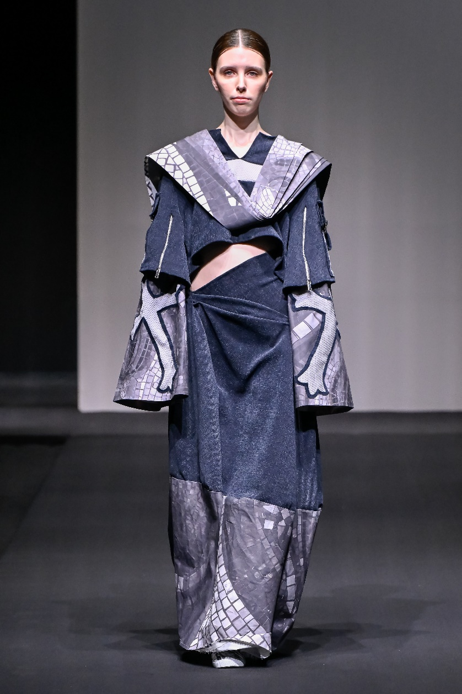
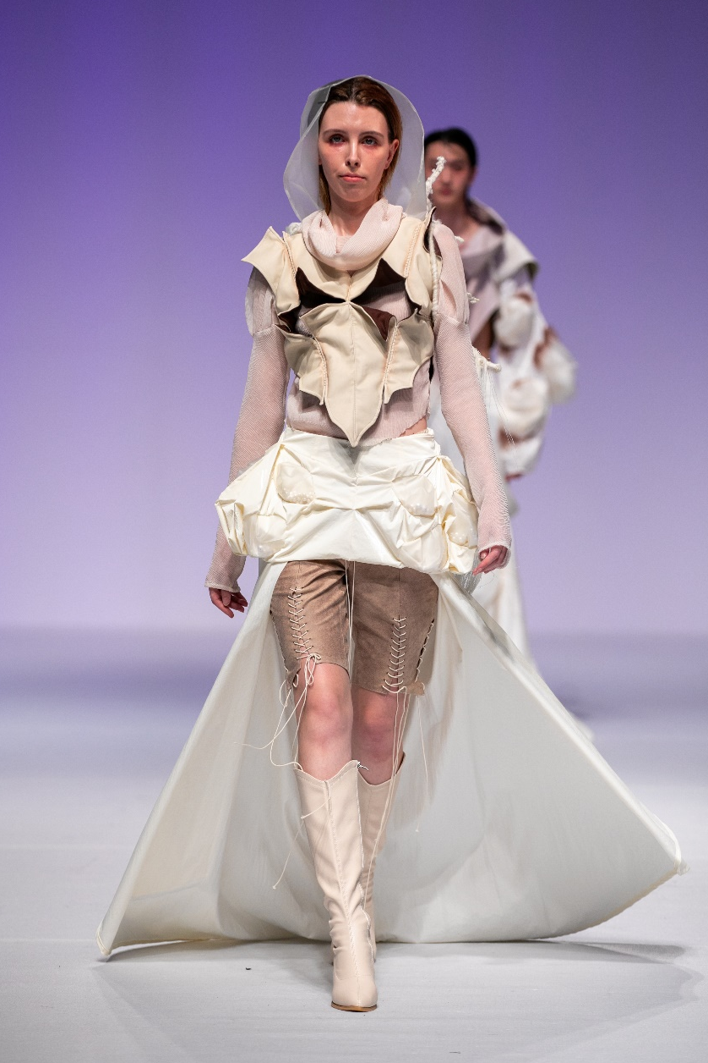
Pyeon Misong (편미송), 2025
Hongik University (홍익대학교) Graduation Show, video (MS), video (BA)
Yoo Seungah (유승아), 2025
Kyunghee University (경희대학교) Graduation Show, video
21

Slide 27
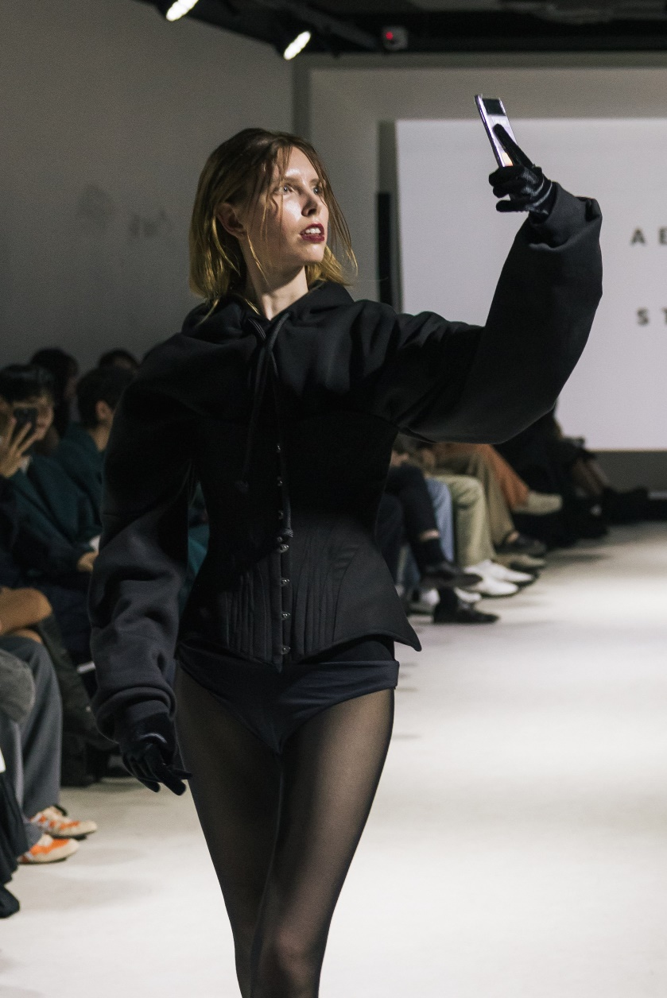
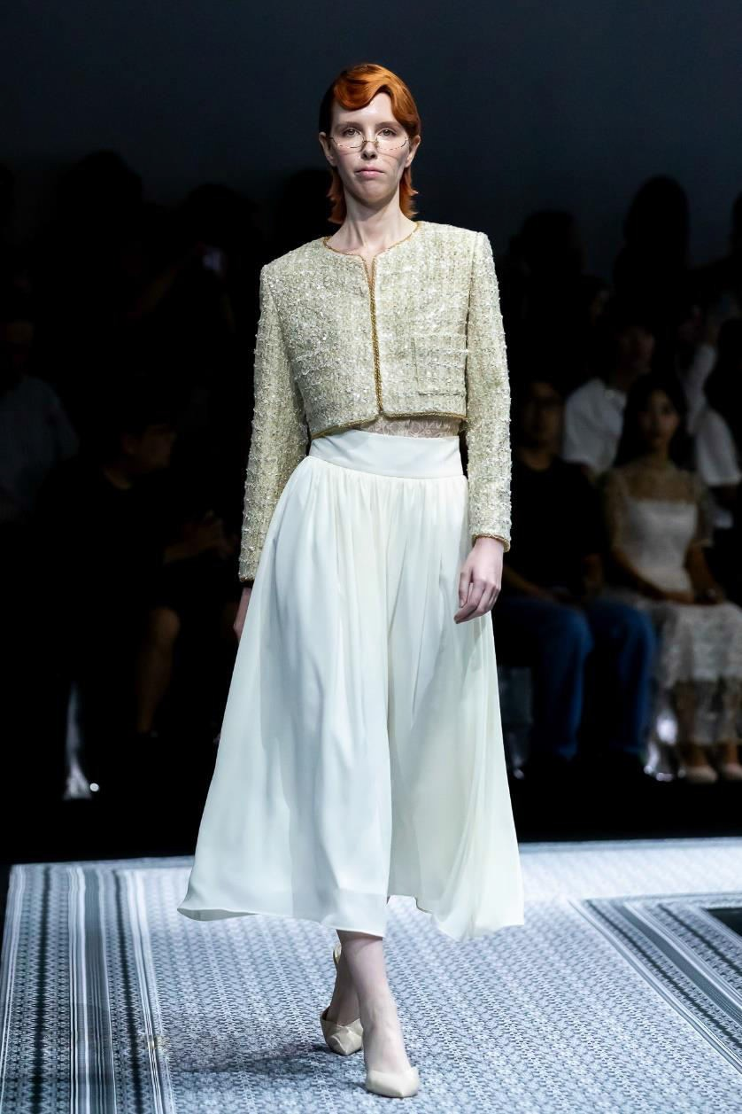
v
Aendör Studio, 2025
Milan Loves Seoul, video
L'EAU ET, 2024
Seoul Fashion Week 25SS, video
21

Slide 28
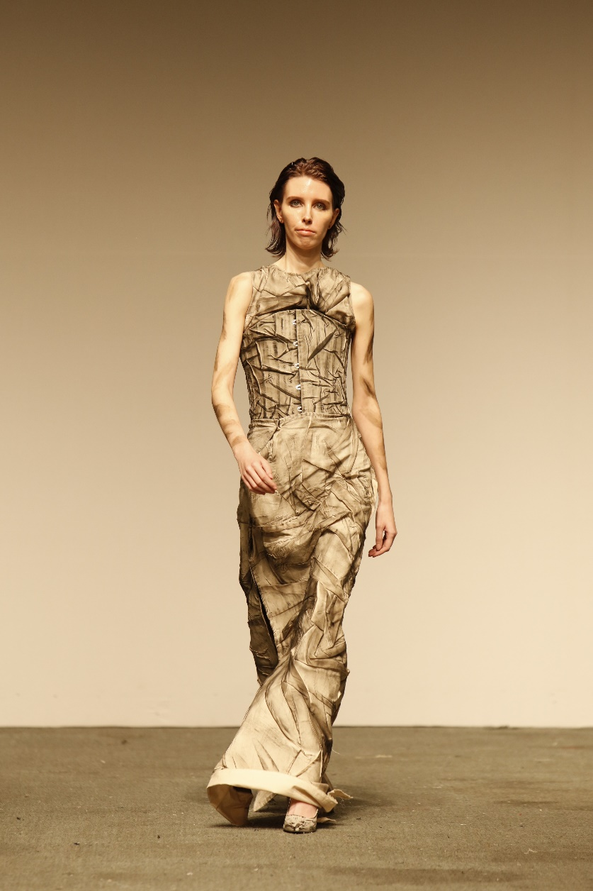
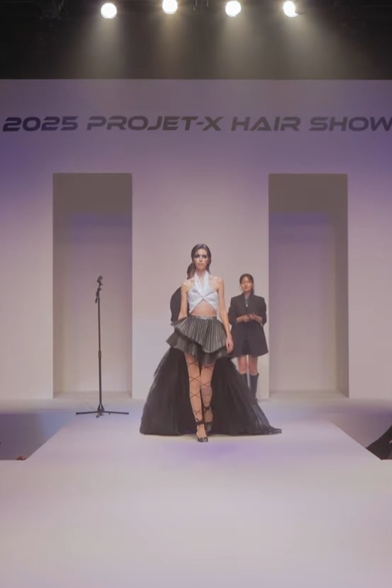
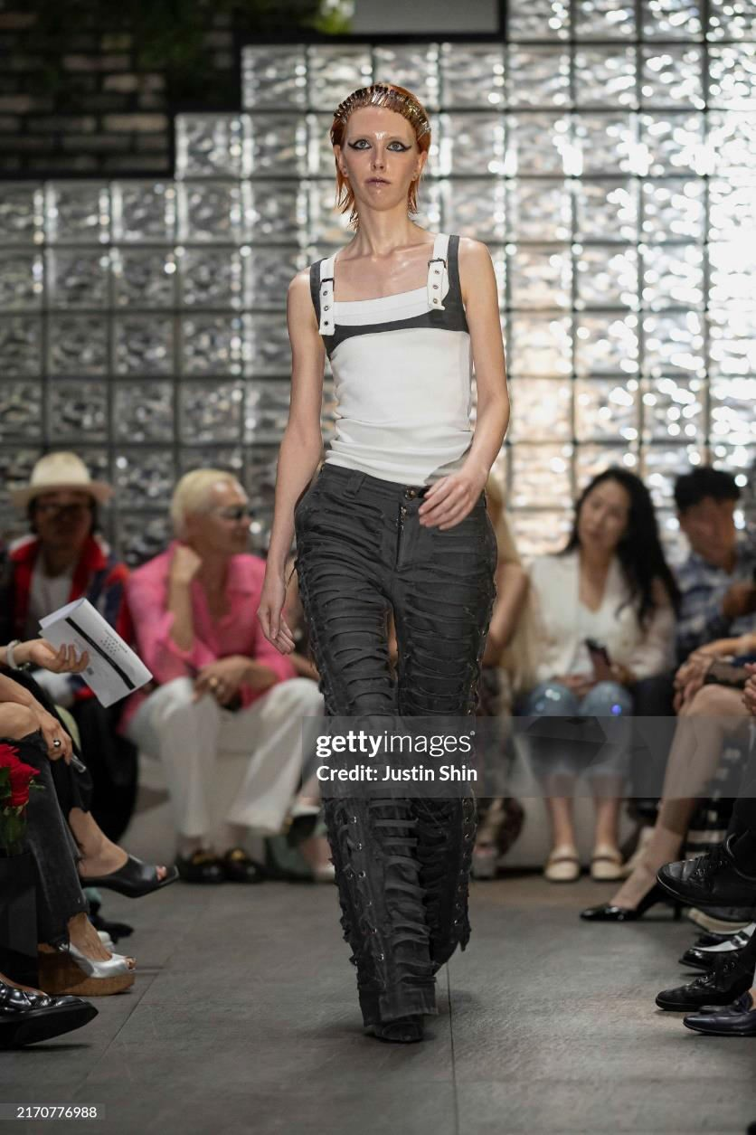
IAC Site, 2024
Milan Loves Seoul, video
KAIJUNG Hair (카이정헤어), 2024
Projet-X Hair Show, video
21

Slide 29
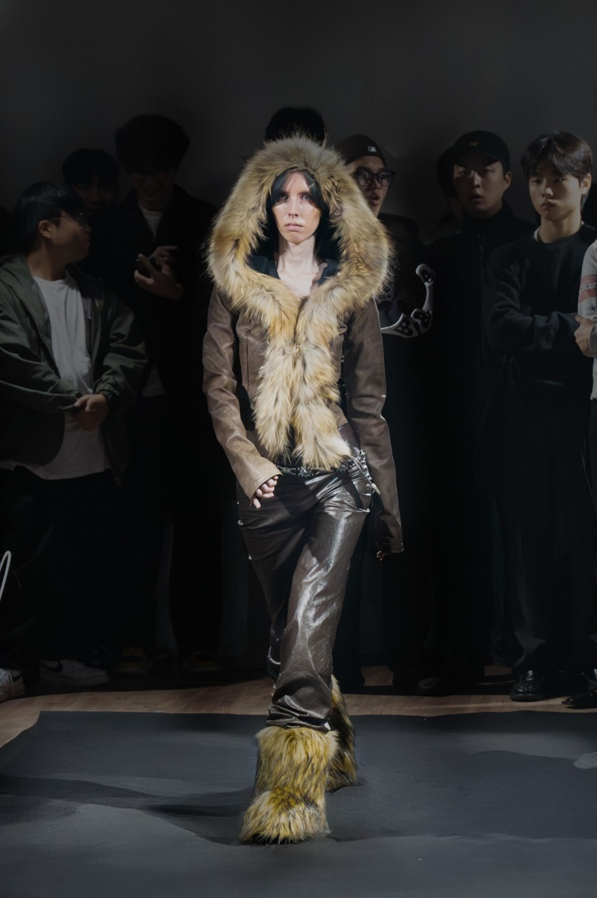
Kim Yangheon (김양헌), 2024
SART (서울예술실용전문학교) Graduation Show
Lee Nagyeong (이나경), 2024
Ulsan University (울산대혹교) Graduation Show
21

Slide 30
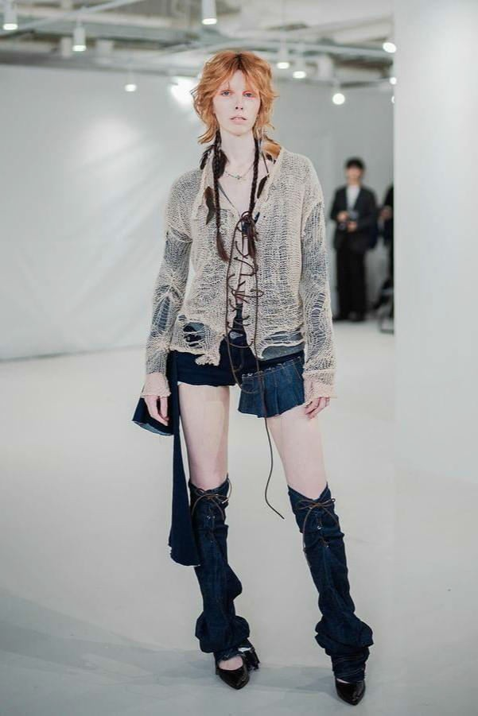

GREAVID, 2024
Cho Kyungho (조경호), 2023
SART (서울예술실용전문학교) Graduation Show, video
GREAVID Brand Launch Show
21

Slide 31


Publications
FIGGI Magazine - FASHION & GLAMOUR NOVEMBER Vol 1251, 2024, visit

Slide 32


FIGGI Magazine - FASHION & GLAMOUR NOVEMBER Vol 1251, 2024, visit

Slide 33


Falcon Magazine (falcon.industry Instagram), 2024, visit

Slide 34



LEDDIT Magazine Vol. 16, 2024, visit, visit (slide 31)

Slide 35


1 Granary (Instagram), 2024, visit
Harper's BAZAAR Singapore, 2023, visit

