Slide 1
Model Portfolio Rosa Bakker
Social media: @Beaglecheoreom
Sizes
Height: 174cm / 5’9 Weight: 47kg / 104lbs Bust: 79cm / 31in Waist: 57cm / 22in Hip: 87cm / 34in
Shoes: EU39, UK6, US8, KOR250 Dress: EU32/34, US0, UK4, KOR44, XS

Slide 2
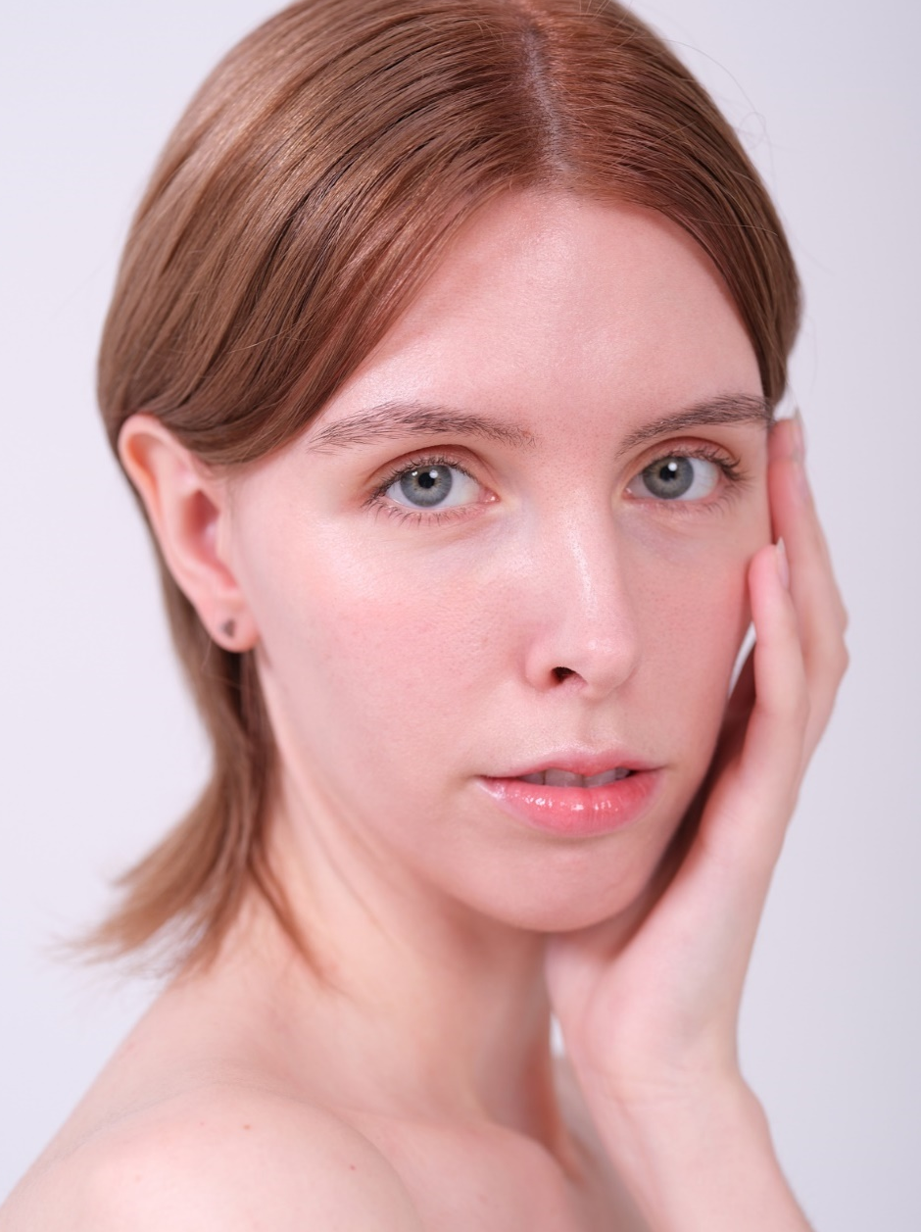
Sections
Haute Couture & Editorial Commercial
Runway Publications
………………… p. 4
………………… p. 14
………………… p. 22
………………… p. 28

Slide 3
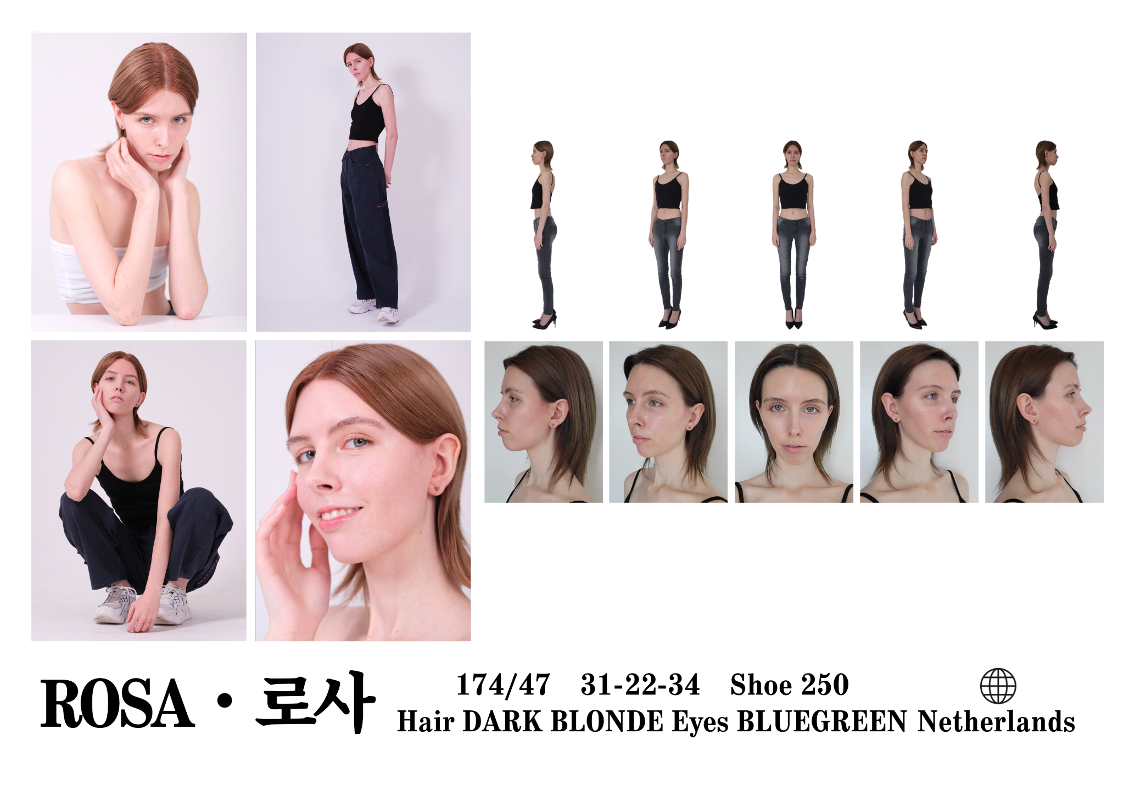
English introduction: video, Korean introduction: video

Slide 4
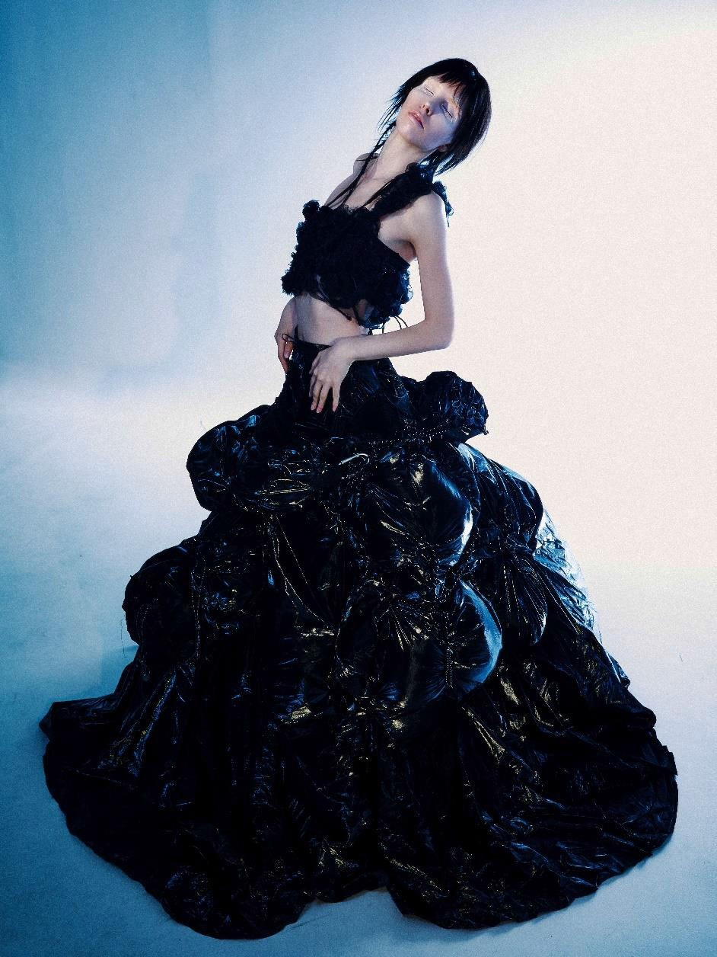
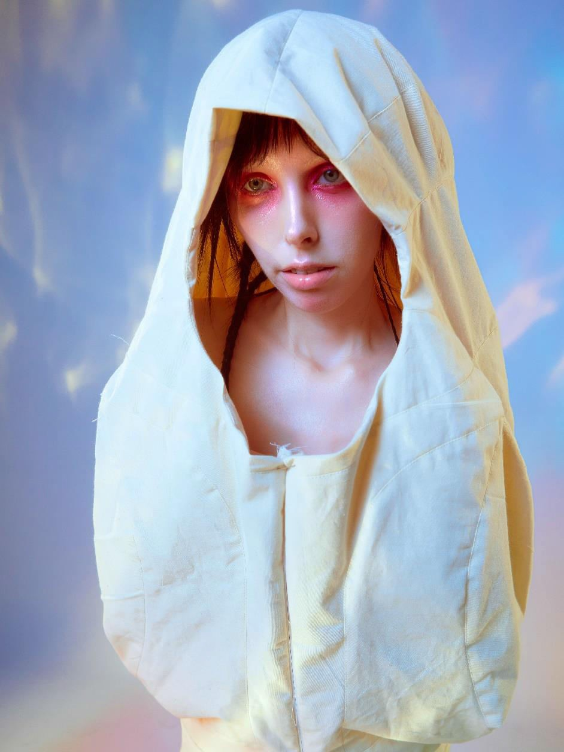
Haute Couture & Editorial

Slide 5
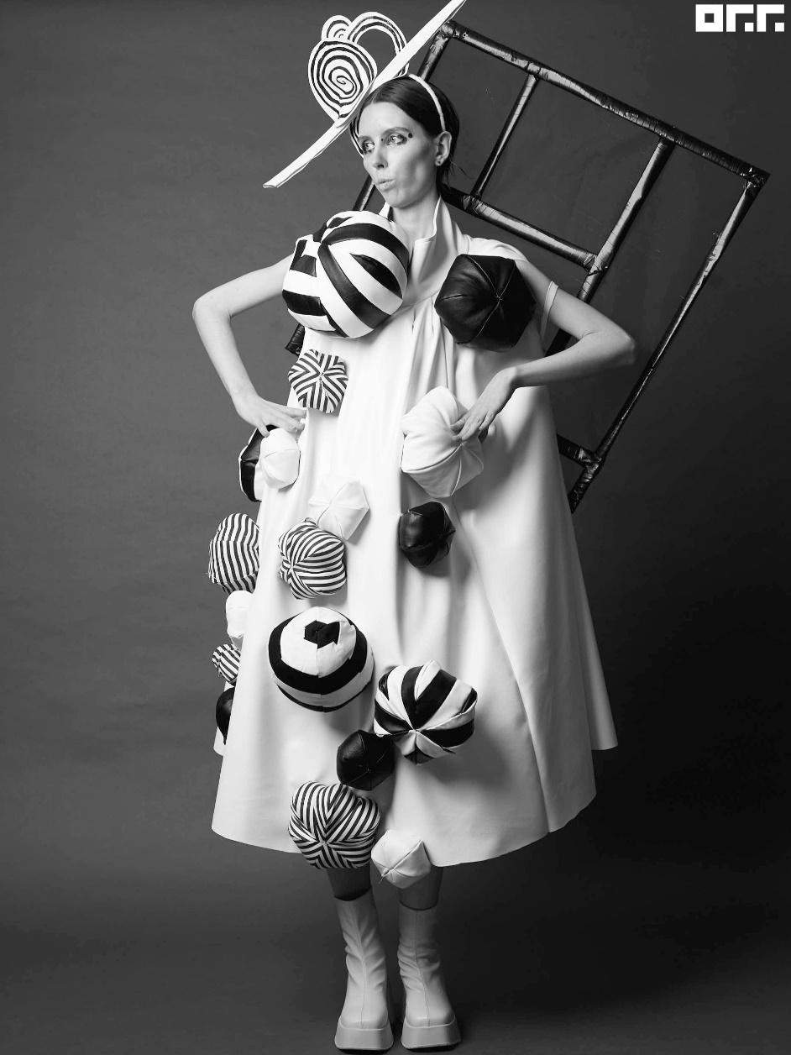
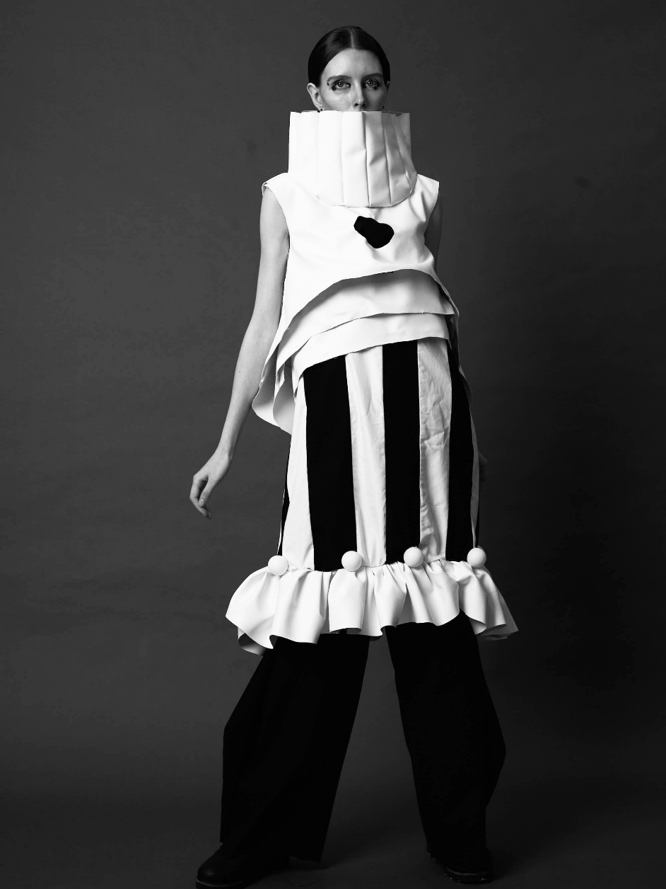

Slide 6
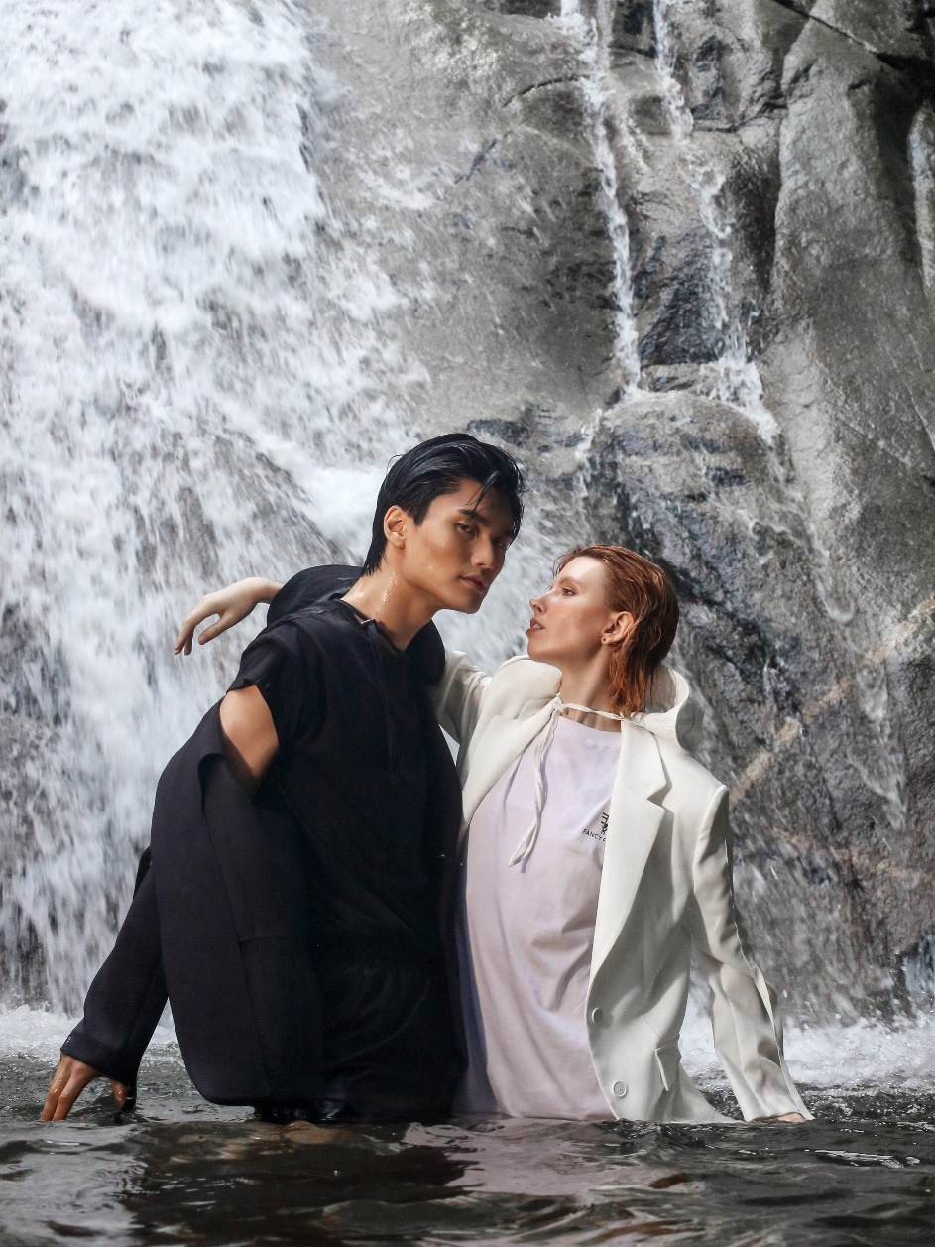
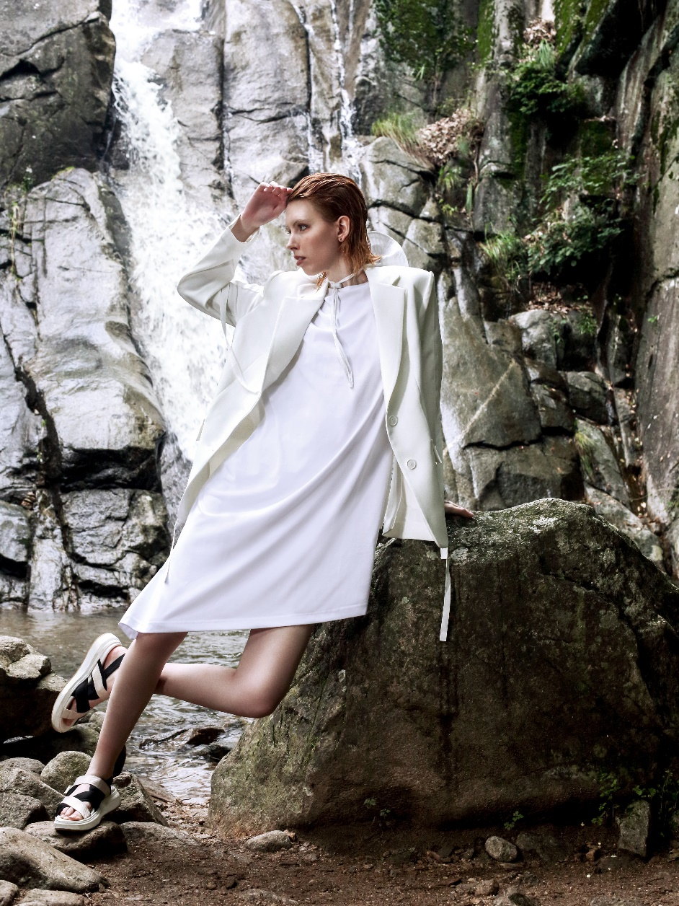

Slide 7
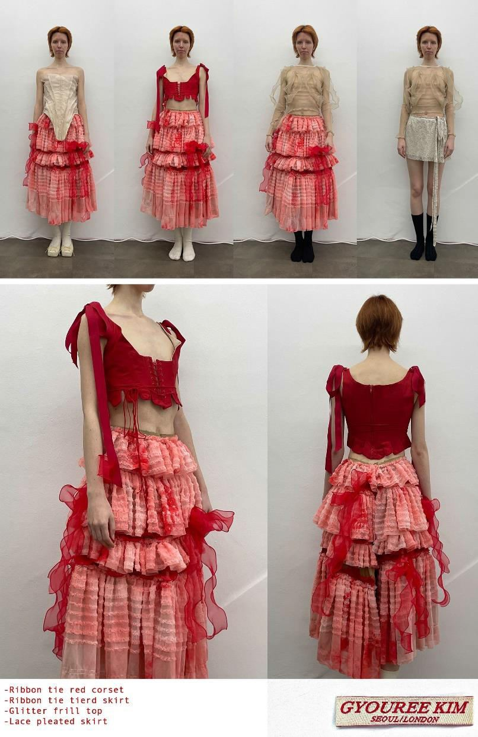
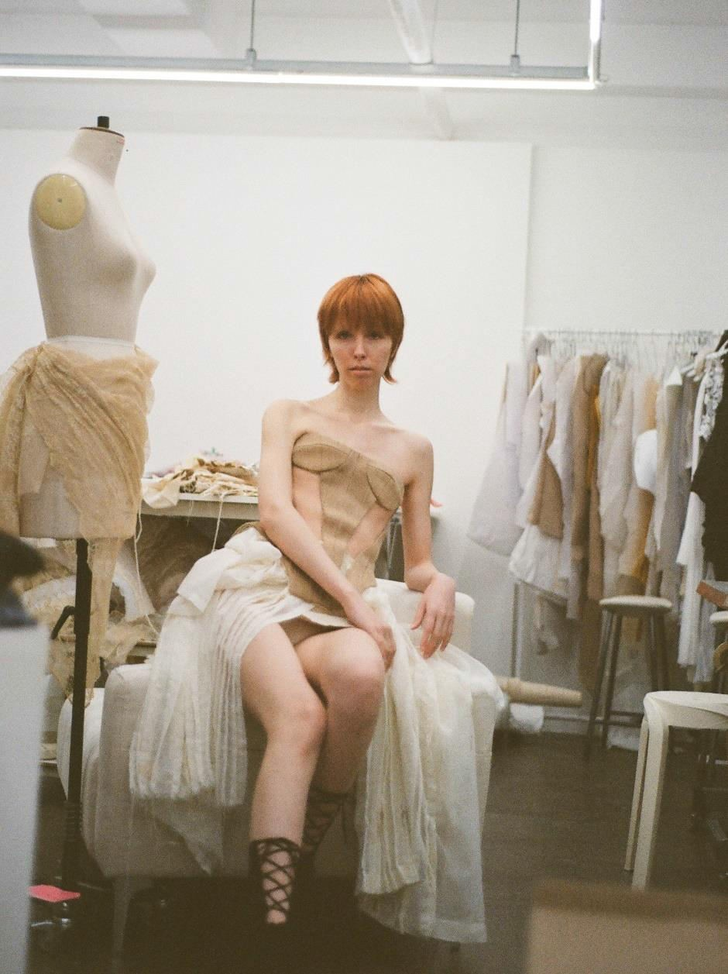

Slide 8
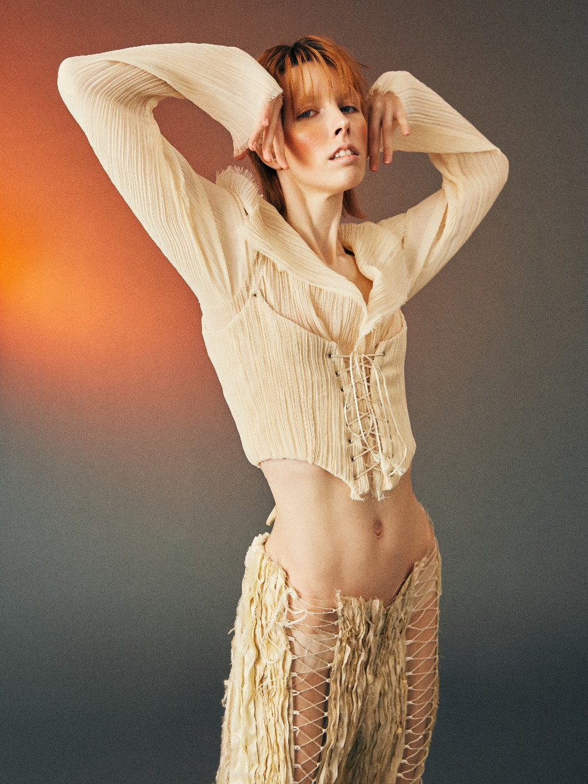
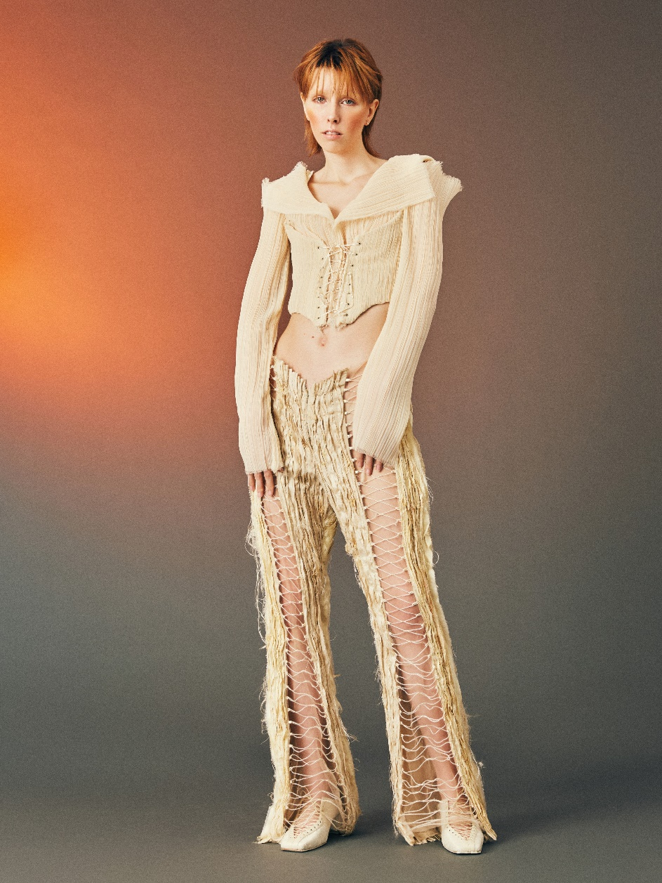

Slide 9
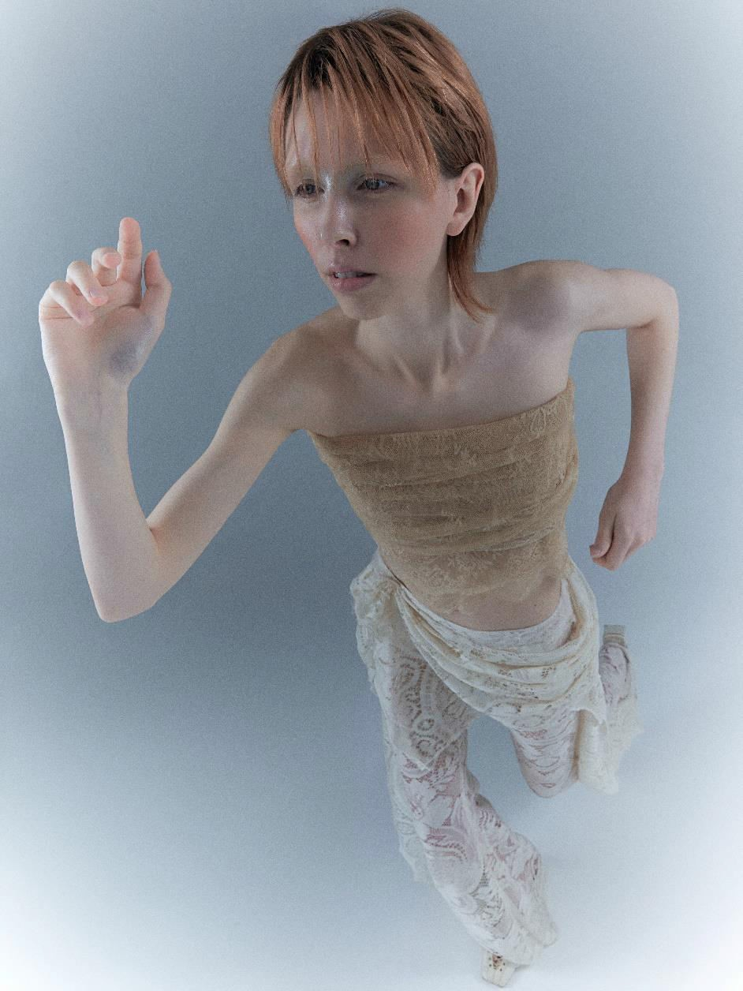
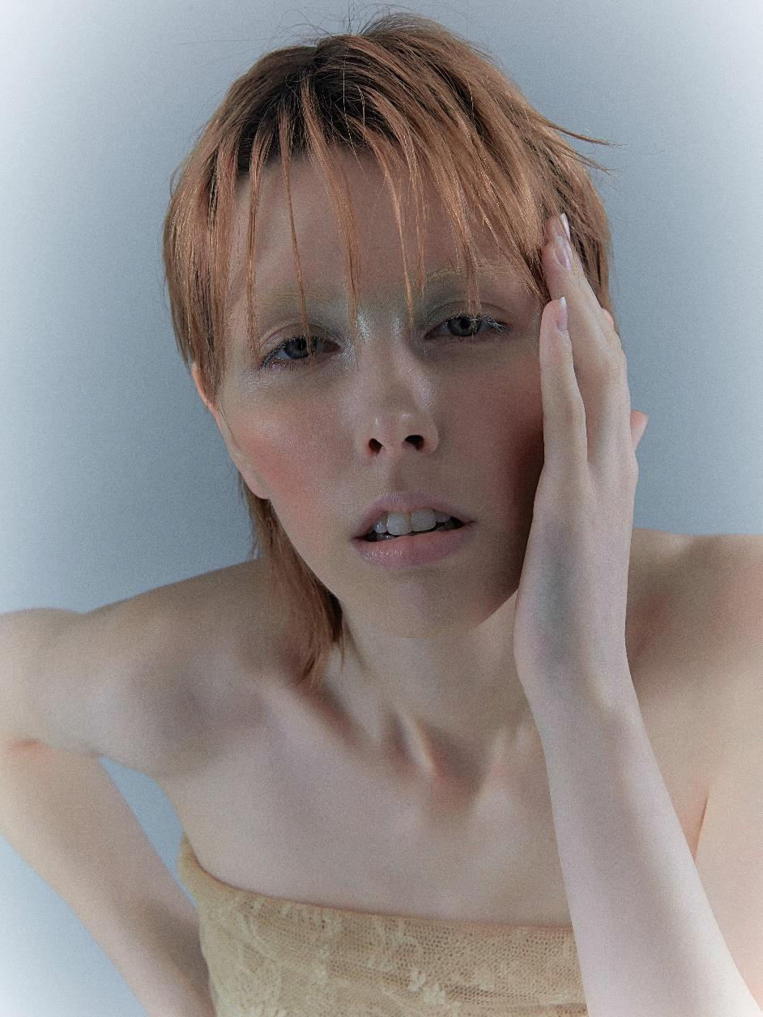

Slide 10
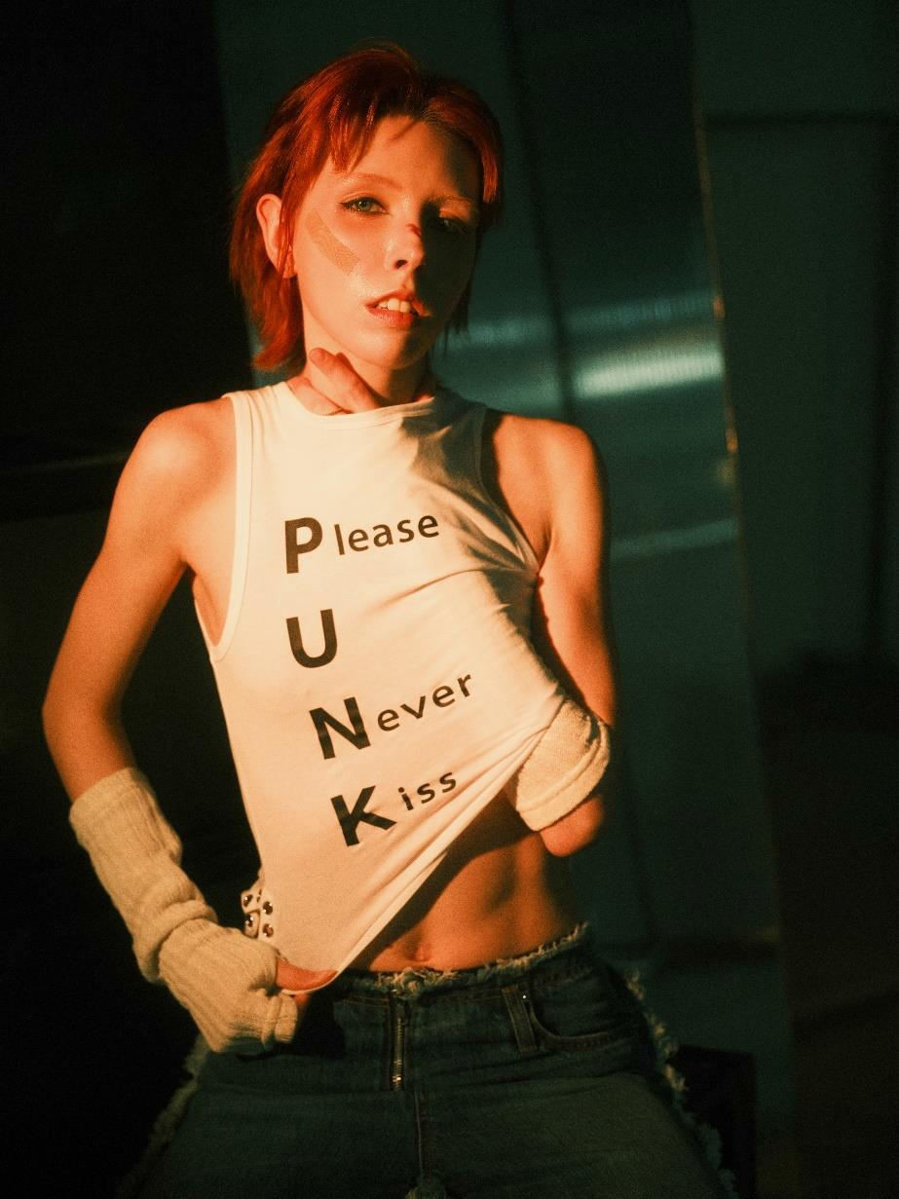
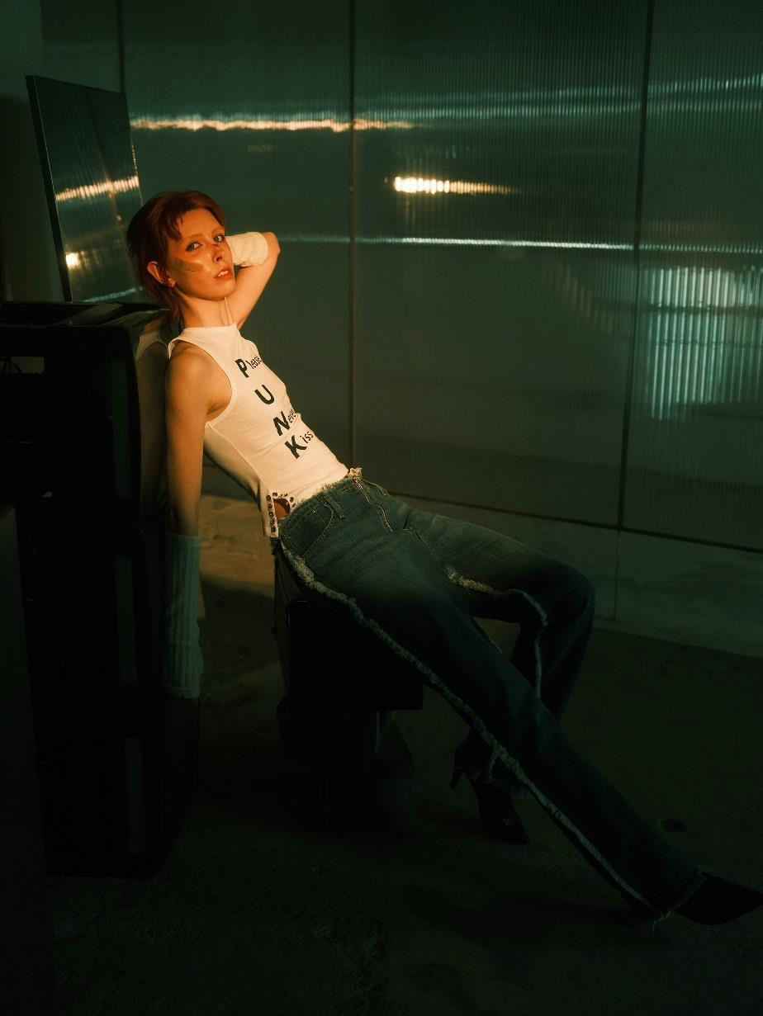

Slide 11
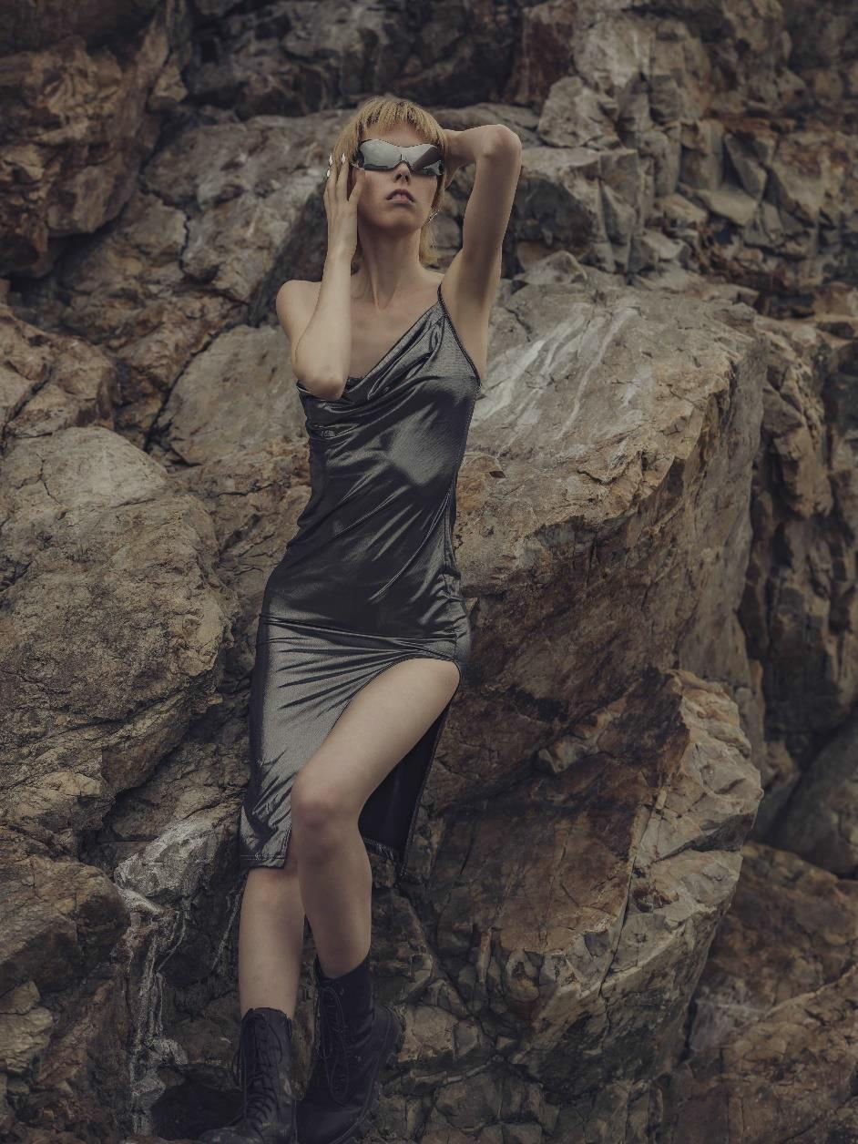
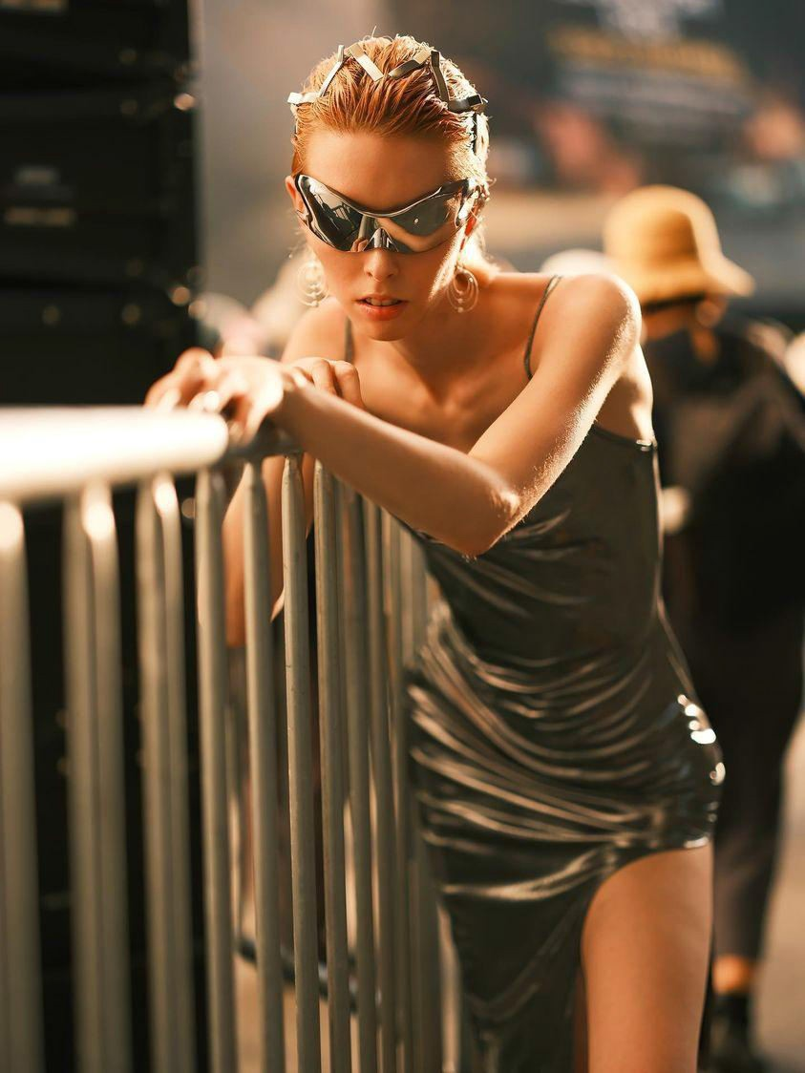
10

Slide 12
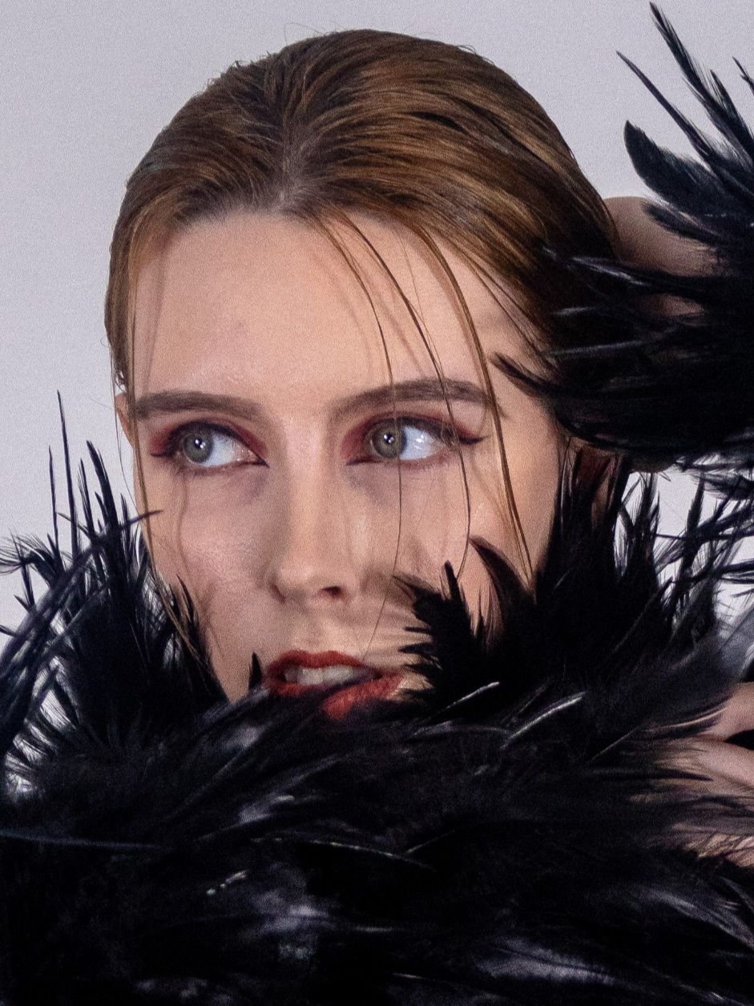
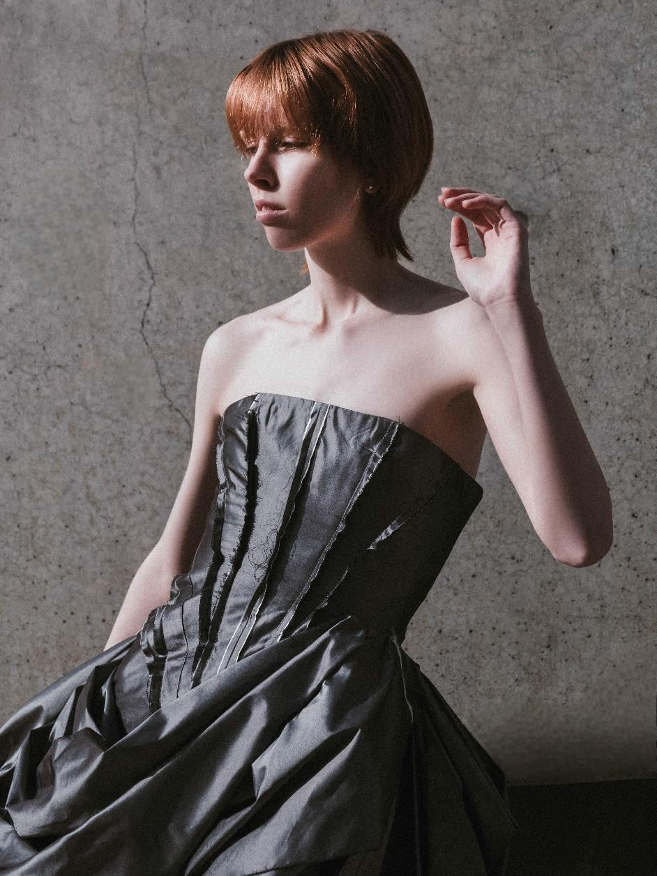

Slide 13
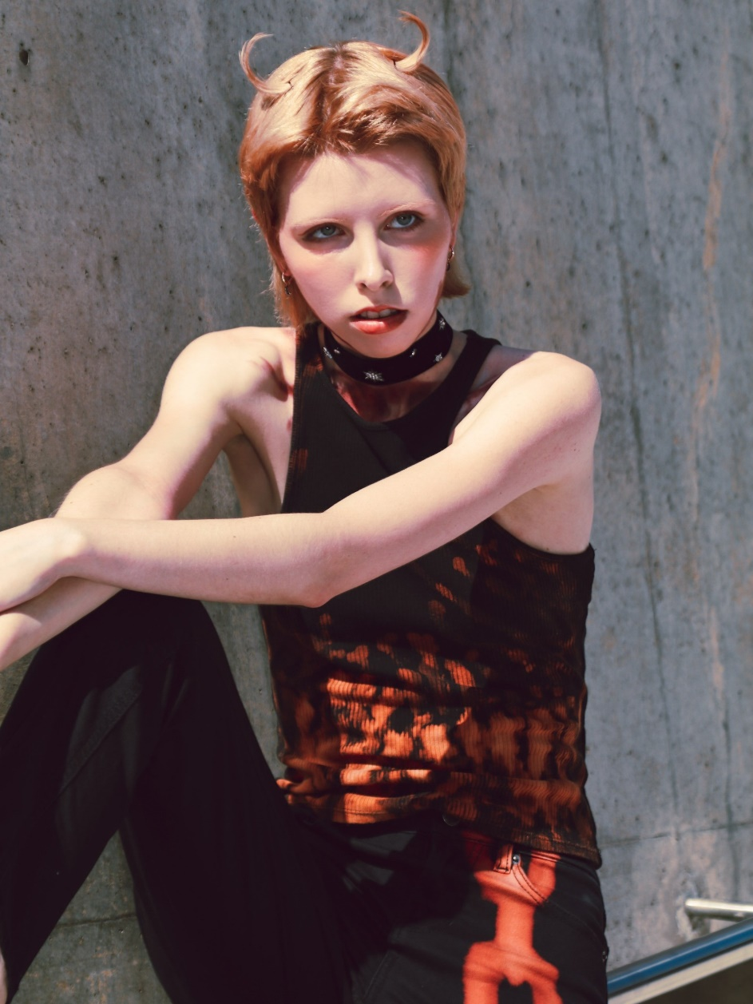
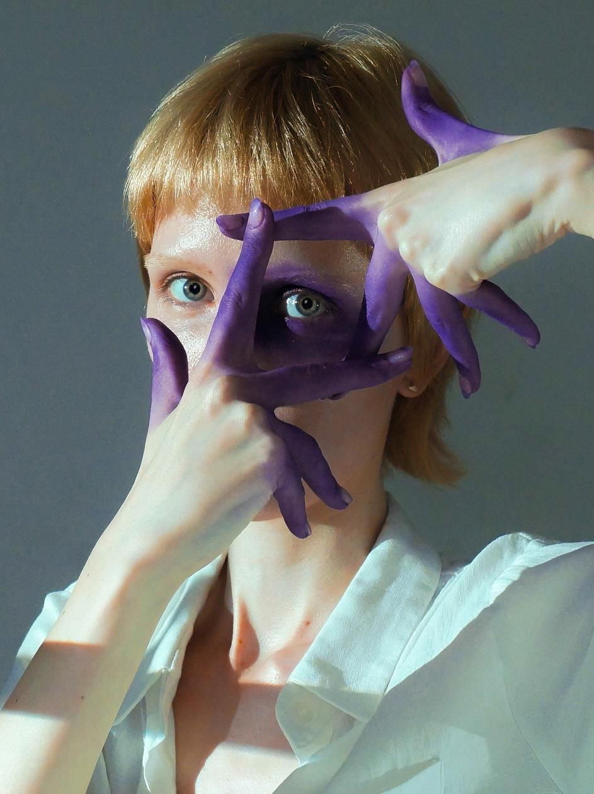

Slide 14
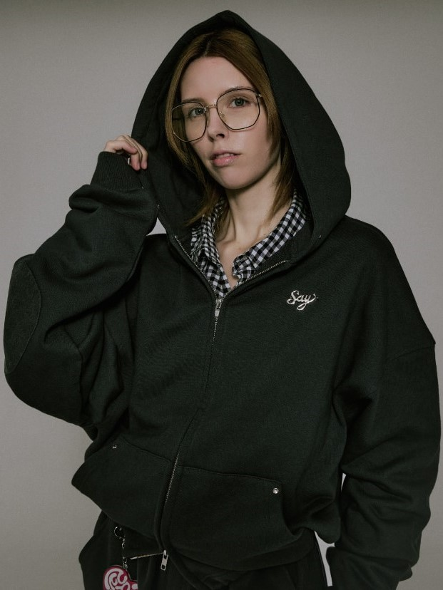
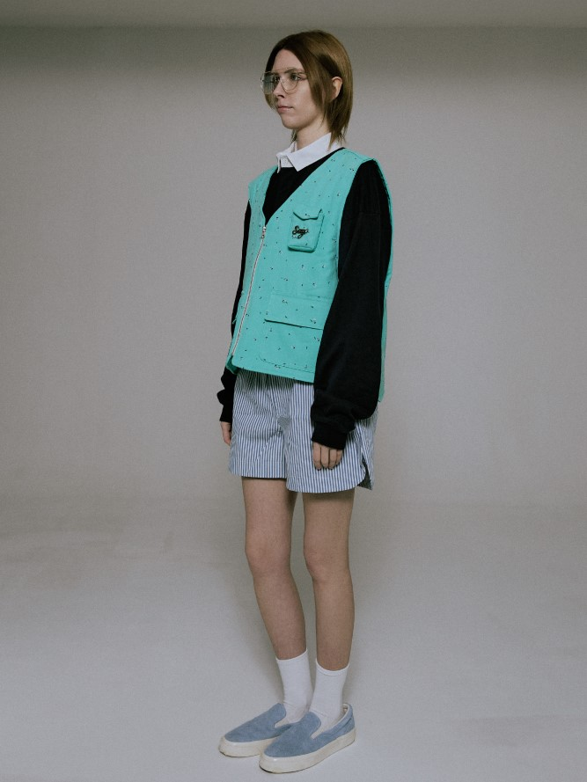
Commercial

Slide 15
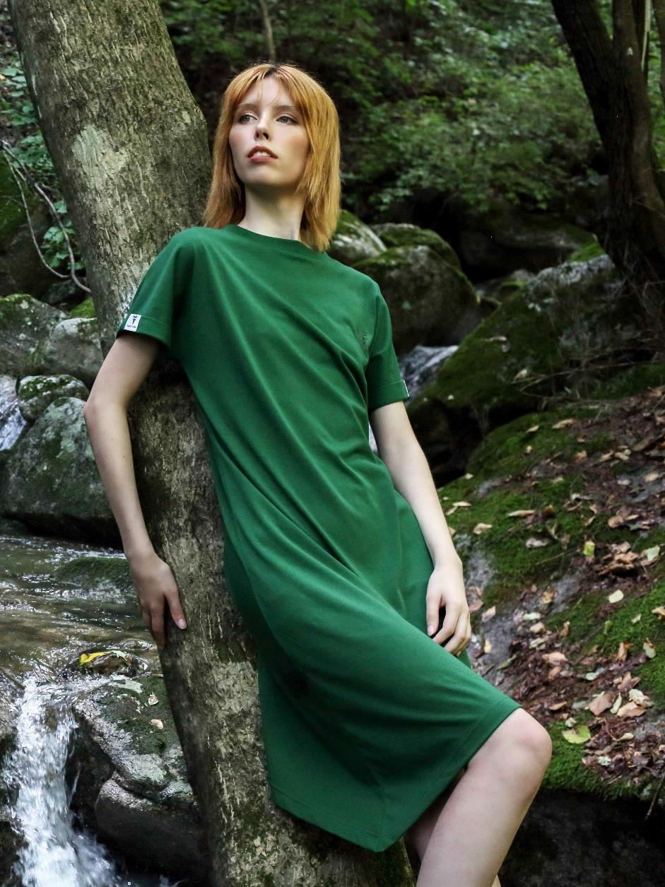
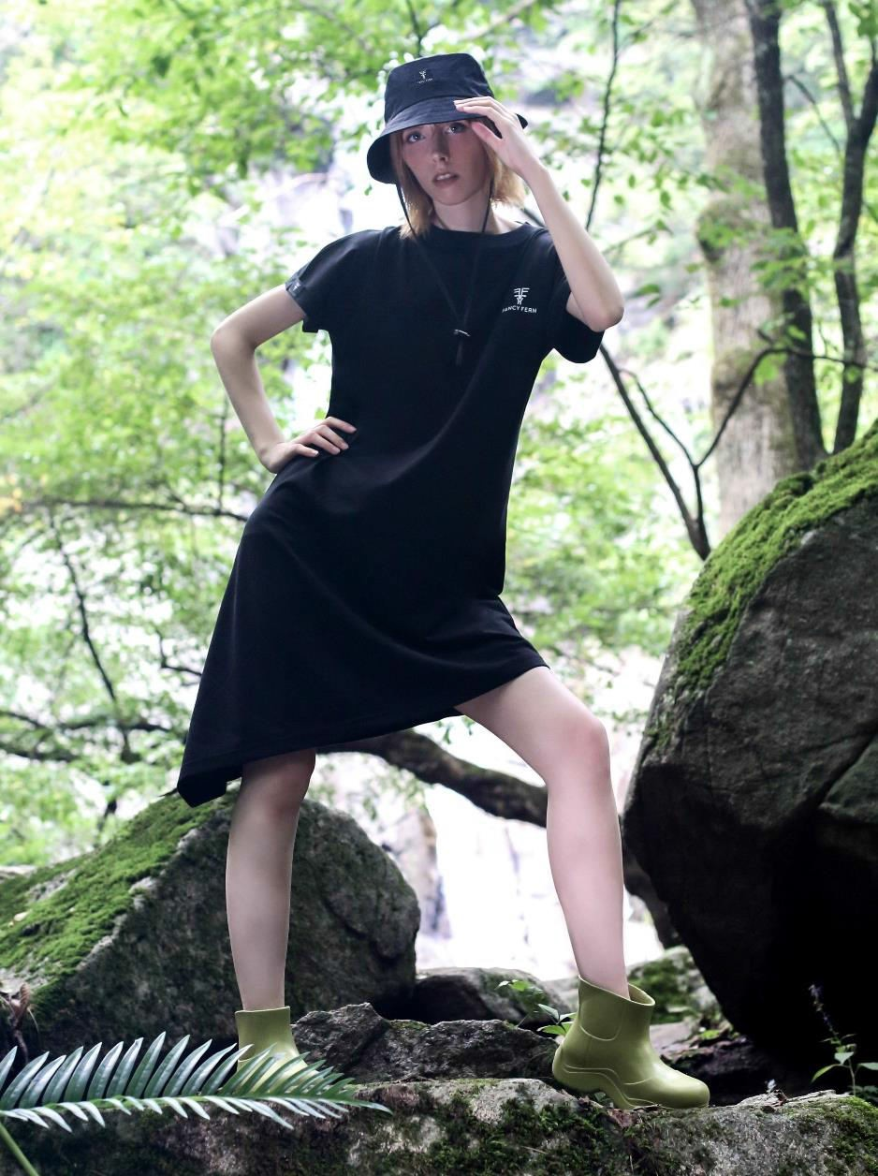

Slide 16
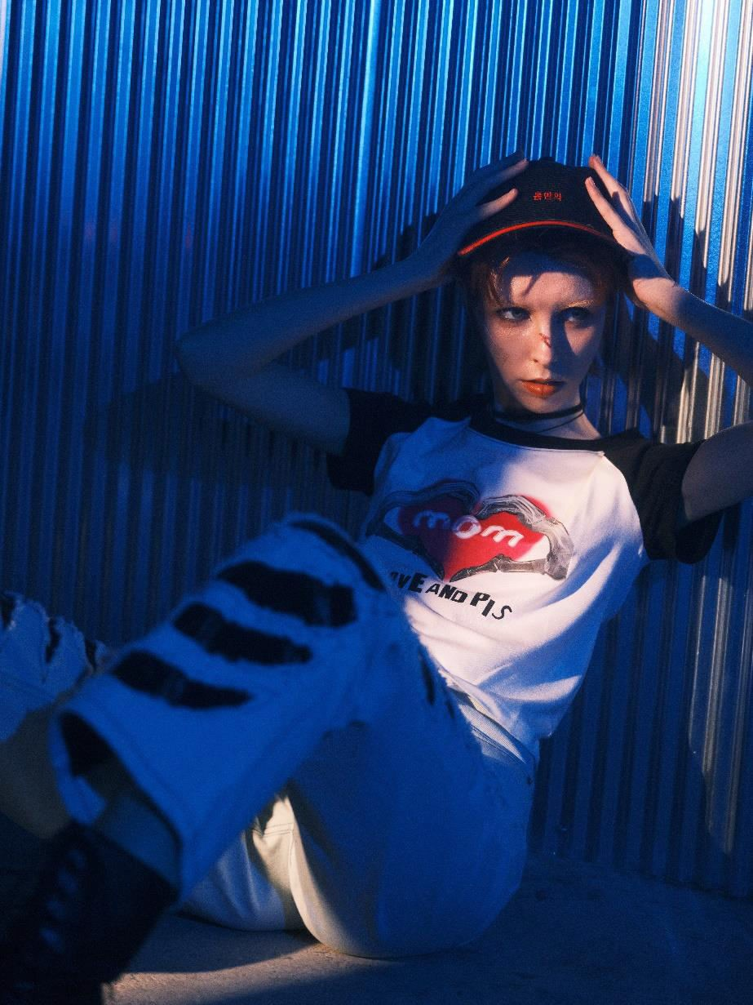
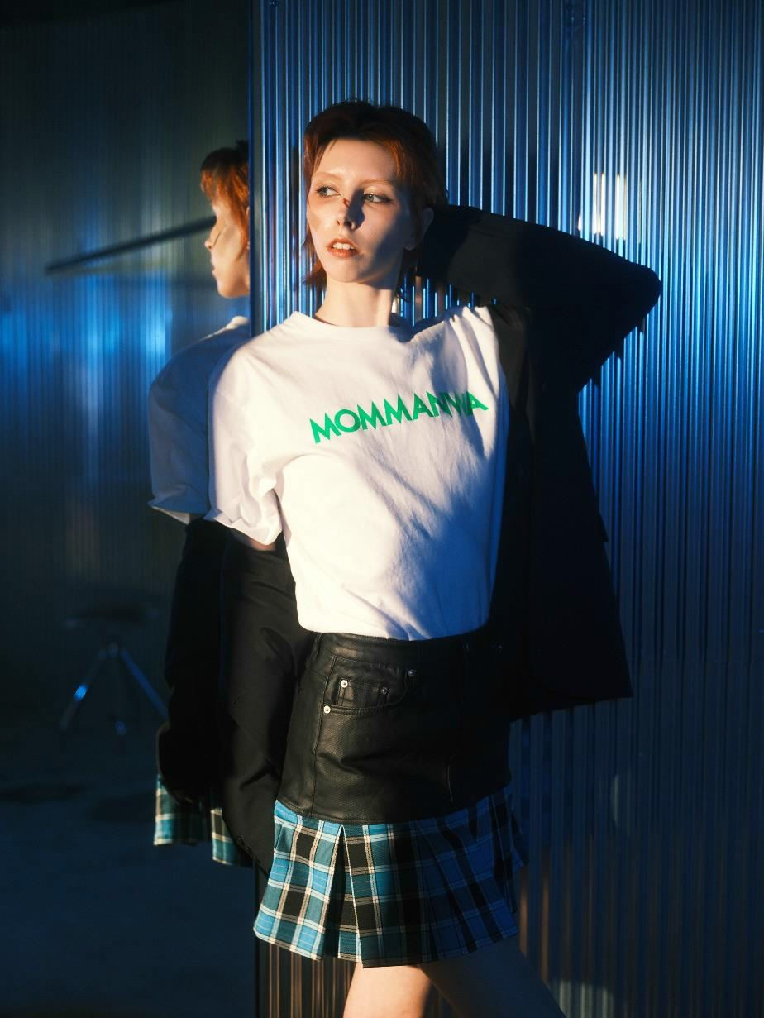

Slide 17
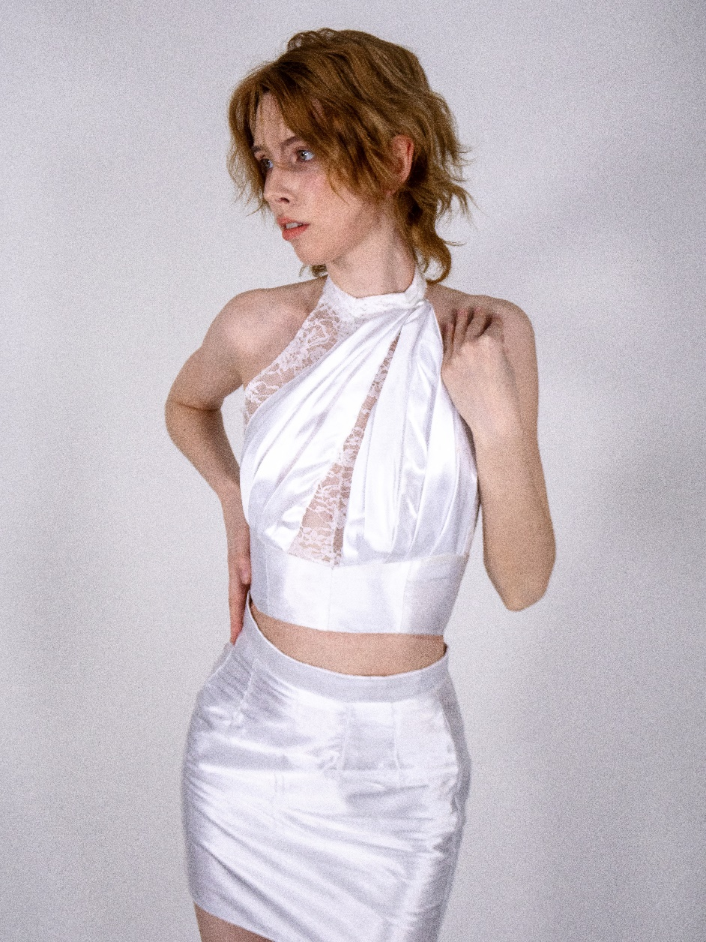
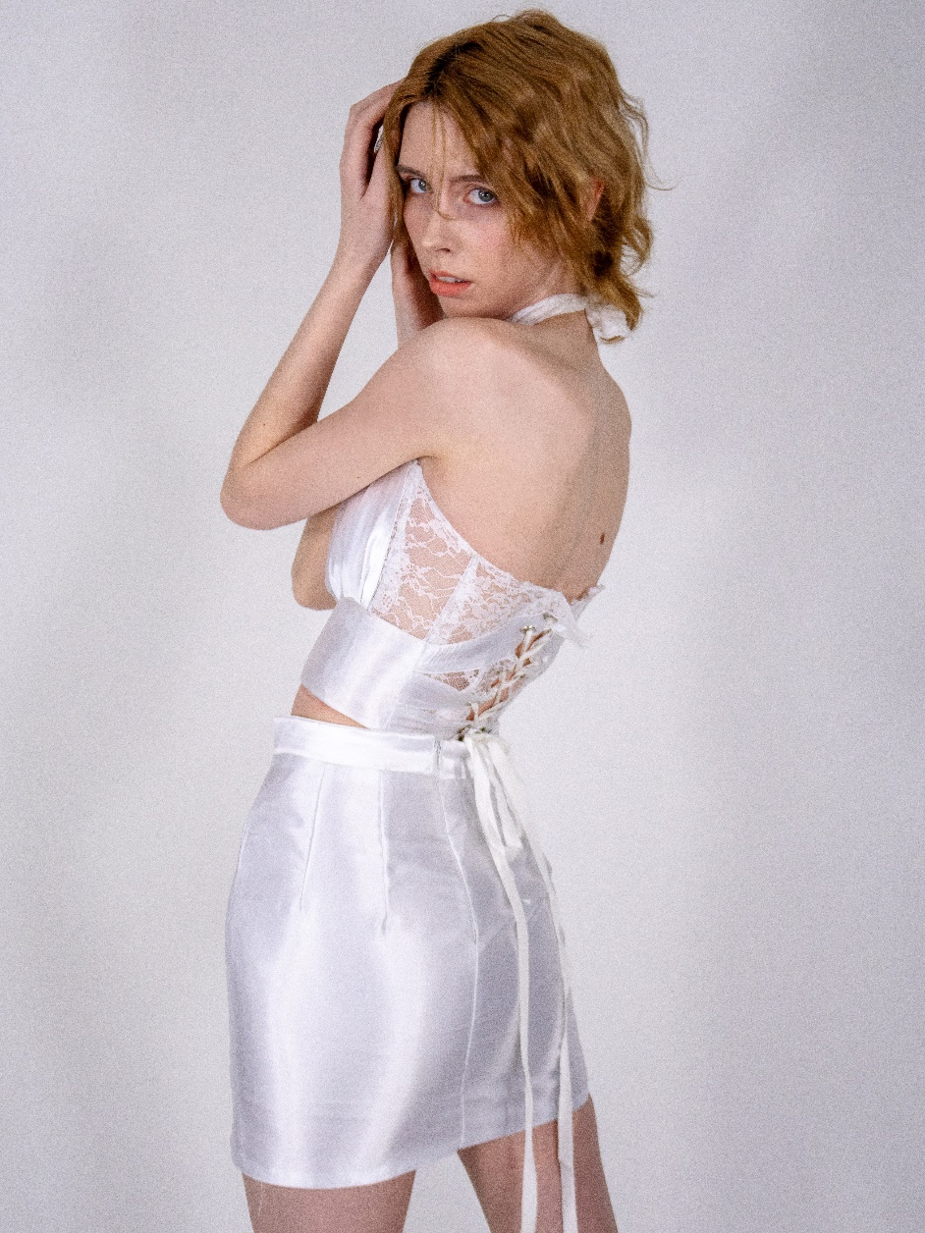

Slide 18
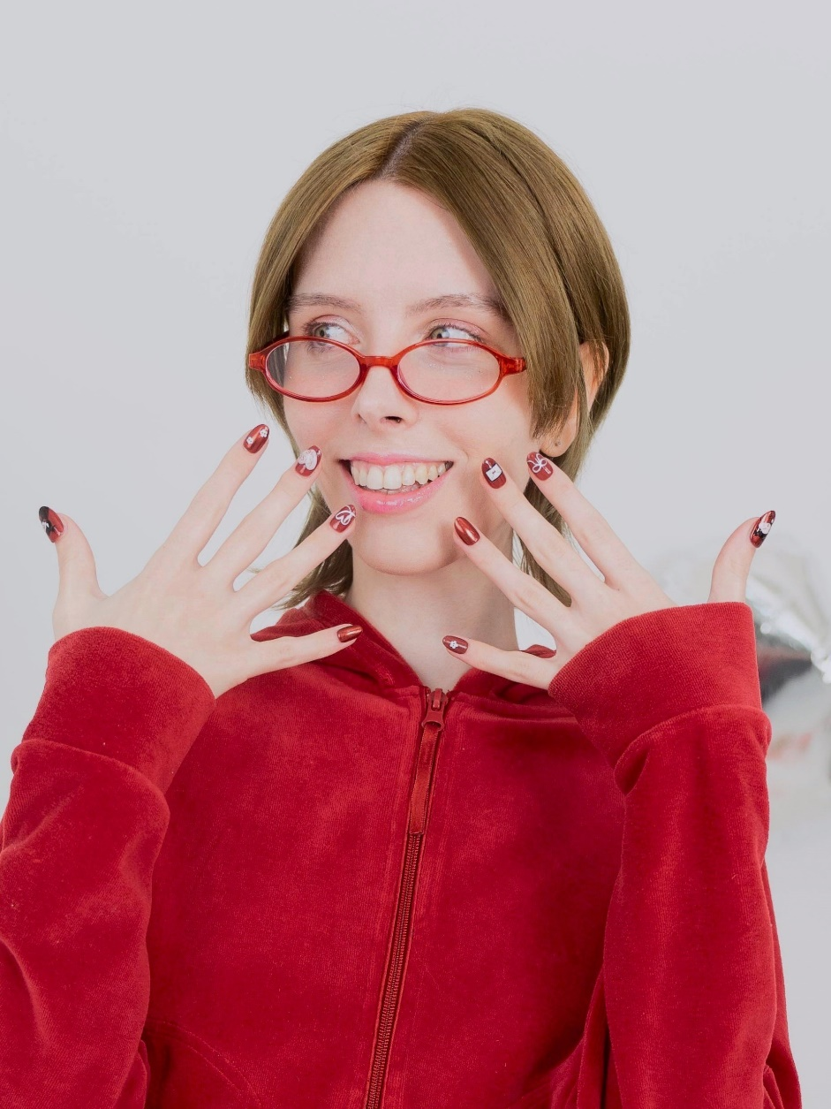
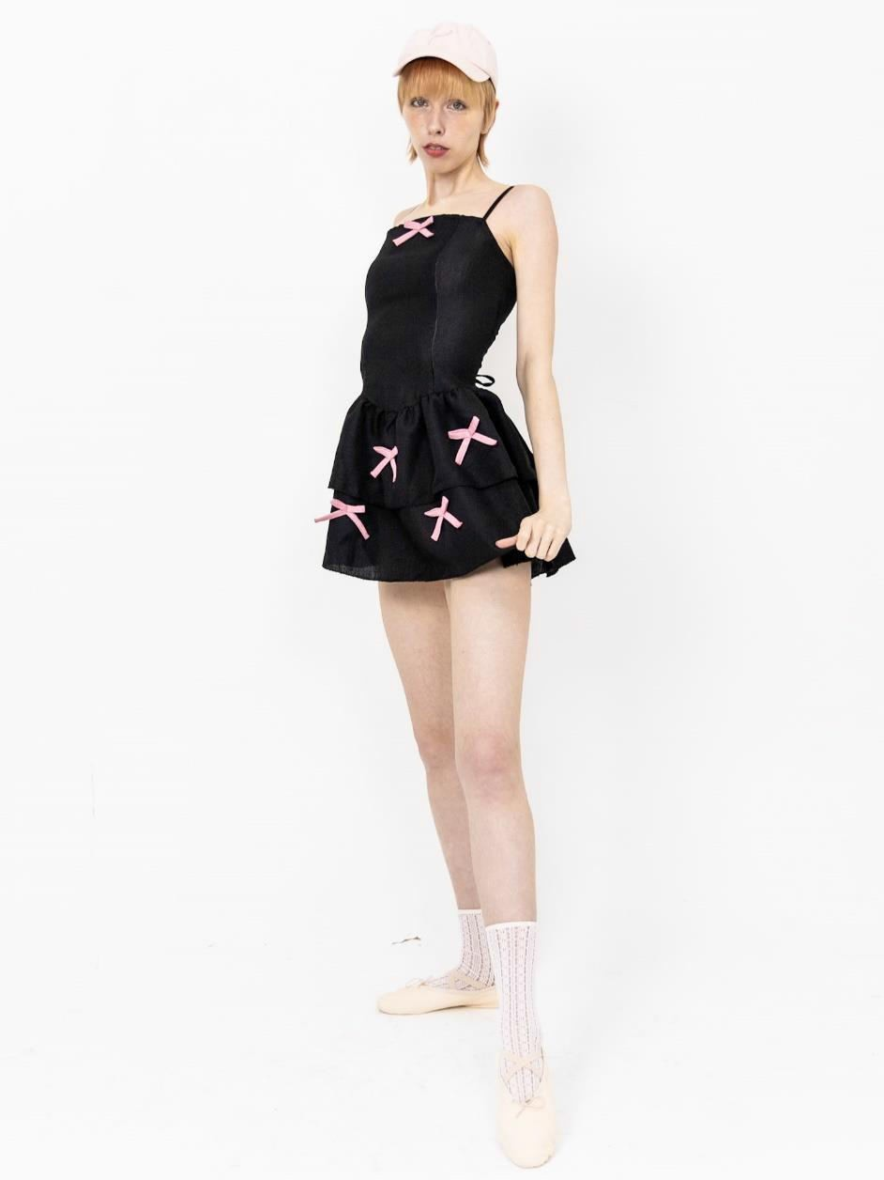

Slide 19
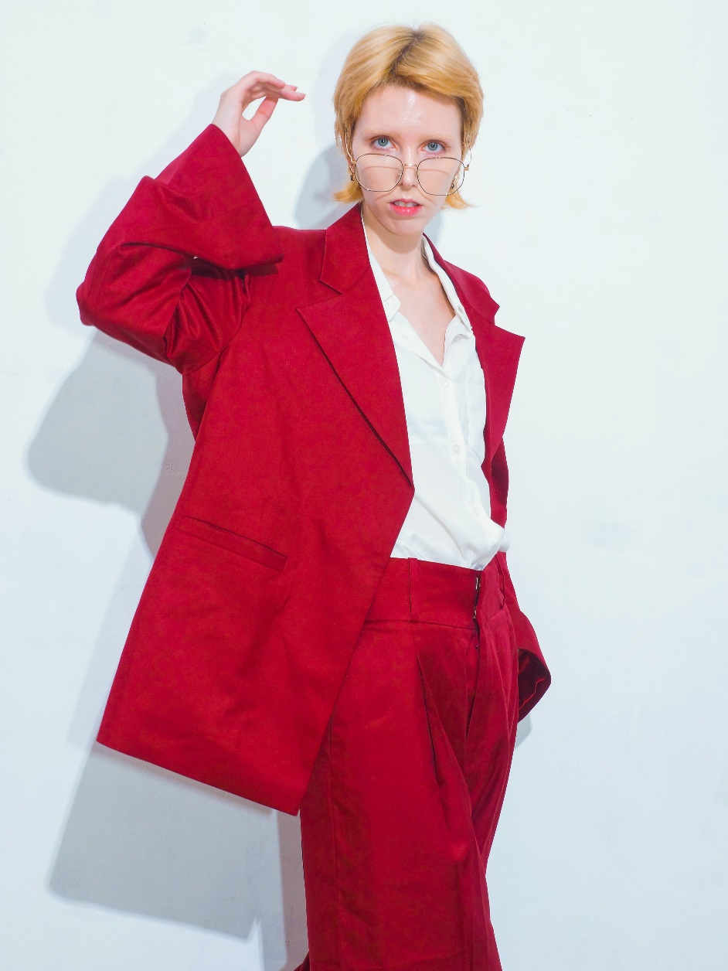
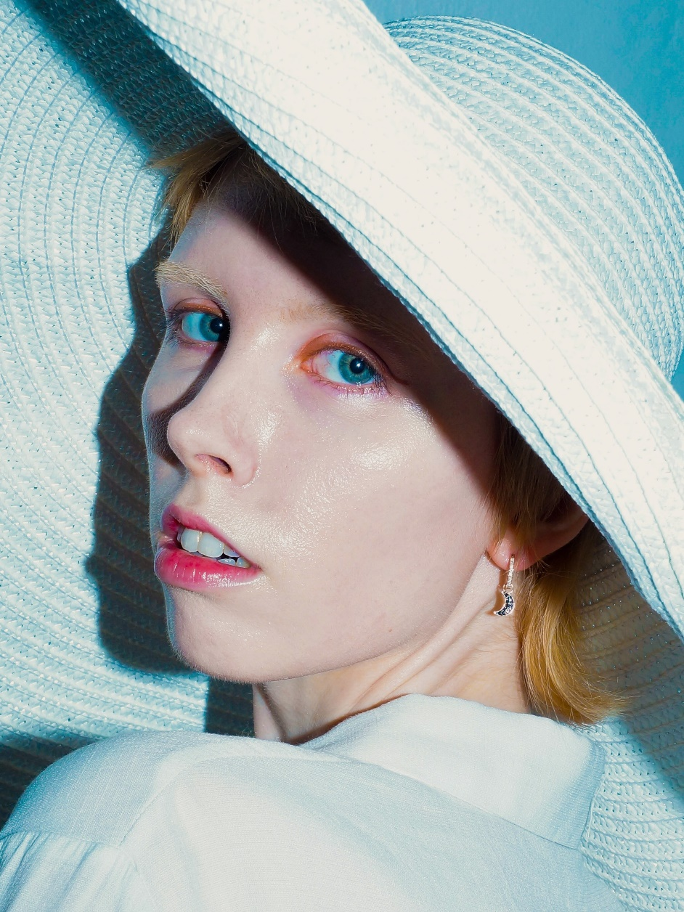

Slide 20
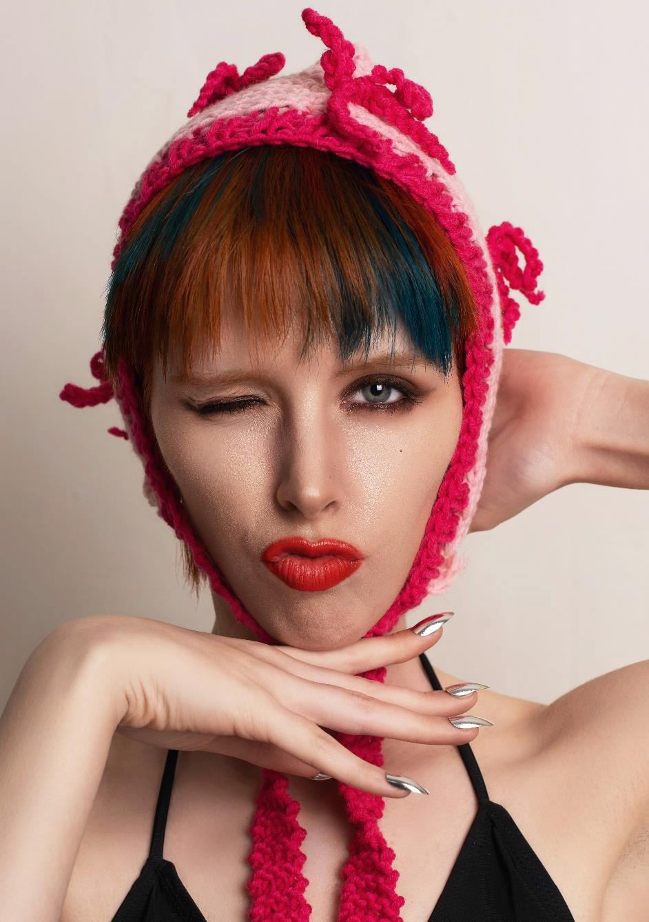
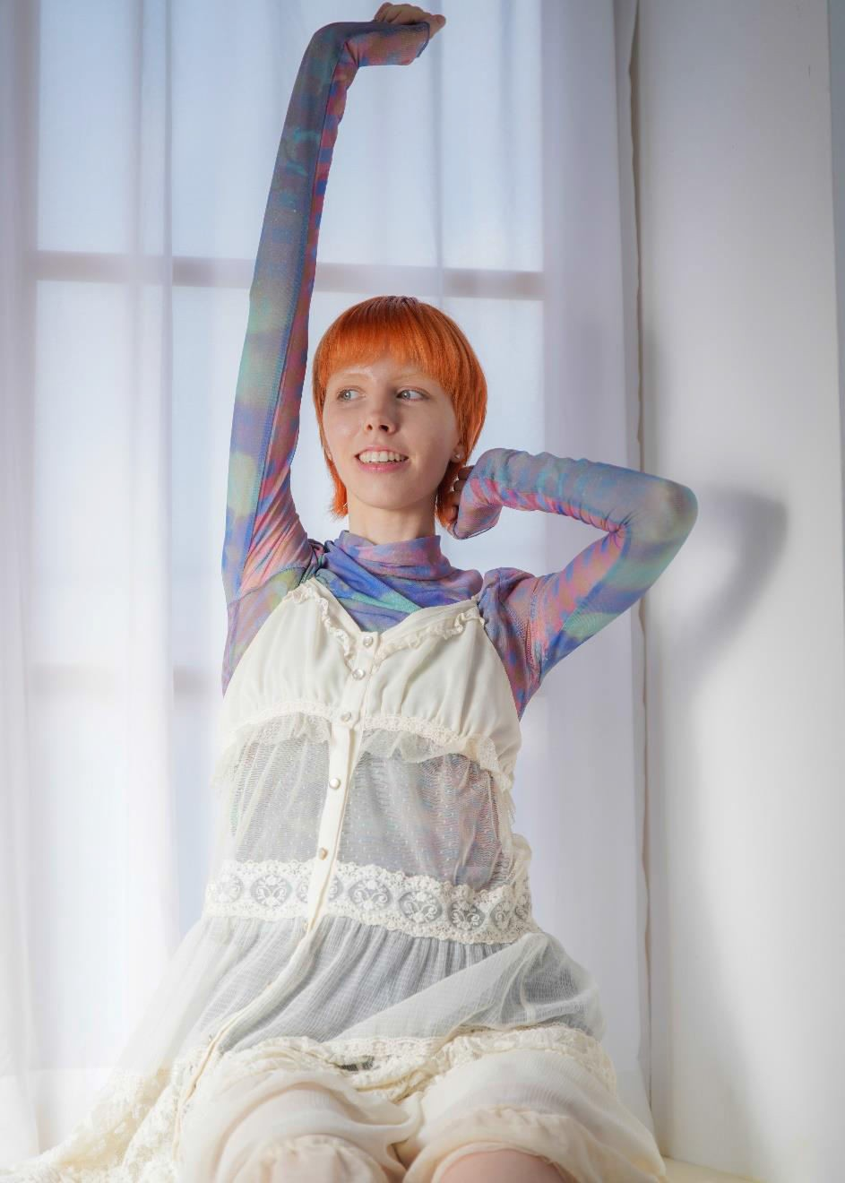

Slide 21
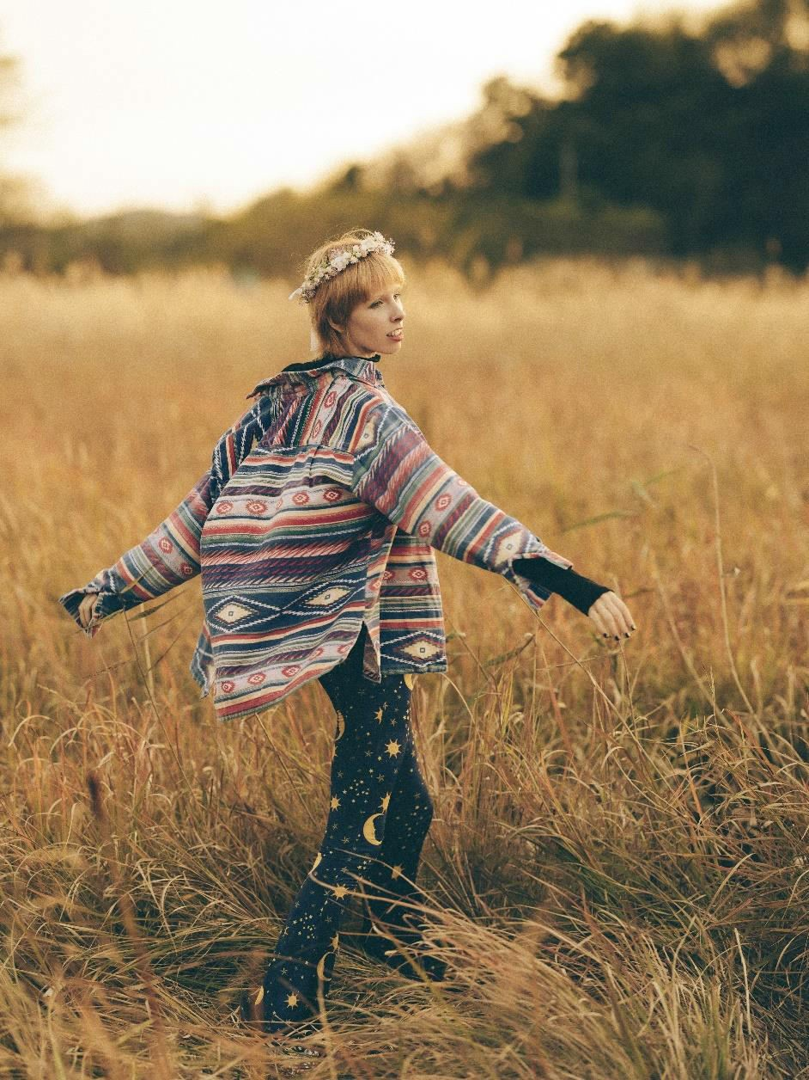
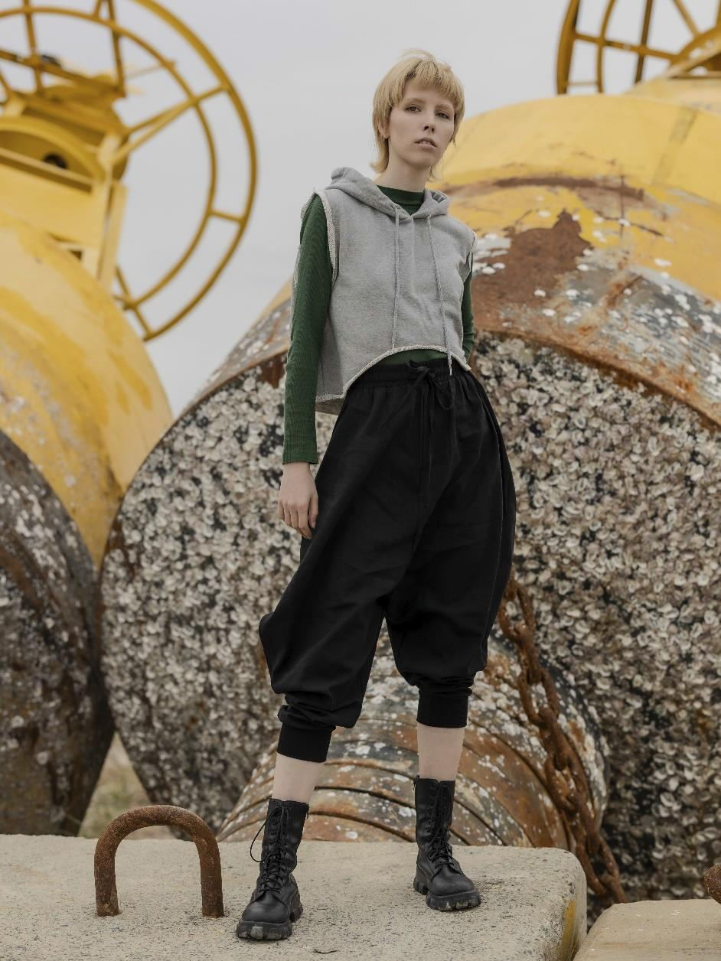

Slide 22
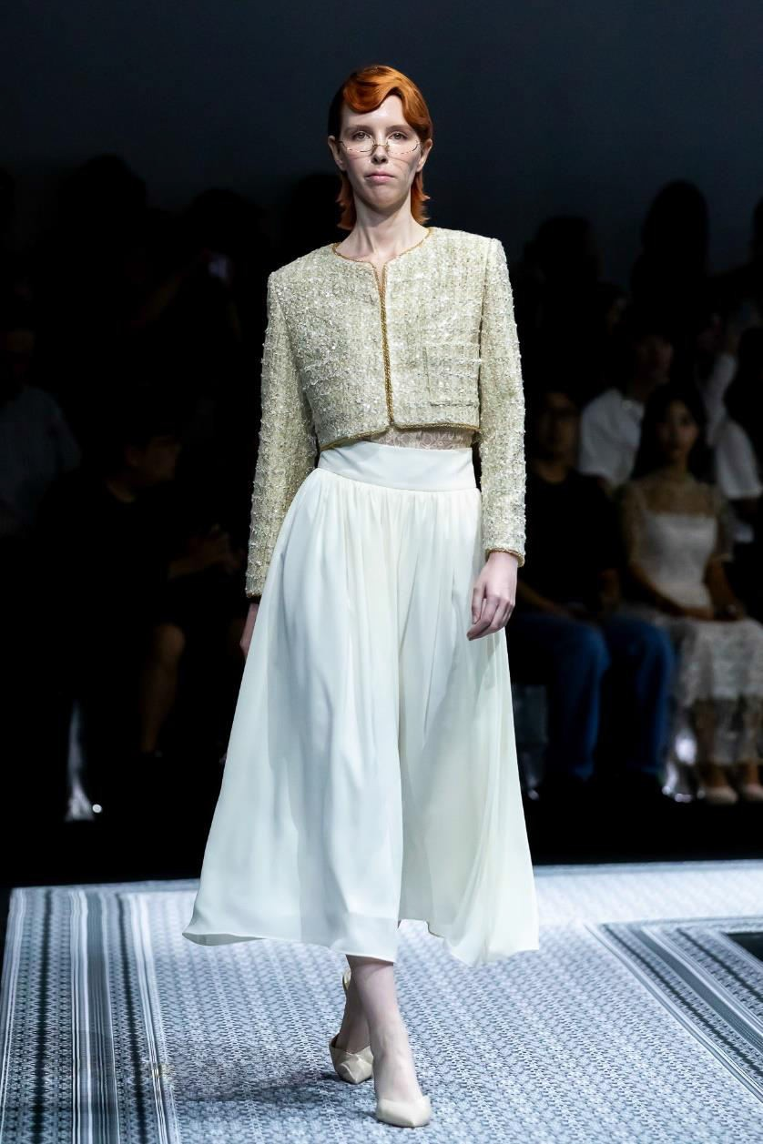
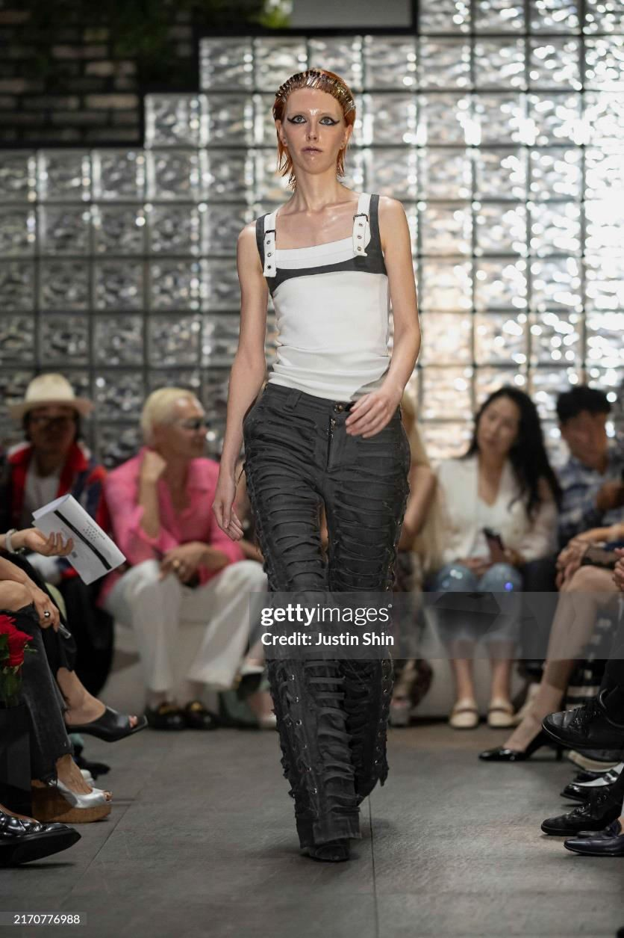
Runway
L'EAU ET, 2024
Seoul Fashion Week 25SS, video
IAC Site, 2024
Milan Loves Seoul, video
20

Slide 23
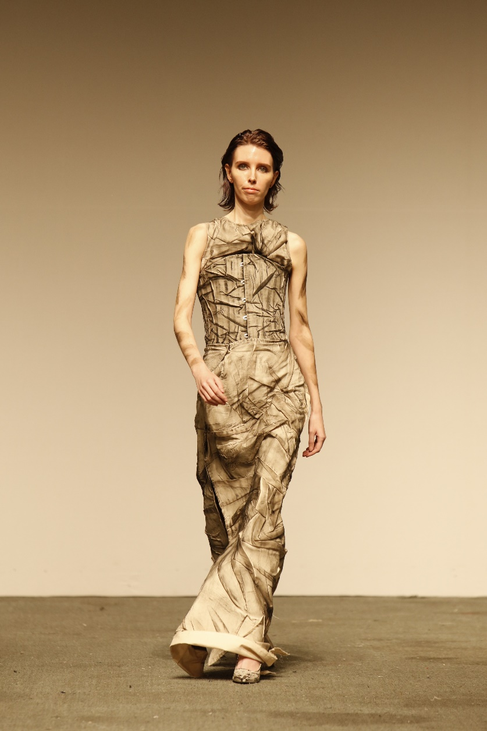
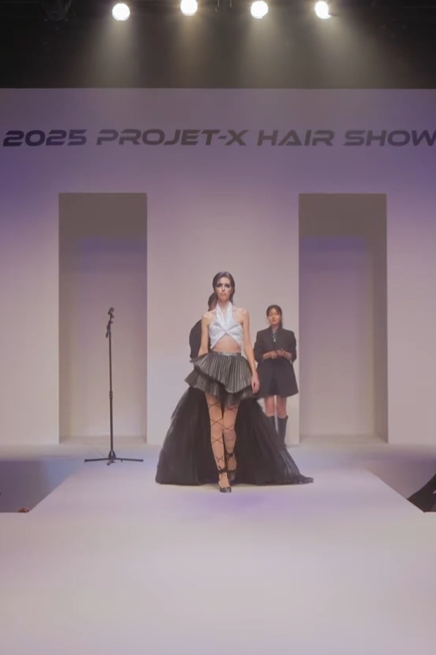
Kim Yangheon (김양헌), 2024
SART (서울예술실용전문학교) Graduation Show
KAIJUNG Hair (카이정헤어), 2024
Projet-X Hair Show, video
21

Slide 24
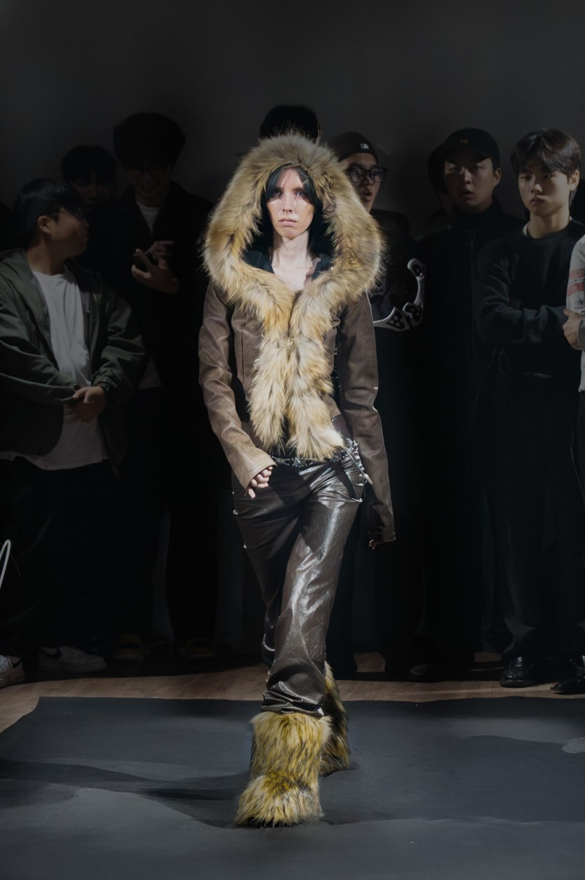
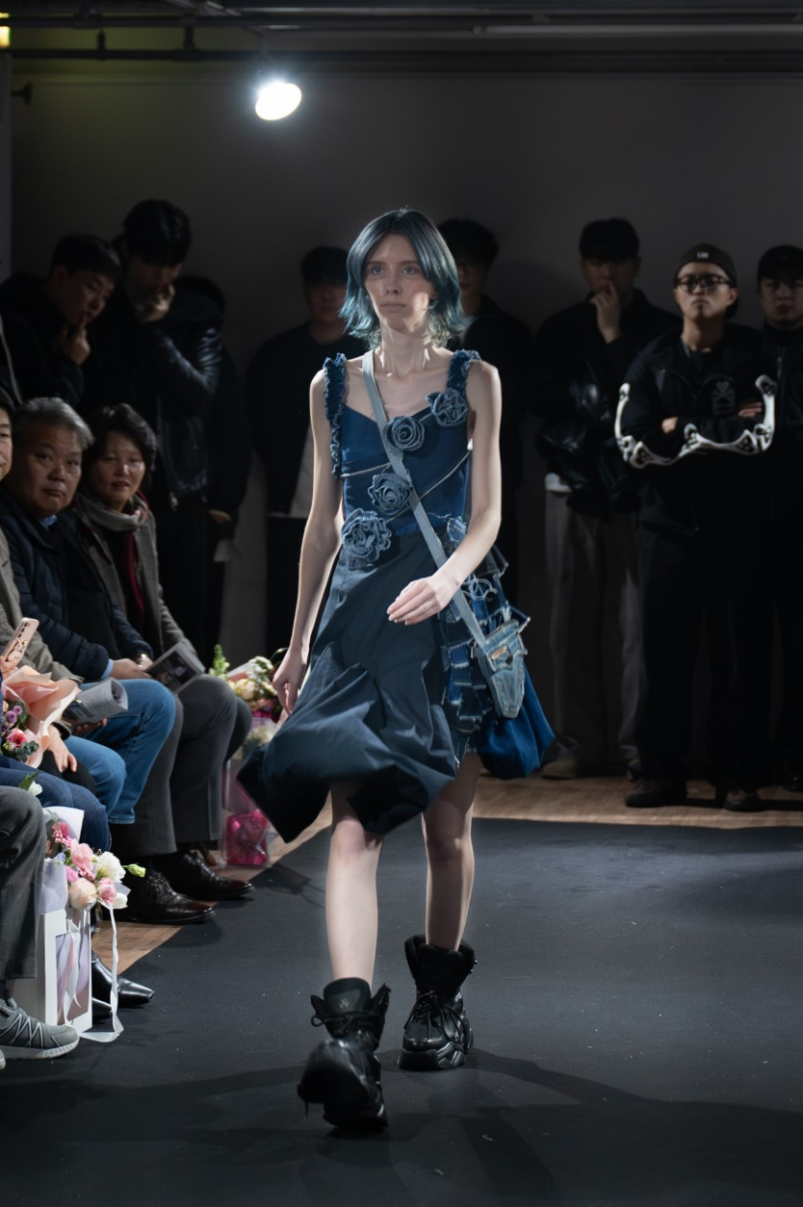
Lee Nagyeong (이나경), 2024
Ulsan University (울산대혹교) Graduation Show
Joo Minjoo (주민주), 2023
Ulsan University (울산대혹교) Graduation Show
22

Slide 25
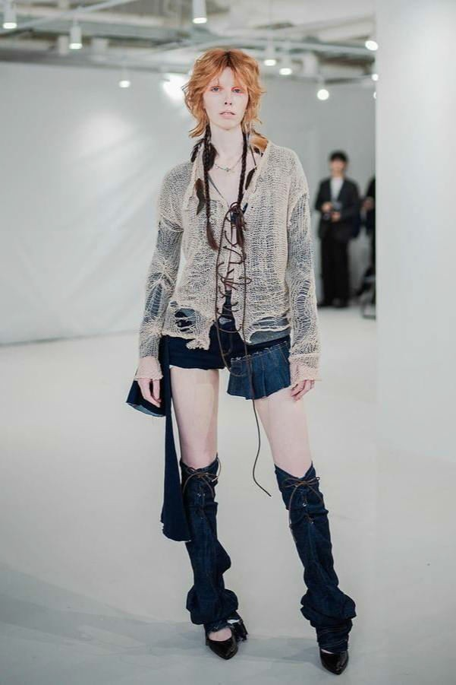
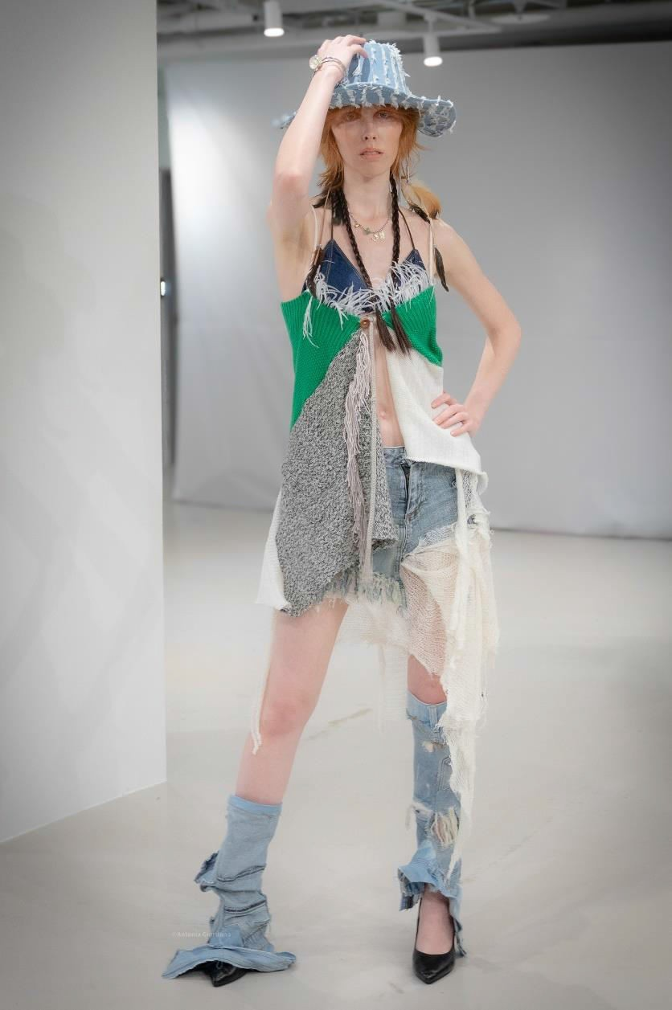
GREAVID, 2024
GREAVID Brand Launch Show
21

Slide 26
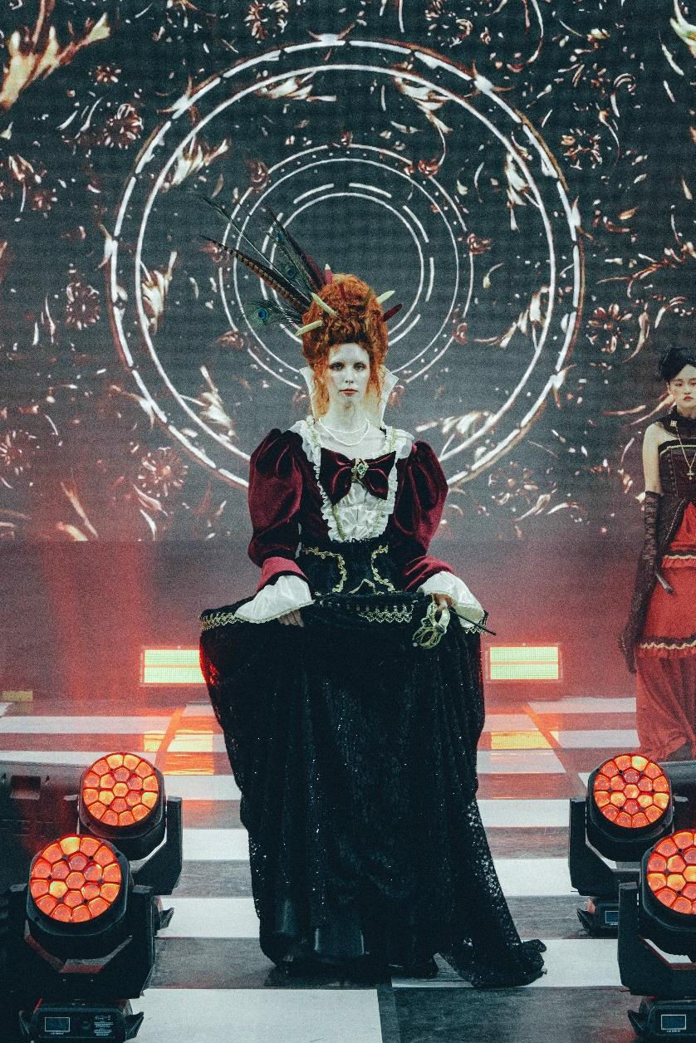
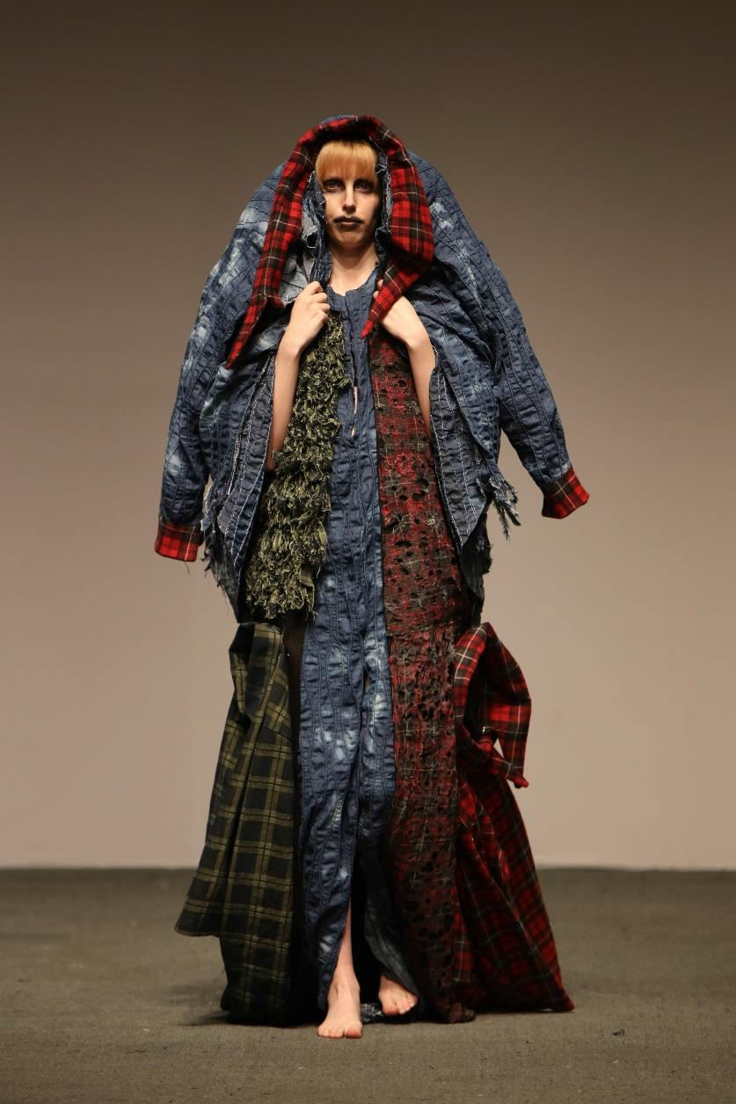
Lee Ga-eun (이가은), 2024
Yuhan University Festival, video
Cho Gyeongho (조경호), 2023
SART (서울예술실용전문학교) Graduation Show, video
22

Slide 27
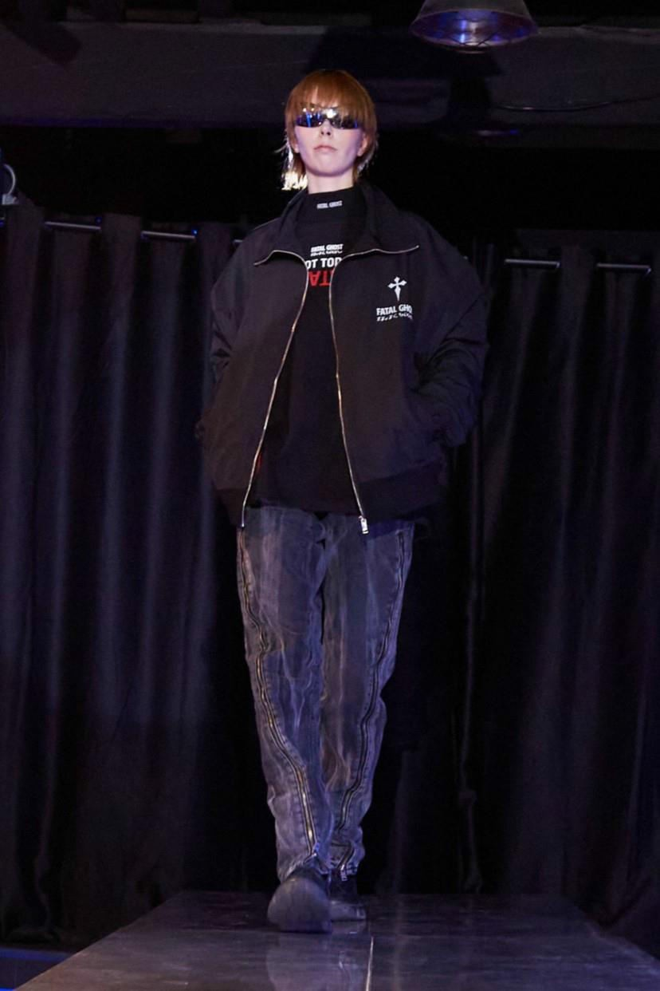
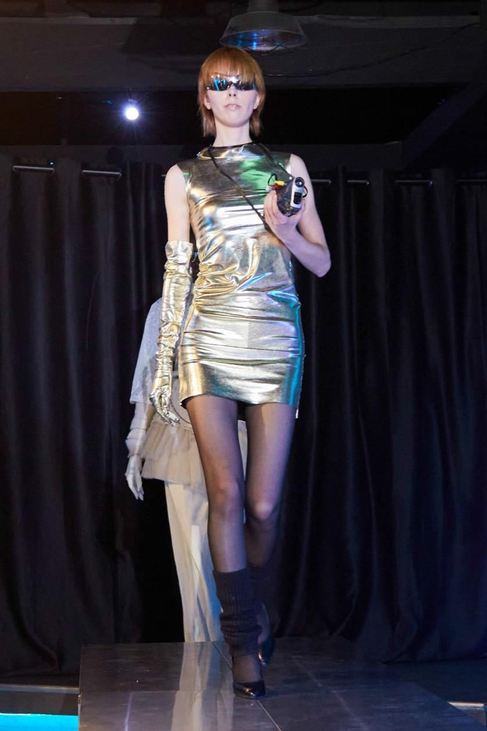
FatalGhost (left) and Jadelynn DayShell (right), 2024
LIT Lounge Itaewon Fashion Event
23

Slide 28


Publications
FIGGI Magazine - FASHION & GLAMOUR NOVEMBER Vol 1251, 2024, visit

Slide 29


Falcon Magazine (falcon.industry Instagram), 2024, visit

Slide 30



LEDDIT Magazine Vol. 16, 2024, visit, visit (slide 31)z

Slide 31


1 Granary (Instagram), 2024, visit
The Fashion Magazine PRISM, 2024, visit

Slide 32


Harper's BAZAAR Singapore, 2023, visit
2023, Mayfly_ Magazine, visit

